Slide 1
Problem & Policy
Poor medical record keeping and disconnected functionality.
District Health Management Information System policy.
Strengthen monitoring and evaluation as well as the use of information in policy and programme planning through the regulation and standardisation of the collection, collation and dissemination of health data.
Clarify the main roles and responsibilities for each administrative level and each category of staff in the mechanisms for ensuring data completeness, data quality and data use and “ownership” at all levels of the health system.
Ensure data security and integrity.
Classifying information policy.

Slide 2
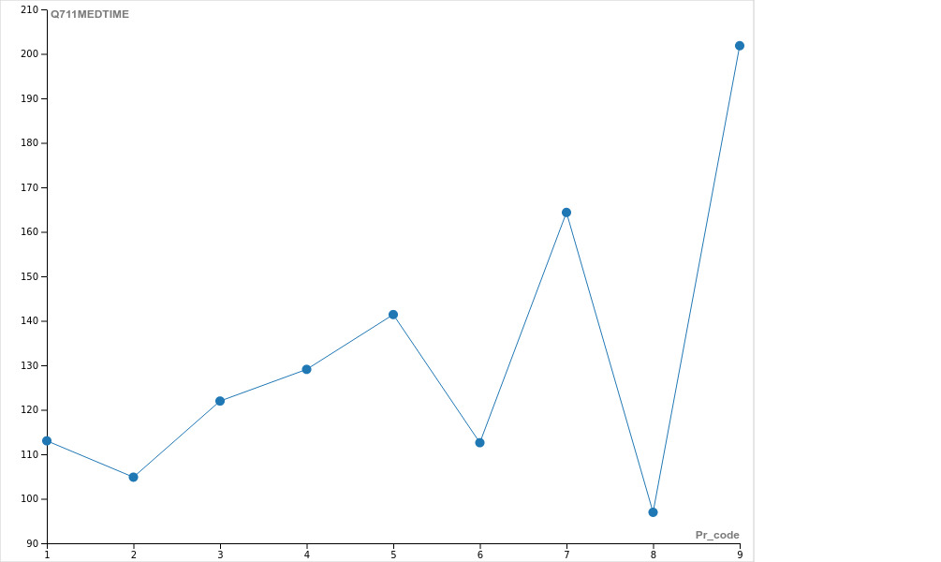
Data on Hand
LEGEND
1 = Western Cape
2 = Eastern Cape
3 = Northern Cape
4 = Free State
5 = KwaZulu-Natal
6 = North West
7 = Gauteng
8 = Mpumalanga
9 = Limpopo

Slide 3
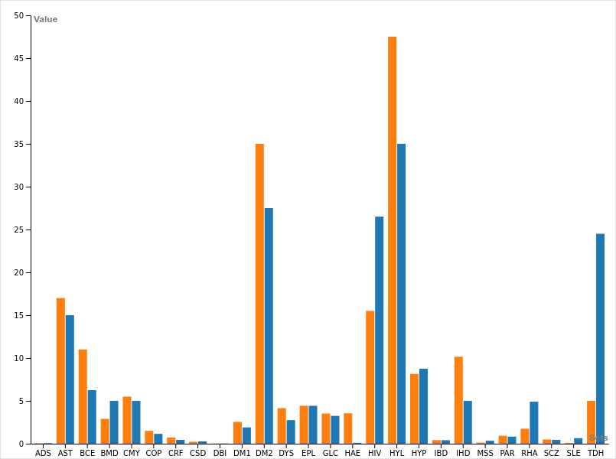
Data on Hand
LEGEND
ADS = Addison’s Disease
AST = Asthma
BCE = Bronchiectasis
CMY = Cardiomypathy
COP = Chronic Obs. Pulmonary Disease
CRF = Chronic Renal Disease
CSD = Crohn’s Disease
DBI = Diabetes Insipidus
DM1 = Diabetes Mellitus 1
DM2 = Diabetes Mellitus 2
DYS = Dysrhythmias
EPL = Epilepsy
GLC = Glaucoma
HAE = Haemophilia
HIV = HIV/AIDS
HYL = Hyperlipidaemia
HYP = Hypertension
IBD = Ulcerative Colitis
IHD = Coronary Artery Disease
MSS = Multiple Sclerosis
PAR = Parkinson’s Disease
RHA = Rheumatoid Arthritis
SCZ = Schizophrenia
SLE = Systemic Lupus Erythematosus
TDH = Hypothyroidism
Chronic diseases per gender
Orange: Males Blue: Females

Slide 4
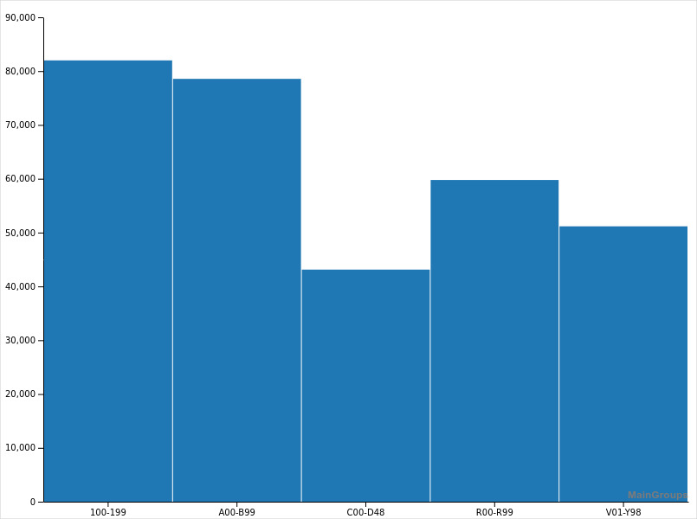
Data on Hand
LEGEND
100-199 = Diseases of the circulatory system
A00-899 = Certain infectious and parasitic diseases
C00-D48 = Neoplasms
R00-R99 = Symptoms and signs not elsewhere classified
V01-Y98 = External causes of morbidity and mortality
Top 5 Underlying causes of death

Slide 5
Solution = PocketDoctor();
A centralized online medical records information system.
A system that allows for a patient to call for an ambulance at a flick of a button and have the emergency services know exactly where to go, what the problem is, and how to stabilize the patient.
Web User interface for record management;
https://pctdr.herokuapp.com/

