Slide 1

Emergency response system.

Slide 2
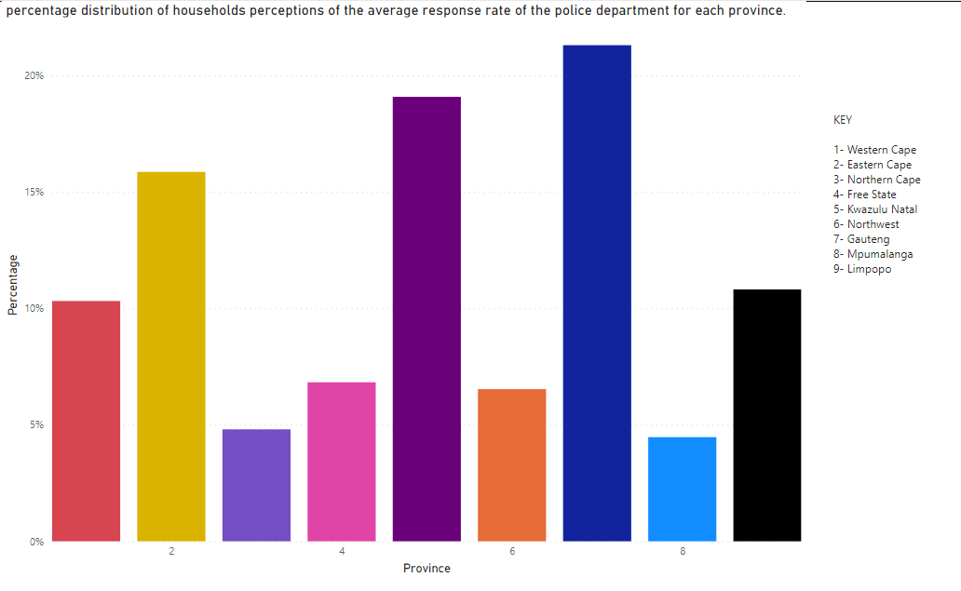
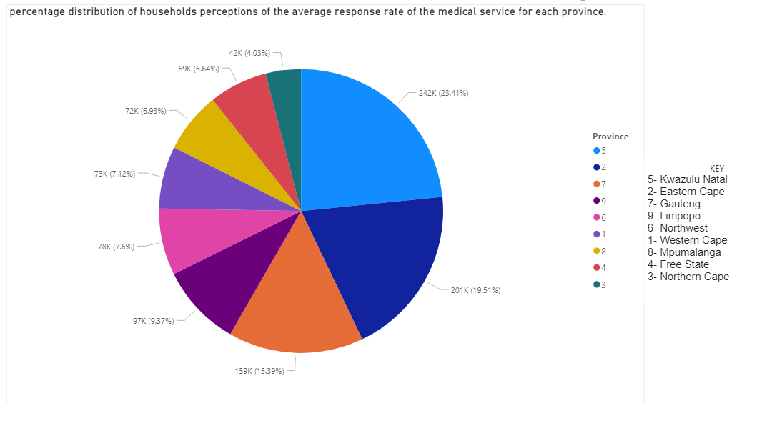
Introduction
Problem Statement:
Emergency Services in underdeveloped provinces have a slower response time in the case of a medical, and or fire emergency.
Policies:
Medical Service Policy: National Policy Framework and Strategy on Palliative Care 2017 8.3 Service delivery platform. “It is therefore critical that palliative care services are made available to all accessing the health care system”.
Section 3.8 of the 2010 to 2014 SAPS strategic plan focusing on technology and resource utilization. Technology is a critical success factor in the successful performing of the SAPS

Slide 3
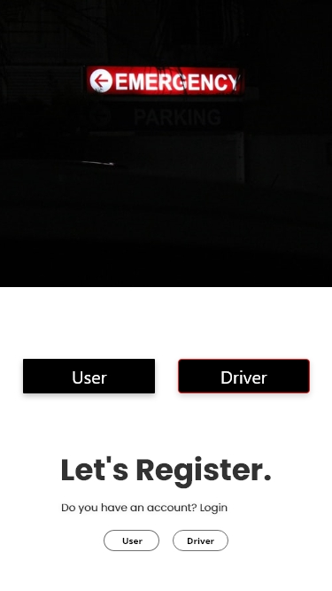
Solution
Allow user to send an SOS to an ambulance, police or fire fighter in terms of emergency.
An app that allows the emergency service to locate the person/ victim with ease.
Wherever they are, they can be geo located be it in a rural area.
Establish a 100% response rate
Revenue
Installation and maintenance
SMS and email marketing.
In app purchases.

Slide 4

Functionalities
The user is welcomed with a splash screen
After the splash screen it’s the landing page
On the landing page, there is a registration for an emergency service company and normal user. Emergency services are allocated a special key, that way only they can access the special functionalities, avoiding anyone registering anyhow.
Users are also allocated a special key
User will be able to specify what kind of an emergency it is that they need.

Slide 5

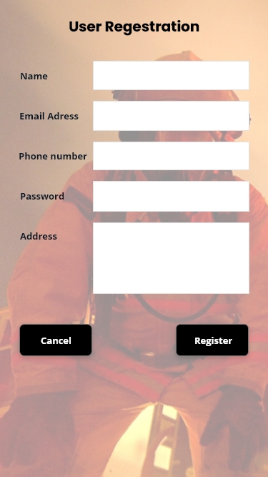
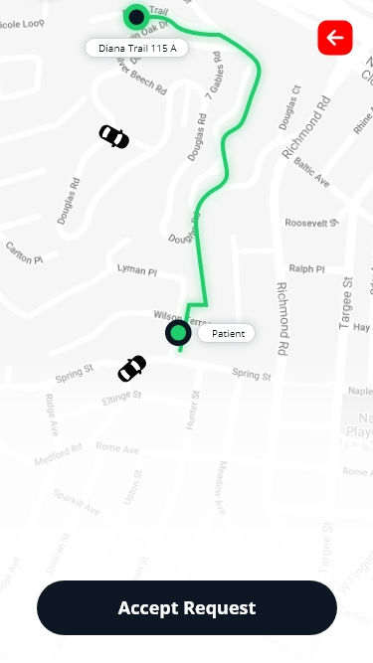
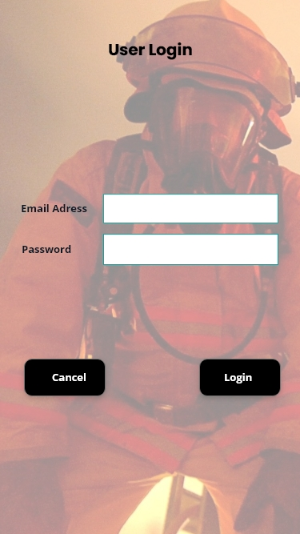
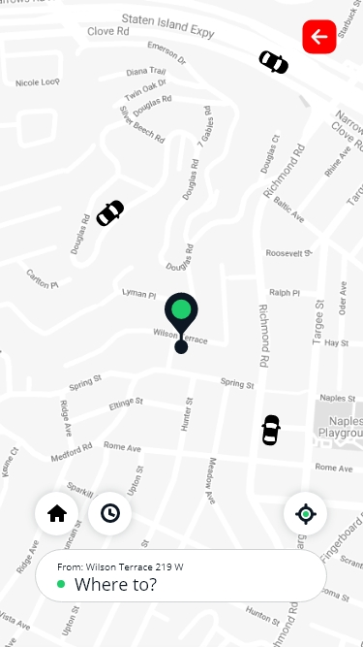
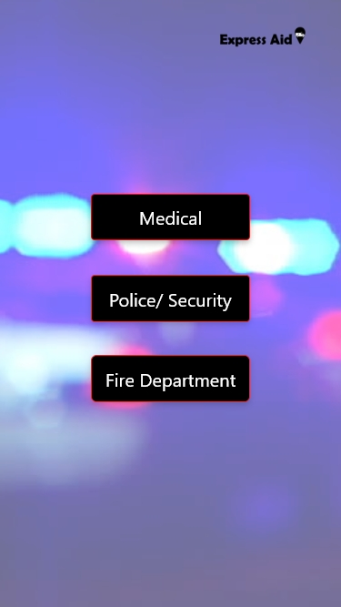
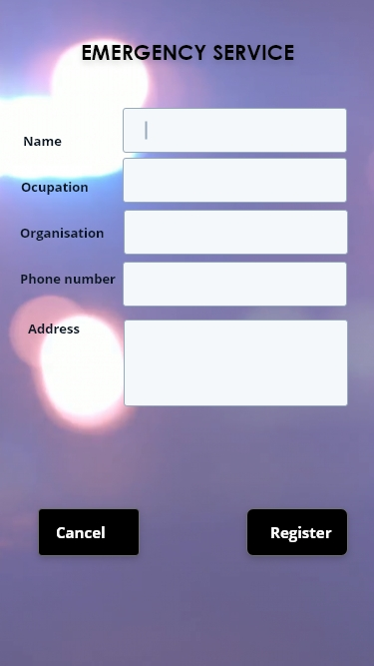
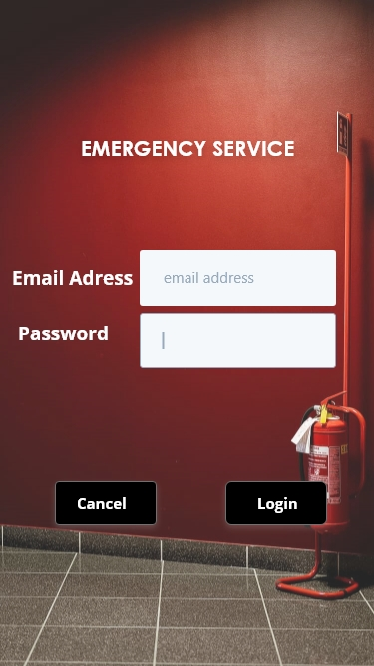
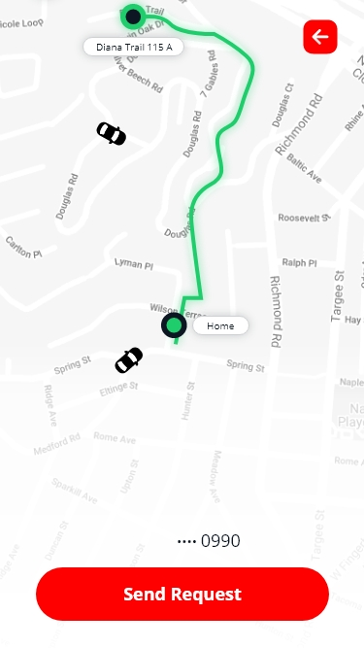
Screenshots

