Slide 1
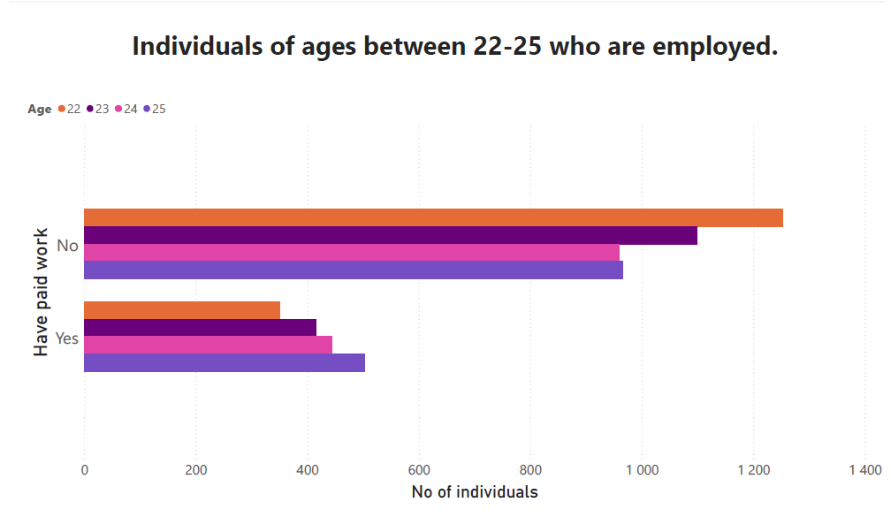
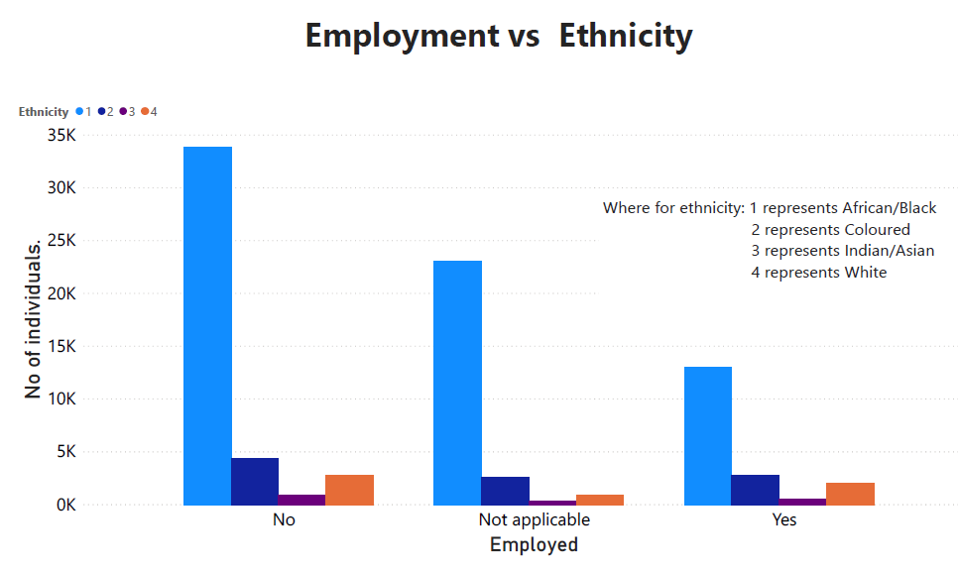
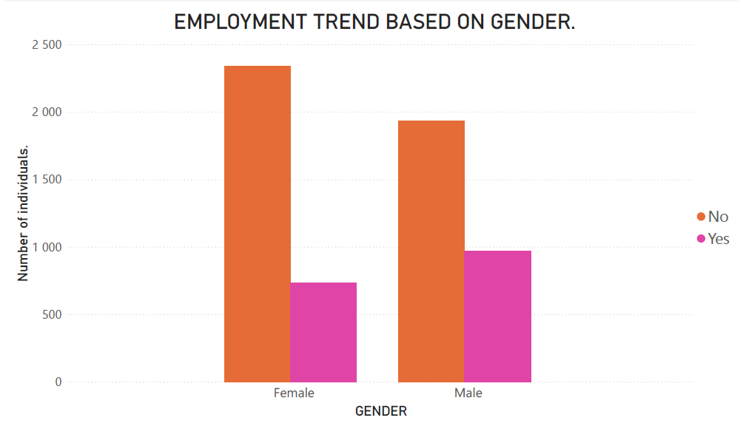
Plot of employment vs age.
Employed?
New Growth Path Policy:
Increase the number of young people that are employed.
Reducing inequality and defeating poverty

Slide 2
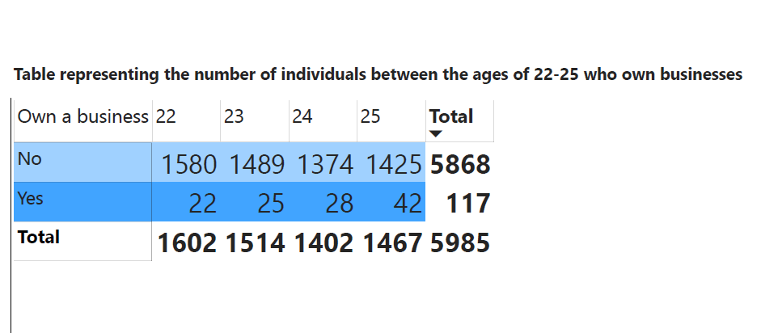
New Growth Path Policy
Technical support in enterprise development.
Promotion of youth co-operatives and entrepreneurship.
The National Development Plan 2030:
Create jobs via entrepreneurship.

Slide 3
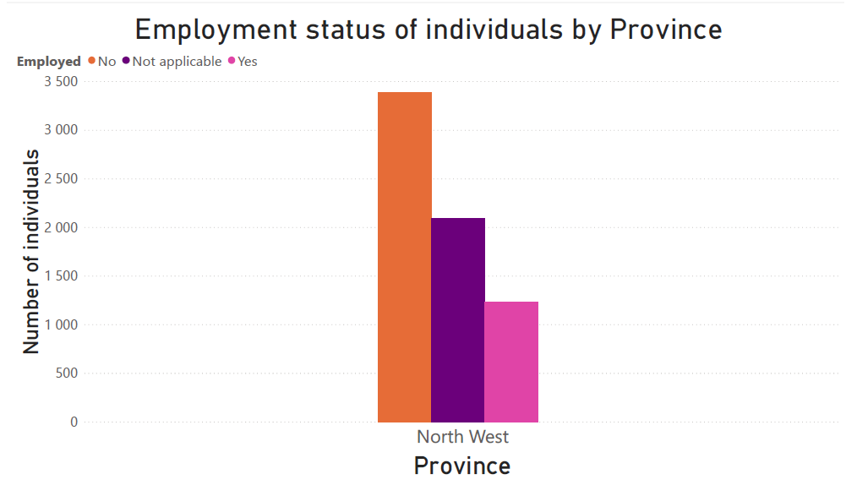
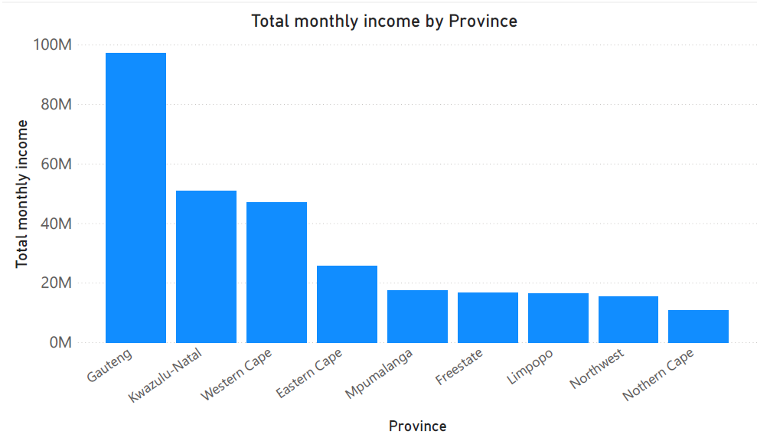
Employment trend in Northwest
New Growth Path Policy:
Identifying areas where employment creation is possible on a large scale as a result of substantial changes in conditions in South Africa and globally.

Slide 4

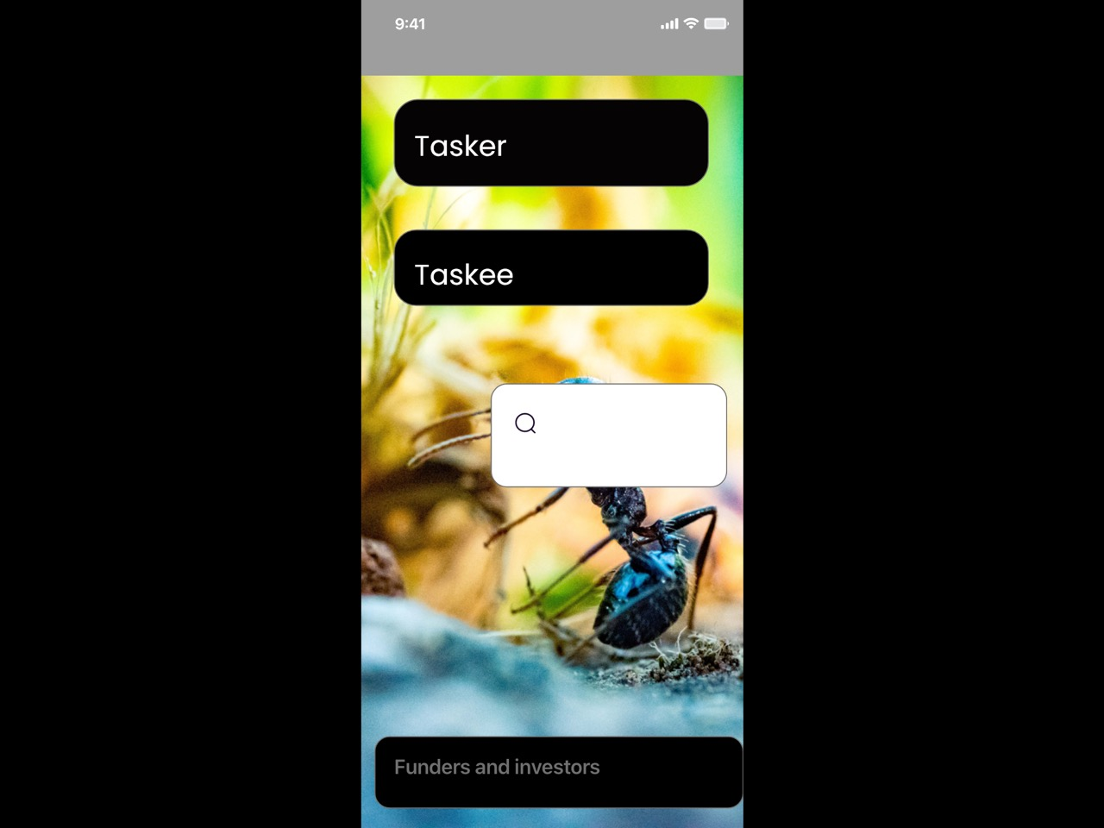
KeyTEE Prototype
The national development plan states that the government plans to increase employment from 11 million to 24 million by 2030
Notes:
Policies from : https://ineng.co.za/south-african-government-policies-since-1994/

