Slide 1

Understanding Digital Technologies and Digital Skills in Organisations and Government is South Africa
Brilliant
Solutions

Slide 2

Dataset
HR Managers knowledge on digital technology in different Organisations and government in South Africa

Slide 3
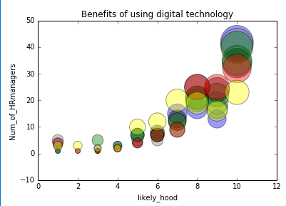
How digital technologies help with:
Ability to manage teams and projects
Marketing
Enhance job capacity
Multitasking
Paperless processes
Time efficiency
Reduced workload
< Not relevant Very relevant>

Slide 4
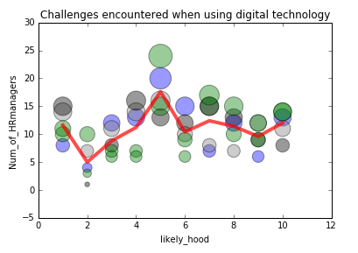
Challenges with digital technology
High costs
Down during loadshedding
Absence of human interaction
Threat of possible retrenchment
Adjusting to new technologies
Lack of required skills
Digital fraud and scamming
< Not relevant Very relevant >

Slide 5
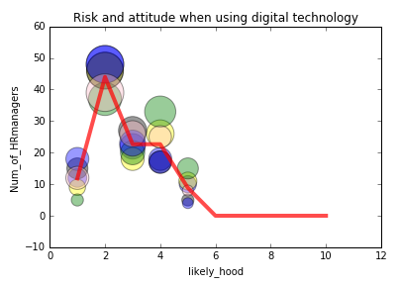
Risks
Exposes employees to Potential financial loss
Data loss probability
Possibility of being Scammed
Data can be easily duplicated
Can be time consuming to learn
Loss of jobs
Attitude
Waste of time
Not interested in employees using digital technology
Not valuable
No need for digital technology
Limits employees
< Strongly disagree Strongly Agree >
Notes:
HOWEVER
Digital technology can be hacked
Data can be lost
People can be scammed through data technology
And lastly, data can be duplicated

Slide 6
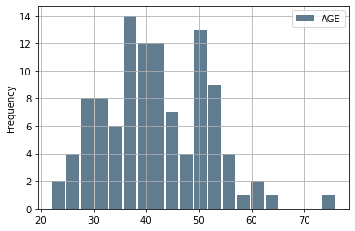
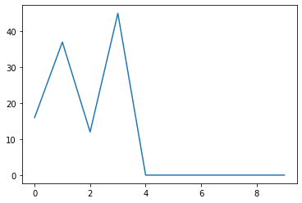
Age Analysis
Notes:
We assumed that the managers might be old people who don’t know much about technology, so we did further analysis peek at 37 and 52

Slide 7
< Strongly disagree Strongly Agree >
Notes:
There are no discrepancies in the data

Slide 8
< Strongly disagree Strongly Agree >
Notes:
The information averages out as there seems to be no trend, where age could be affecting the data

Slide 9
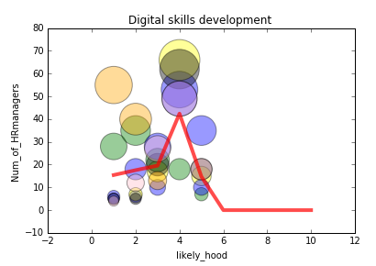
Organisation supports digital technology
Training is conducted
Organisation does not support systems
Organisations encourage development
Digital skills encouraged through external training
Organisations encourage external training
< Strongly disagree Strongly Agree >
Notes:
In last analysis we looked at Digital skills development and after analysis, we found that, the trend is more neutral as theres a spike right in the middle and the questions are very important

Slide 10
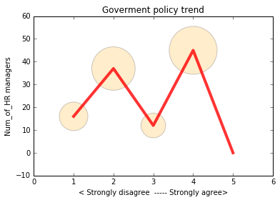
Looking at the trend, there are no policies affecting the ability to attract the best talent with the latest digital skills.
Notes:
Meaning that there are no policies against developing a solution

Slide 11
Conclusion
HR managers believe in the benefits of using digital technology
However, Statistics show that they are not aware of the risks involved in digital technology such as hacking, scamming etc.
Furthermore, most organisations do not conduct digital skill development thus putting the organisations at risk of cyber attacks.

Slide 12
Solution
Our proposed solution is to design a system that will make Not only HR target managers, but the organisation as a whole which works in this way:
Using social engineering to bring awareness to the organisation
the system will ensure that employees follow internet protocols at all times and avoid sharing personal data as well as important organisational data to unsecure websites.
The app will ensure that users don’t access vulnerable sites that could put them at risk.
Notes:
Communicate with people on how to be more alert with digital technology

Slide 13
Solution
According to the department of communications and digital technologies, Notice 513 of 2020, Strategic element 3, focusing on 3.1 which states that “South Africa needs to advance digital skills for the work force at an unprecedented, particularly for low-skilled workers who will otherwise bear the brunt of job vulnerability.” the solution provided addresses this section.
Furthermore, as states in this document 2.1 million civil servants need digital skills development.

Slide 14

Thank you

