Slide 1
Young Innovators 2021 Nemisa Hackathon
GROUP MEMBERS
Asikelelwe Sixaba
Tshegofatso Mhiko
Thato Moenti
Shaun Masuku
Simphiwe Gininda
Luyanda Mbalana

Slide 2
Objective policy
To develop digitally intelligent learners/workers and equip them with the necessary skills in today’s workplace.
To develop a platform that will teach South African learners digital skills.
Build a country that will participate in the digital economy
Create a cost effective platform the government can use to educate learners and workers about digital technology

Slide 3
Problem Statement
The demand for digital skills in the workplace is high, whereas learners are not taught any digital skills for when they head to tertiary or workplace environment.
Workers are not equipped with digital skills when going to a workplace, rather, they must learn how to apply basic digital technologies by themselves or when they get to that new workplace.

Slide 4
Diagrams showing the relationship between number of employees and the learning method used for learning digital skills

Slide 5
We analyzed the data and found that workers are expected to have digital skills in most working fields.

Slide 6


Slide 7
Example of the Demand for digital skills:
Retail: https://www.digitalcommerce360.com/2018/04/24/demand-for-digital-skills-in-retail-is-growing/ [accessed 26 February 2021]

Slide 8
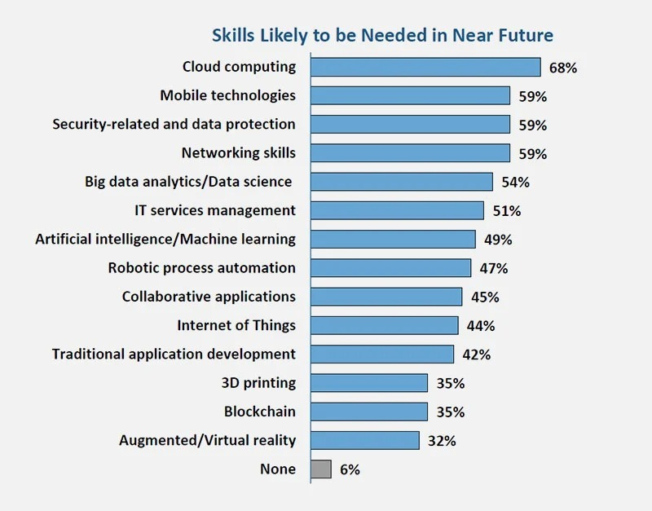
https://mybroadband.co.za/news/business/339525-the-most-valuable-it-skills-in-south-africa.html [accessed: 26 February 2021]

Slide 9
THE SOLUTION
A website teaching basic digital skills to learners and workers.

Slide 10
The platform will be zero data rated website and we aim to work with the department of telecommunications and digital technologies to make that possible.
Learners will use school computer labs to learn and personal cellphones/computers if having one.
Once the user is registered, he or she will have access to the platform.
All content will be loaded on the platform before learners register.

Slide 11
The user will choose one digital skill at a time and move to another one when done.
List Of basic Digital skills to be taught:
Computer Literacy(Typing, learning different hardware and software computer components)
Web Development
Research Skills
Microsoft Office
Digital Marketing

Slide 12
Each digital skill will have the following:
Notes, Videos and PDF’s.
Quizzes and tests will be there to test the progress of the learner and the learner will not be able to move to another unit until the test is completed.
The website will have an auto chat robot for interaction.

Slide 13
Making a data free website
- Beneficial to learners who don’t have internet access

Slide 15
The Benefits

Slide 16
More than 59% of workers agree that learning digital skills will provide them with a variety of advantages, such as enhancing the capacity to do their job,

