Slide 1

VEISH GROUP
VEISH GROUP
The Unemployment rate amongst the youth(15-34 years) is 63.3% of the total number of unemployed persons in South Africa
From:statssa.gov.za/June 2020
PRESENTATION BY MR GM DIALWE
PRESENTATION BY :
MR GM DIALWE

Slide 2
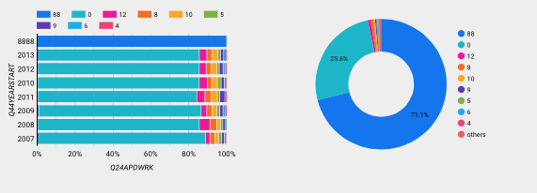
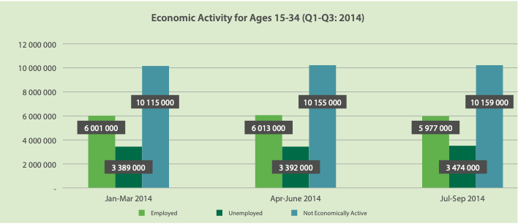
Data Story
Highest education level
FROM STATAS SA

Slide 3
Derived from the Government’s National youth development policy framework (2002/8)
Sustainable development
Improve standard of living
Large scale employment
Aligned with The National Economic Recovery Plan: Promote Reindustrialization

Slide 4

Solution : Smart bag
Unique selling points
Stain Free
and water resistant bag
Made from nano tech
Materiel
Renewable energy source

