Slide 1

TravelM8 Northern Cape
Tourism potential in the Northern Cape
Melvin Kisten – iammelvinkisten@gmail.com
Galaletsang Mabothe
Stefany Bam
Hanna Sebolai

Slide 2
Policy Objectives
Observe factors that influence tourism in the Northern Cape
Visa
Immigration
Tax
Investors
Labour force
Education
Infrastructure development
Notes:
Note: We plan to minimize negative impacts to tourism.

Slide 3
Describe data needed
Migration
Composite Infrastructure Index
Education
Tourism Potential
Towns
Quality of Labour Force
Commercial Services
Safety and Security
Transport and Communication
Notes:
Our policy objectives influenced the data that we needed.
This particular hackathon seeks to engage with government data to unlock insights that should inform policy decision.

Slide 4
How was data prepared?
Sub setting
Cluster analysis: k-means method
Multiple regression
Correlation between the independent variables and the dependent variable.
Notes:
Because we delt with unsupervised data, we used unsupervised learning to and adapted the method of clustering analysis and instead of randomly selecting our independent variables we used sub setting method.
Sub setting- Selected variables that best suited our policy objectives.
Cluster- Grouping of variables which have similar characteristics.
Multiple regression- Selecting a single dependent variable and comparing it to multiple independent variable.

Slide 5
Complexity of data modelling techniques
Cluster analysis: k-method
Regression analysis
Time complexity
Notes:
Cluster- Grouping of variables which have similar characteristics. The K-method is best suitable because it is scalable, can be used for large data sets and has a time complexity of Big-O(n) where if the data is in real time then the results can happen almost instant.
Regression analysis- Selecting a single dependent variable and comparing it to multiple independent variable. Since this follows after the cluster analysis procedure, if at all new data is processed, the results will be quicker.

Slide 6
How well the results support policy objectives?
Identify factors that influence tourism in the Northern Cape.
Our results is to inform tourism optimization.
Identify towns with similar tourism factor observations.

Slide 7
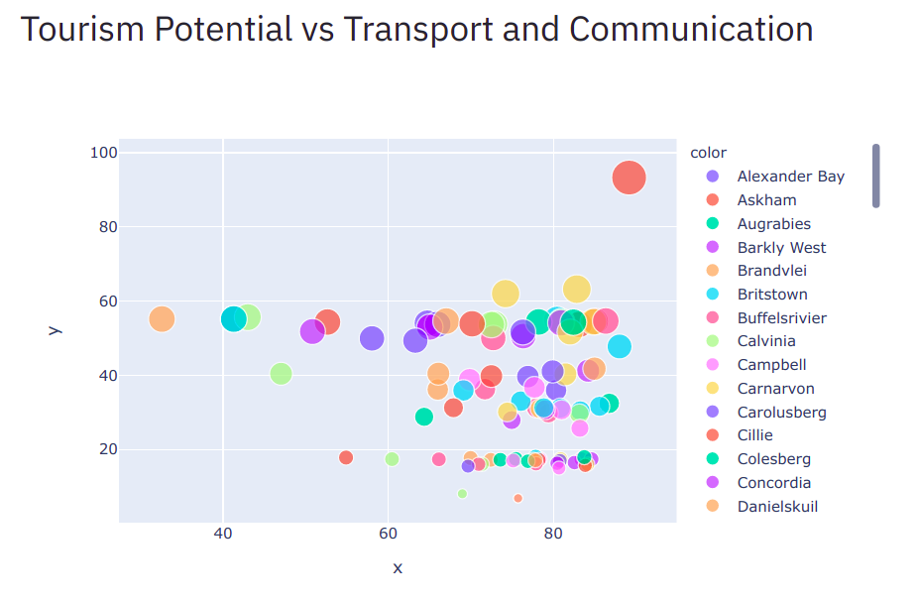

Slide 8
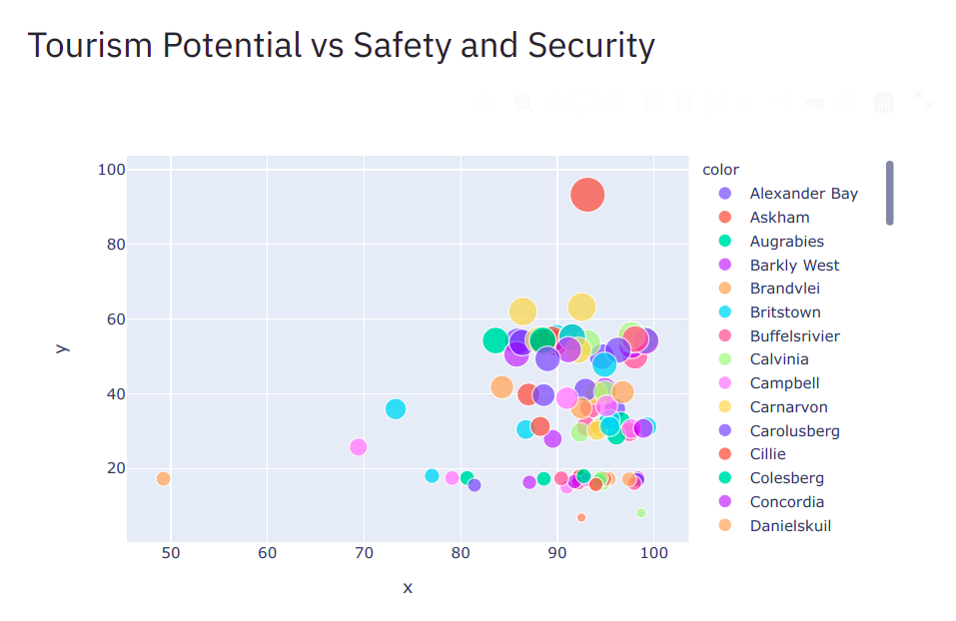

Slide 9
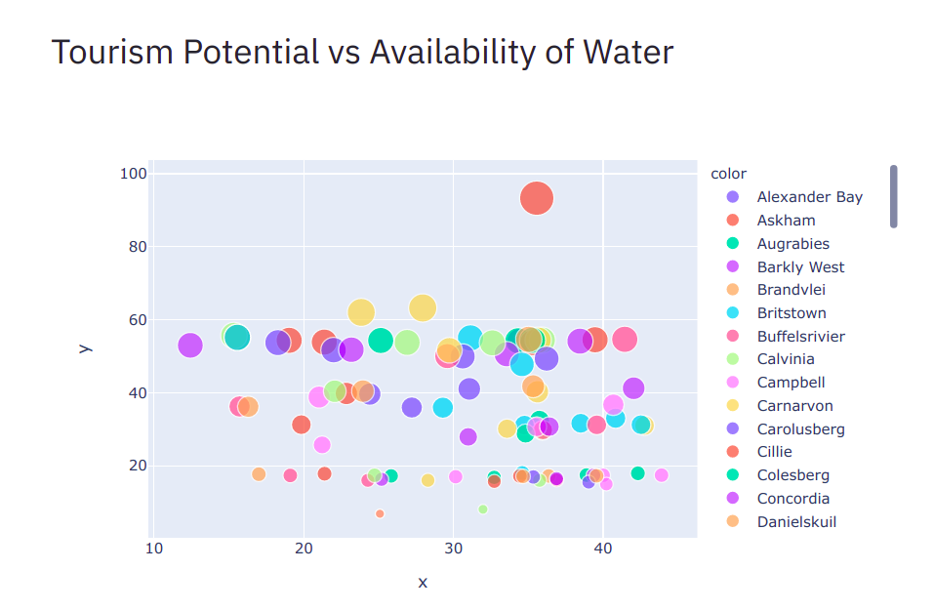

Slide 10
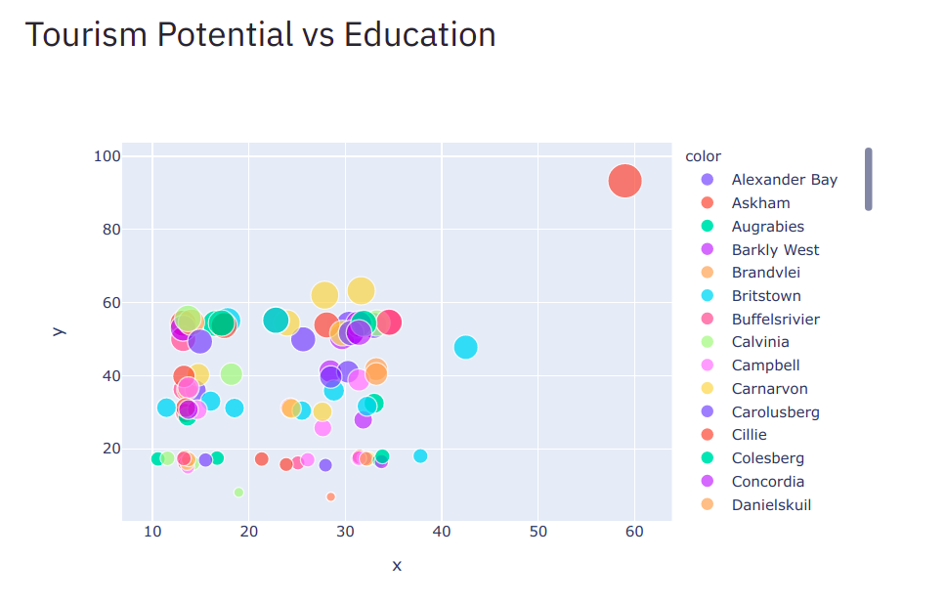

Slide 11
Conclusion
The Department of Tourism is not the only government department that must be involved. Instead, as we have seen, transport and comms, safety and security, availability of water and education are contributors to the tourism potential in our province. Hence it is paramount that respective government departments be part of the work that TravelM8 is spearheading.

Slide 12
THANK YOU!
Any questions?
Melvin Kisten
Email: iammelvinkisten@gmail.com

