Slide 1
The Venoms
Promoting inclusive 4IR

Slide 2
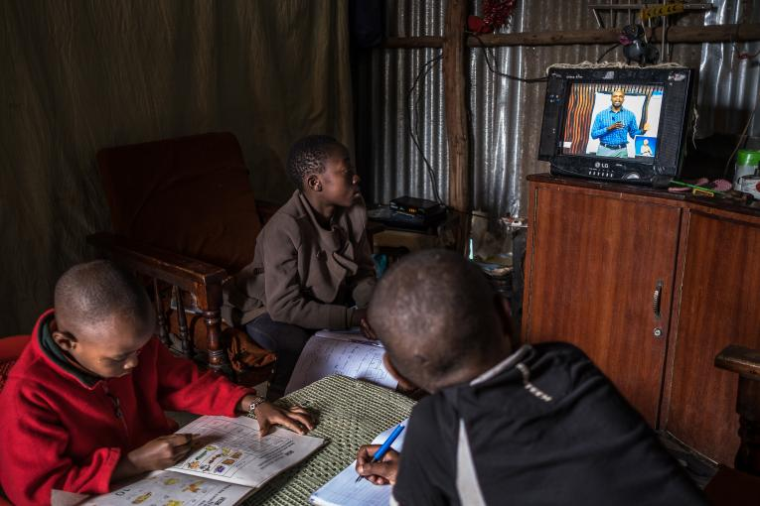
Improving Connectivity

Slide 3
Policy Objective
Strategy Objectives The objectives of the Digital and Future Skills Strategy are to provide:
  • A roadmap for priority digital skills action points: Identification, categorisation and guidelines for collectively building a comprehensive range of digital skills, set out as strategy elements, driven either by DCDT (DEPARTMENT OF COMMUNICATIONS AND DIGITAL TECHNOLOGIES) directly, or in conjunction with other stakeholders and structures;
  • A roadmap for stakeholder collaboration: Identification of key action points to facilitate stakeholder collaboration across government, with state agencies and government appointed committees, with organised business and labour, with academia, scientific organisations and civil society.
      DEPARTMENT OF COMMUNICATIONS AND DIGITAL TECHNOLOGIES NOTICE 513 OF 2020
      As gazette by honourable Minister MS STELLA NDABENI – ABRAHAMS on 30/08/2020

Slide 4
Data We Used on The Policy
Mostly qualitative data, with a categorical data type
Digital Behaviours – Individuals
Digital Behaviours – Organizations and Government
MOOCs & Online Learning Behaviours
Complementary datasets
General household survey

Slide 5
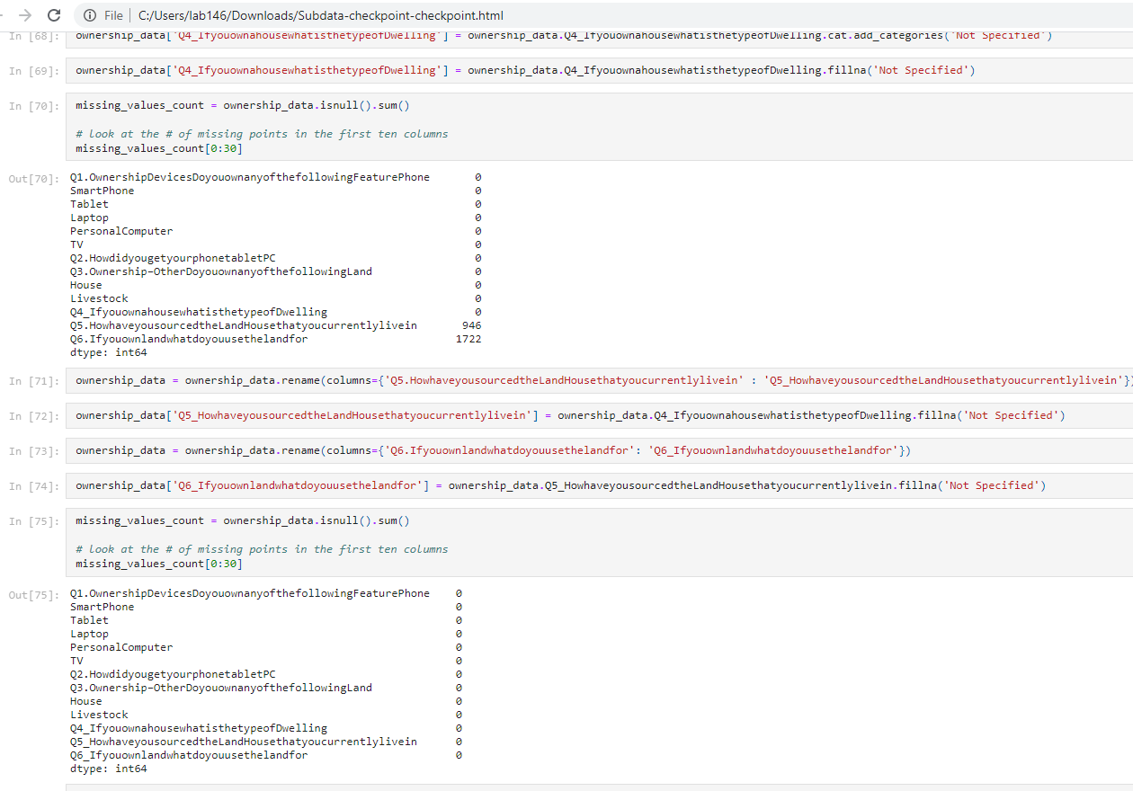
How we managed to handle our dataset
Data Cleaning
  We broke the whole data into subdata
  Managed to clean all the null
  values on the data
  Application used: Jupyter
          Phython
          Spider
  Subdata with null values
  Data cleaned from duplicates and
  null values

Slide 6
We will be speaking primarily towards these strategic action points:
Strategic action point 1.1
Strategic action point 1.3
Strategic action point 2.3
Strategic action point 3.1
Strategic action point 5.1
Strategic action point 5.2
Strategic action point 8.1
Strategic action point 8.4
Strategic action point 8.5

Slide 7
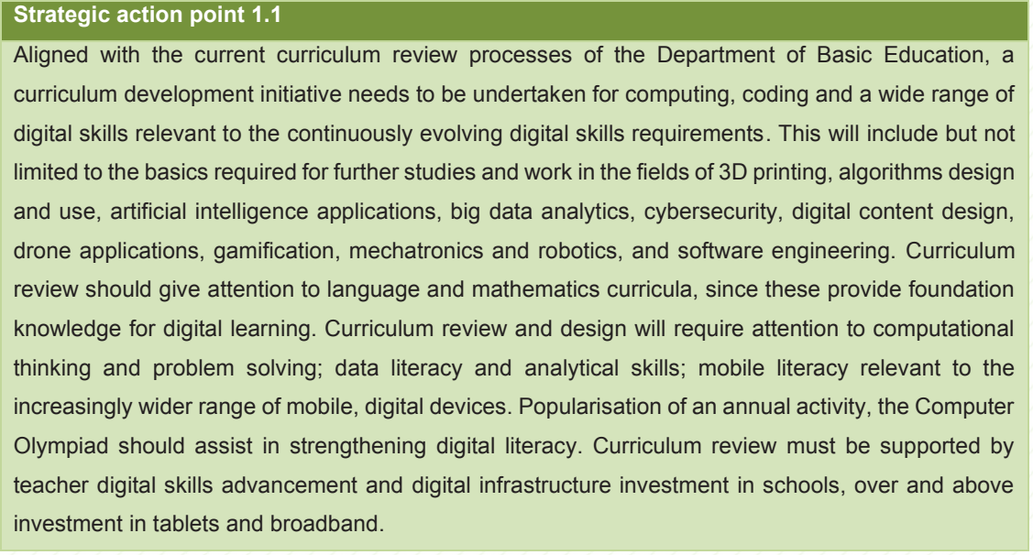
The data shows a clear bias towards urban areas in terms of access and device ownership.
In order to redress apartheid spatial planning and urban migration, more resources need to be directed towards rural areas
With reference to Strategic Action point 5.2 – more resources should be diverted to hosting events such as the Hackerthon in rural and semi-rural areas.
SETA are at the coalface of skills development and should be used to give access to rural and semi-rural areas communities for learners-hips and development – reference Strategic Action point 8.1
Seed funding should be diverted to semi-rural and rural areas. Currently these resources are concentrated to Gauteng and the Western Province. This side-lines rural entrepreneurs.

Slide 8
MySchoolApp Concept Design
MySchoolApp
After school hours connectivity
(internet access)
Prevent Theft
Keeps record of access to the premises
Biometrics
Push Notifications
Linked with Security company

Slide 9
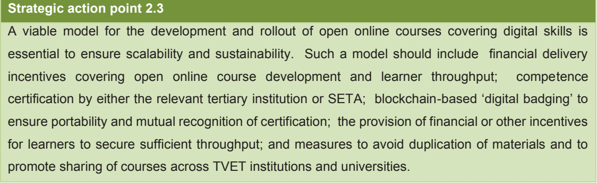
Our data suggests that rural and semi-rural areas are unjustly side-lined when it comes to the digital revolution. An increase in access to training and opportunities will not just create additional employment but will also lead to an increase in entrepreneurship.

Slide 10
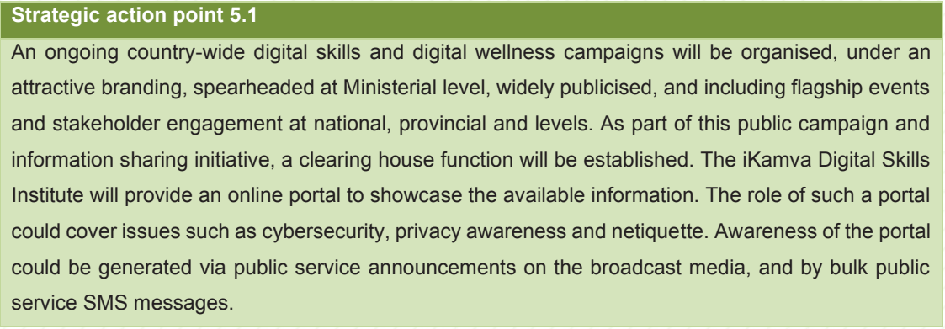
‘Digital Behaviours – Individuals’ dataset can shed more light on this matter.
Clean the data and process it to reach an educated conclusions. There is also data on
Government’s digital communication which could shed like on an effective strategy to communicate with the public

Slide 11
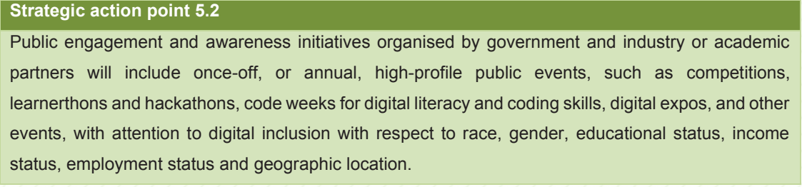
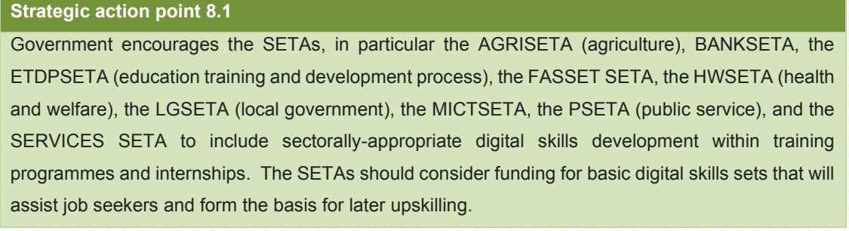
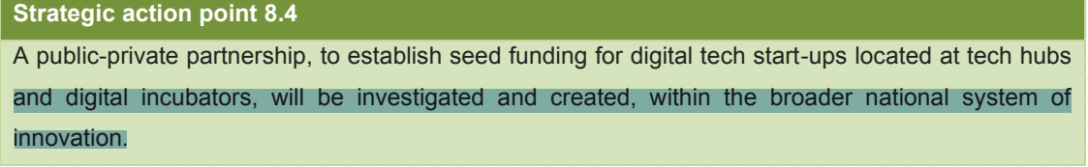

Slide 12
Conclusion
The South African ICT landscape is skewered towards metros rather than being all inclusive.
While this is cheaper in terms of building infrastructure but it doesn’t allow for fair development in skills and innovation.
Rural areas, given the opportunity could shake up the industry and disrupt urban migration while creating employement

