Slide 1
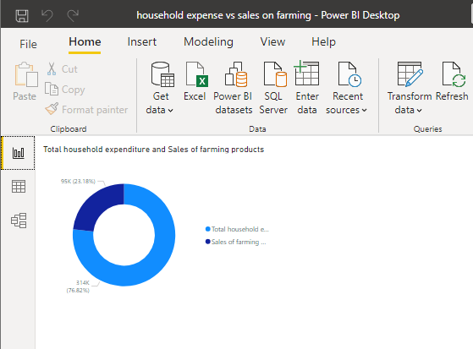
THE DAILY BIRD PROJECT: Food security and sustainable program.
Identified Problem
Food security is an eminent issue due to lack in sustainable living with surplus of consumers and a shortage of producers.
Consumerism is a chain that hampers sustainable growth.
Supply & Delivery of local fresh produce in rural and urban derived from the (NHTS2013) data set.
We also used statssa and food security policy south Africa.
Transportation modes and costs to go to buy food and groceries increase costs of products
The delayed time factor to buy food and groceries
(NHtS2013)
Total house expenditure vs sales on farming products .
Unemployment rate statssa :
(The results of the Quarterly Labour Force Survey (QLFS) for the fourth quarter of 2020 show that the number of employed persons increased by 333 000 to 15,0 million in the fourth quarter of 2020, and the number of unemployed persons also increased by 701 000 to 7,2 million compared to the third quarter of 2020.

Slide 2
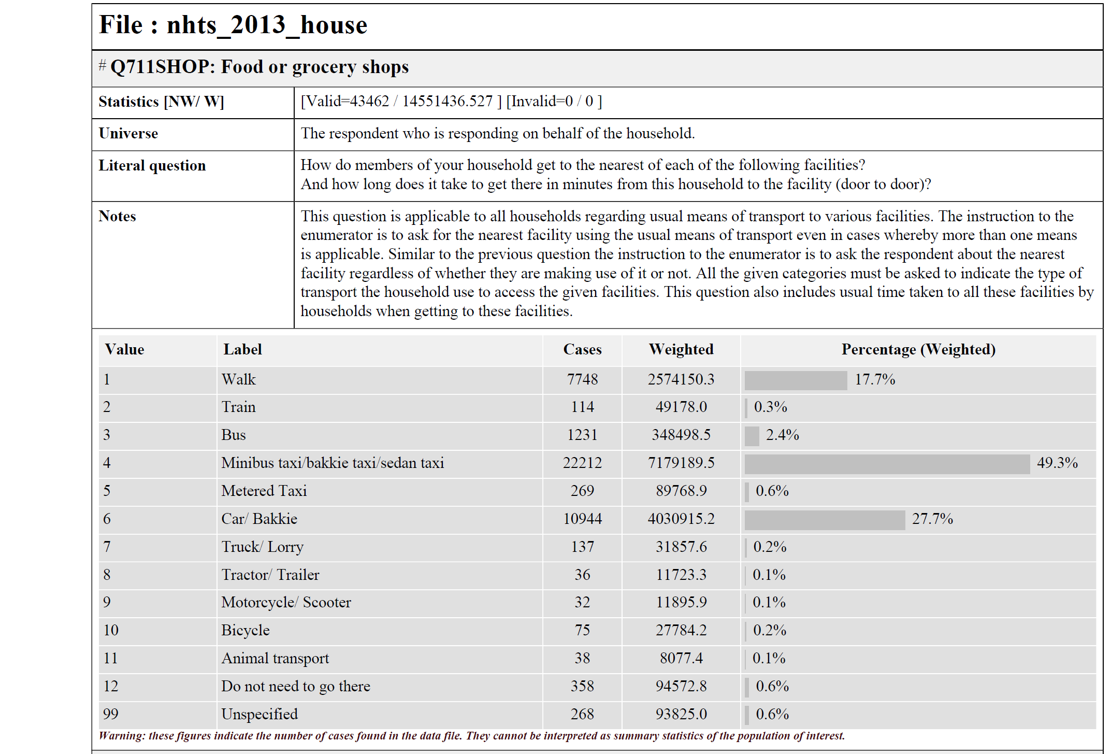

Slide 3
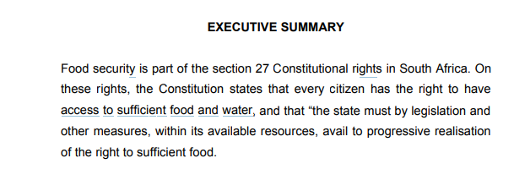
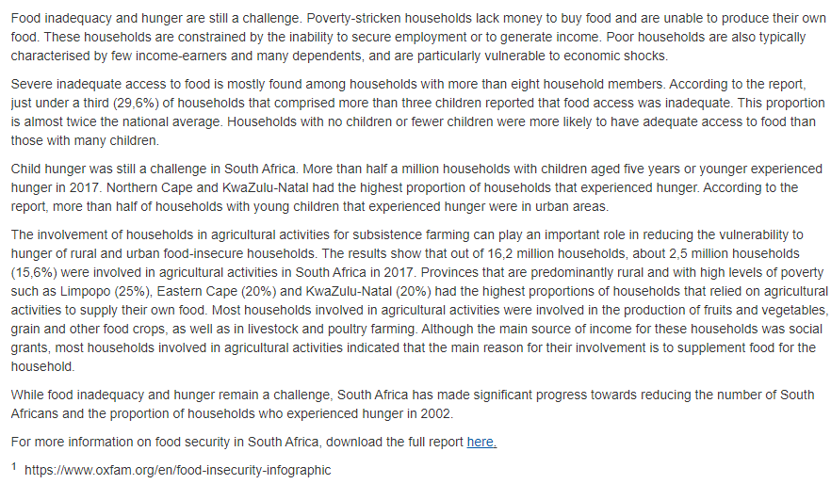
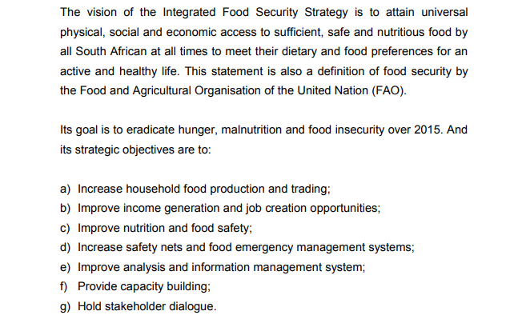
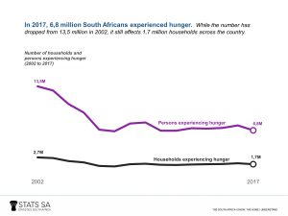

Slide 4
Solutions
- Sustainable rural farmers
Developing a platform by utilizing a app to trade fresh produce, sourced from local farmers through 4IR technologies and farmers being trained into the Daily Bird Project.
Assisting farmers in producing the highest quality fresh produce by providing specialist support as and when needed.
Affordability for the consumer and feasibility for the producer even if it means your neighbour becomes your supplier (food security policy objective)
4IR Technology includes
Big Data;
Cloud Computing
Real time data analytics Internet Power BI used
Artificial Intelligence.

Slide 5
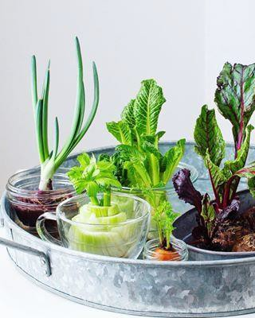
Large rural and communities will benefit in the following ways;
Saving
* Farm to fork model/ soil to fork as others may refer to it
* More affordable and accessible produce
Income opportunities
* Join the local farming force and promote sustainable living through utilizing the user friendly app,
Employment
* Fresh produce will be from farmer to consumer; picking, sorting and packing, delivery and data capturing.
Covid-19 strategy social distancing avoid crowded areas modes of transport by delivery methods order and process online. Quality and control checks would be placed. Can’t rely on chain stores break consumer culture.
Carbon credits: Reduce emission gases
Governance & policies
Clearly defined company policies including returns, wastage and Qpro standards to adhere to.
Pre drawn up contracts and agreements between the fresh produce supplier and the The Daily Bird Project to mitigate potential risks identified and ensure fair- trade.
Technological challenges;
*Lack of internet access
…DR KK FREE WIFI
*Operational challenge
…Business continuity mode

Slide 6
Farmer benefits
Introduction to a open market,
Training in sustainable farming, Problem identification and real-time analytics linked to the markets.
*Yield suggestions based on statistics
Forecasting for planning planting and harvesting schedules
Chatbots, FAQ; for agricultural assistance
small scale farmers would then penetrate the independent supermarkets and wholesalers
Supplier payments to run on a weekly schedule and be credited to their account with the Project to still be able to access the buyer portal and buy what they cannot produce
Ongoing Support Cost
Network Servers Data analyst Monitoring
Data capturing and analysis
Systems Developers
Supplier portal with discussion room

Slide 7
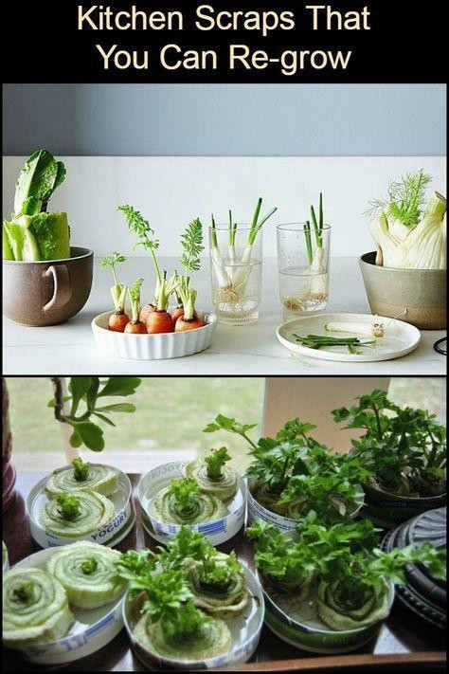
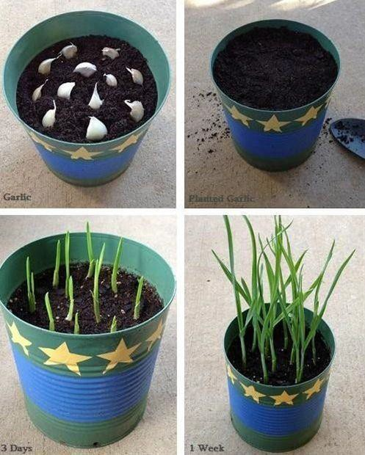
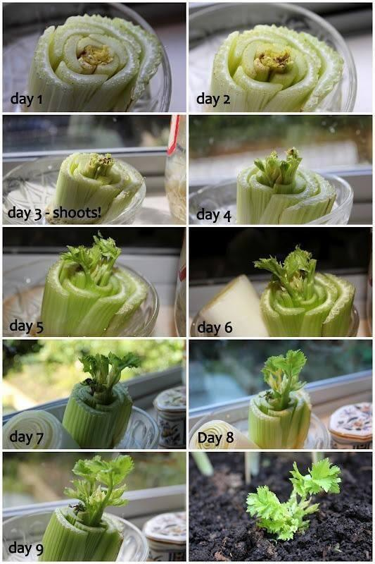
KITCHEN SCRAPS CAN BE USED TO AS SEEDLINGS TO GROW WHICH CONTRIBUTE TO SUSTAINABILITY IN TERMS OF THE ABOVE FRESH PRODUCE

