Slide 1
Statement to address IDP and services delivery challenges facing Mahikeng Local municipality

Slide 2
Objectivity of the presentation is to
Develop Integrated Development Program (IDP) APP and device tracking system
This will enable people to participate more on IDP and service delivery programs

Slide 3
Problem Statement
Lack of quality IDP and services delivery program in Mahikeng community
Most of IDP and services delivery are not able to cover community due to poor management
IDP reviews and documentations

Slide 4
Policies and acts
In terms of the Municipal systems act of 2000, in compliance section 34 of this act municipal council must be conducted of integrated development planning.

Slide 5
Solution to the problems identified in Mahikeng local municipality
IDP APP and device tracking
Will accelerate delivery of services
Improve community participation
Increase access to services

Slide 6
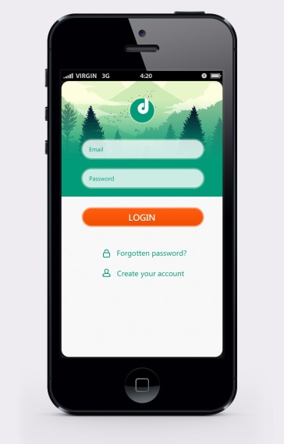
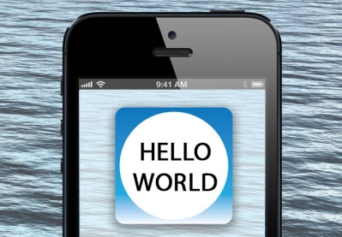
Prototype
This how the IDP and Services delivery APP will work for municipality:
First the App will allow individual to register HIS/HER details including the ward that he stays and the name of ward councillor
Second Step, Now the APP Opens and start to Great you and also allow yo To navigate in different area e.g. date with the latest development

Slide 7
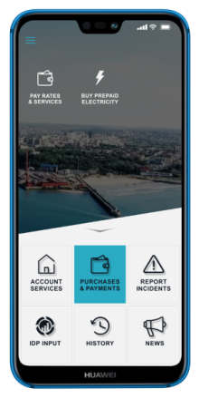
MAIN MENU OF THE APP
IDP Documentation
Invitations
Media and latest news development
Participation of ward elections or Bio-Elections statistics
Geographical area of wards
NB THE APP IS DATA FREE ANYONE CAN DOWNLOAD THE APP

Slide 8
Device tracking
This system work hand in hand with the app

Slide 9
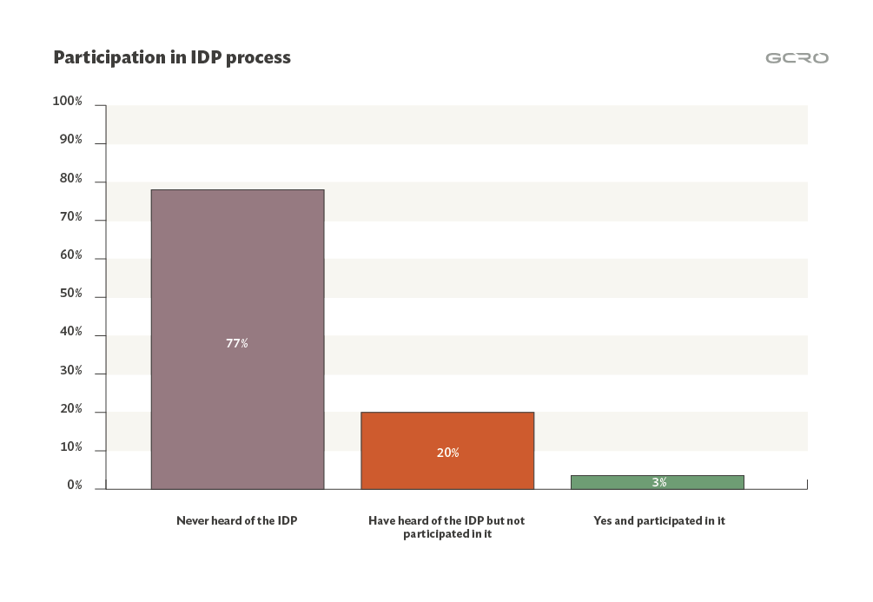
REAL LIFE DATA ANALYSIS 2018 /19 FINANCIAL YEAR IDP RIVIEW

Slide 10
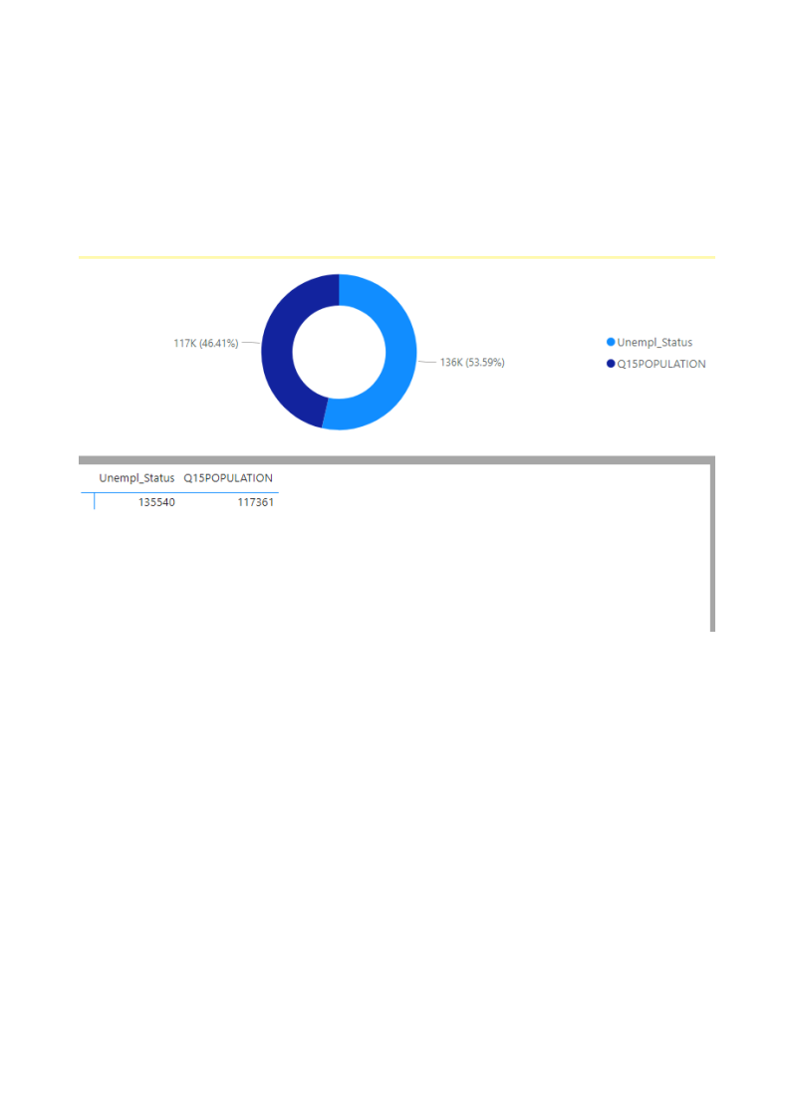
Data given analysis Analysis statistic of population v unemployment status whom are likely to participate in IDP Program

Slide 11
END

