Slide 1
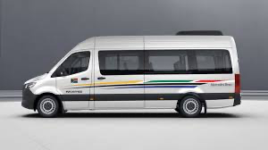
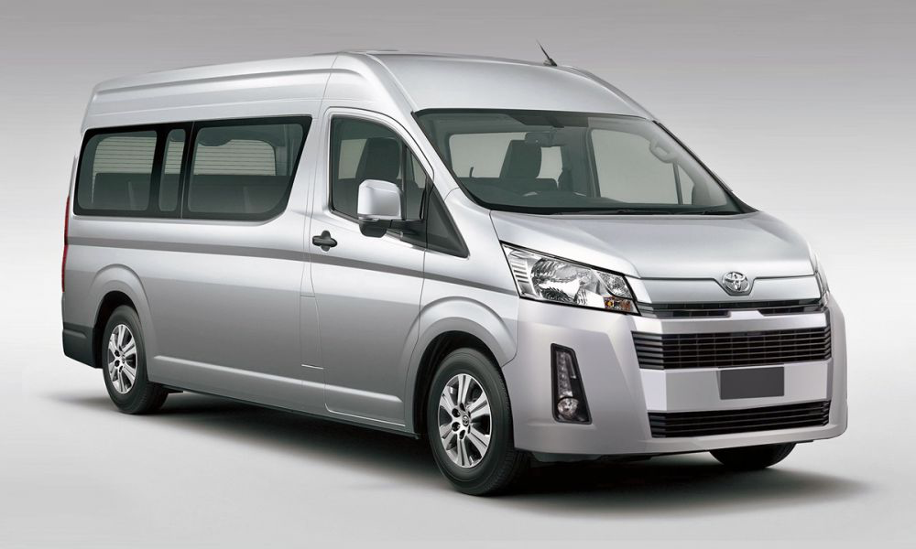
S.I.T
Smart Itaxis
By Thato Godfrey Loeto
founder of PULA MADIBOGO HOLDINGS

Slide 2
PROBLEM STATEMENT
DISSEMINATION OF
MISLEADING INFORMATION IN OUR COUNTRY.
POLICY
“Anyone spreading misleading information is guilty of an offence and liable on conviction to a fine not exceeding R10 000.”
And the objective of this policy is to curb citizens from been reckless with information by misleading the nation.

Slide 3
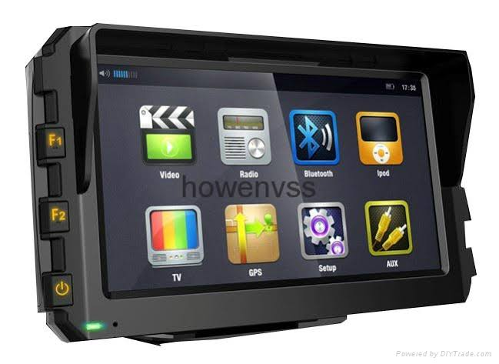
MULTI PURPOSE INFORMATION DEVICE
PROTOTYPE
This device will be located on the dashboard, and function as an announcer, Every 15 minutes there will be a 2 to 3 minutes of information sharing even if you are listening to radio.
We request that every newly minibus taxi should be embedded on the radio system of the vehicle.
GCIS as their responsible for managing government's public communication they will be ‘center agents’ for announcing factual information such as loadshedding schedules, Covid 19 related information, local weather forecast, local funeral annoucements and etc
The business sustainability of this device, it will create business for taxi owners as well, SMMEs will get opportunity to advertise their businesses on this device
This is the innovative communication device that will assist our government to be in control of factual information it disseminate.

Slide 4
POPULATION THAT USES PUBLIC TRANSPORT
Others
Our pie chart reflect that majority of our population use or prefer taxis to travel daily
Taxis
69%
Source : statssa.gov.za

Slide 5
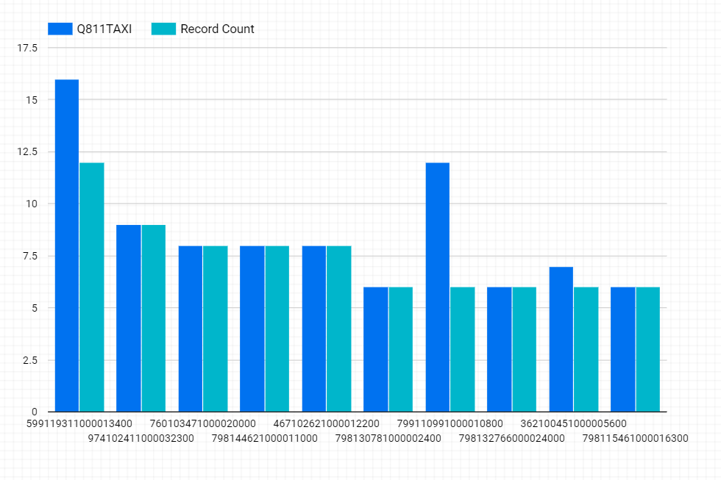
MINIBUS TAXI SERVICE
From our dataset i pulled the MINIBUS TAXI SERVICE and use microsoft Power BI to plot this following findings..
Days travelled
Passengers

