Slide 1
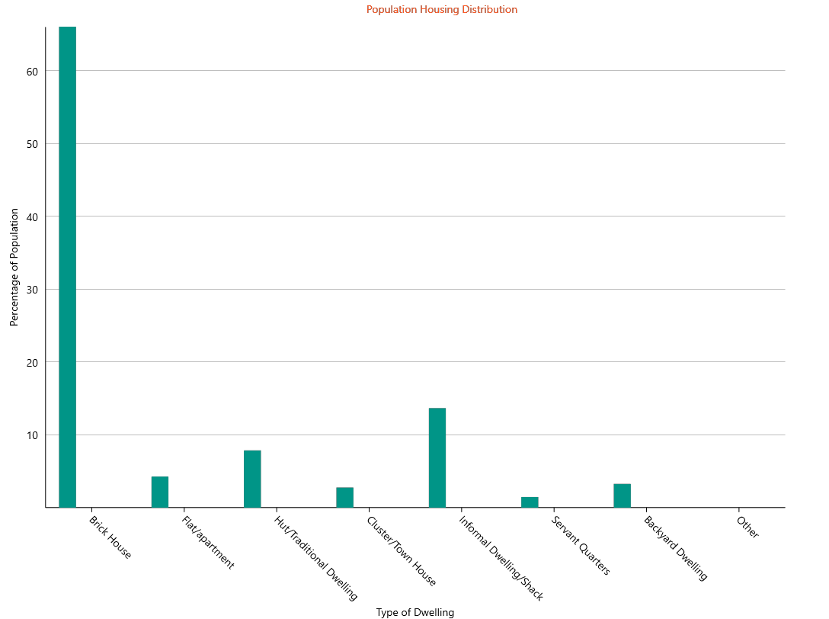
13,6%
= 7,5 million

Slide 2
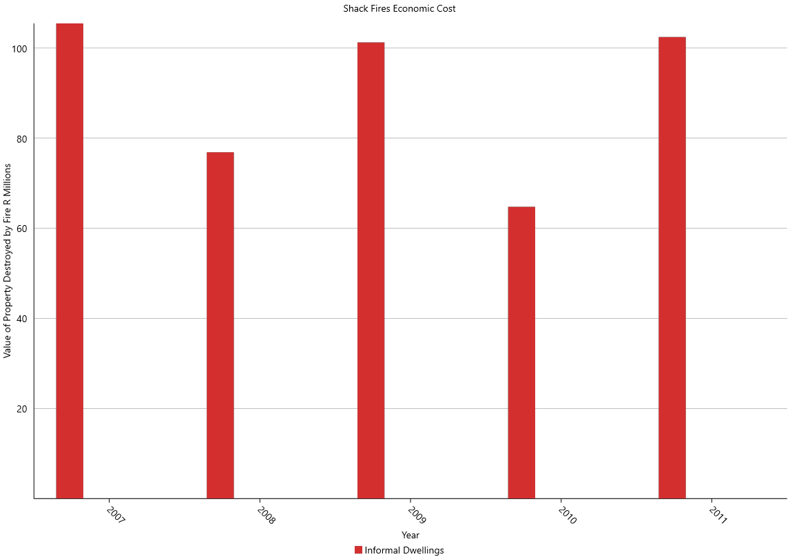
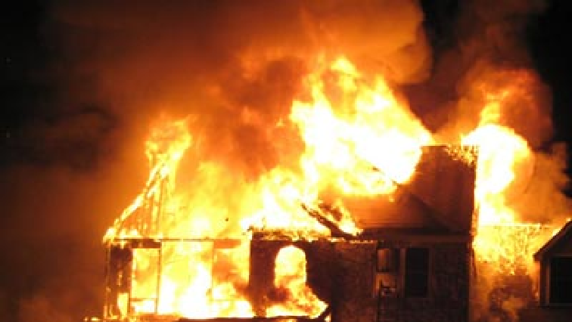

Slide 3
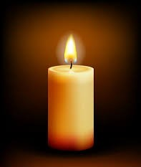
Smart Candle
Burns 24 hours
Switches off when it falls over
2x Brighter

Slide 4
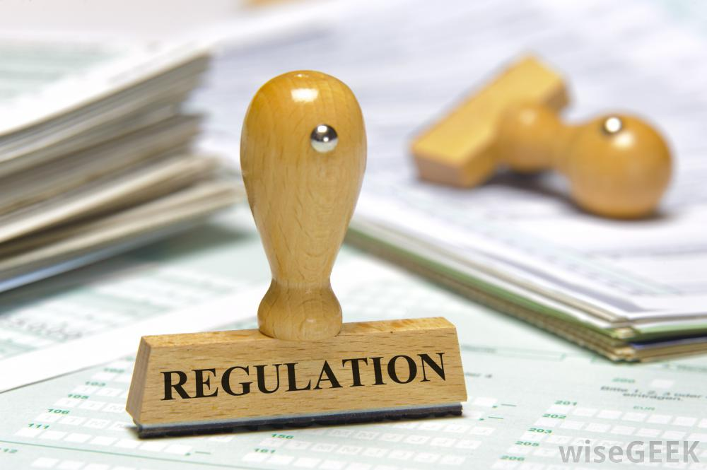
Policy Objectives
According to the South African Bureau of Standards, the CKS60 stipulates that a domestic candle is required to burn for 9,5 hours.
Our objective is with success of our product development is to influence legislation to mandate a candle that will burn for 24 hours and self-extinguishes in the case of falling over to reduced risk of household fires and the deaths and loss of property that go with them.

Slide 5
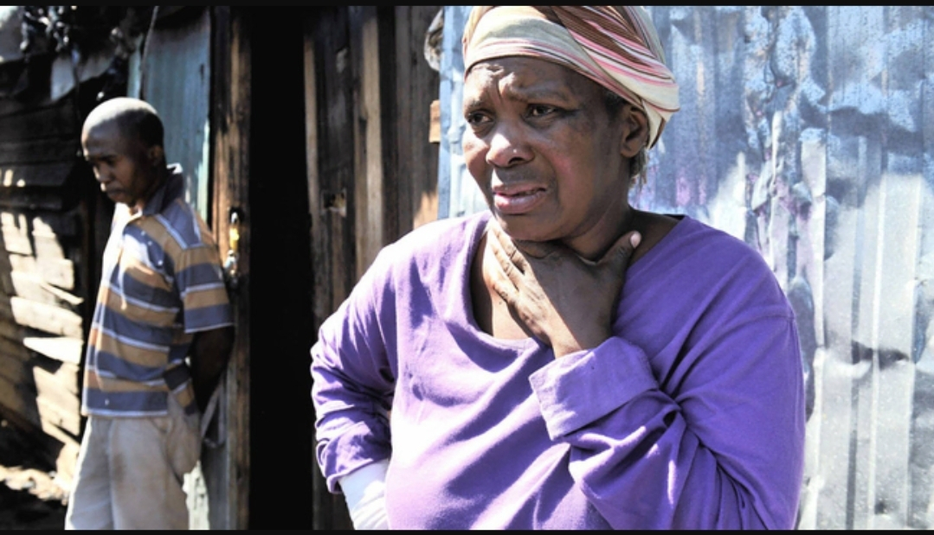
Gauteng - Iris Mthabela after losing 4 grandchildren in a shack fire started by a candle.

