Slide 1
SMART WATER REGULATOR
Siyakhula Tech

Slide 2
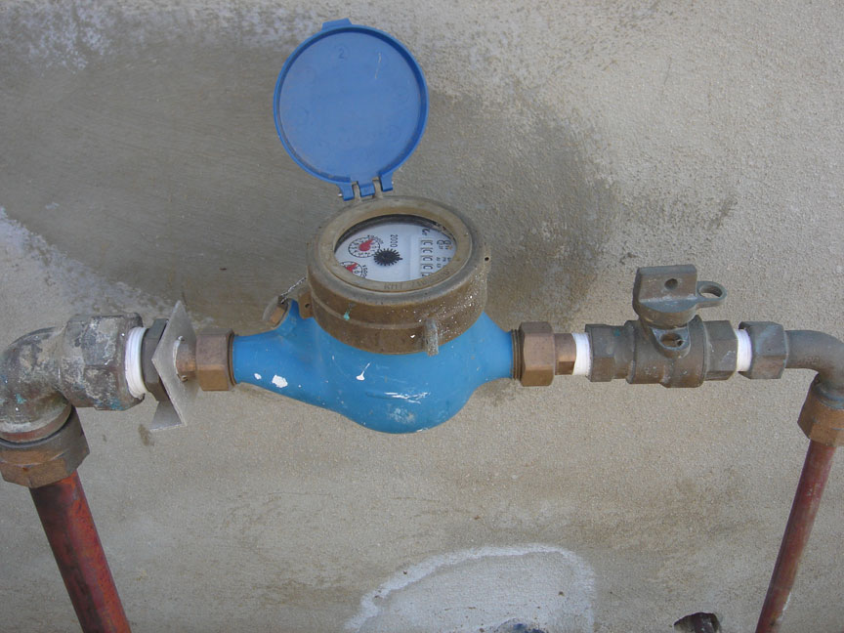
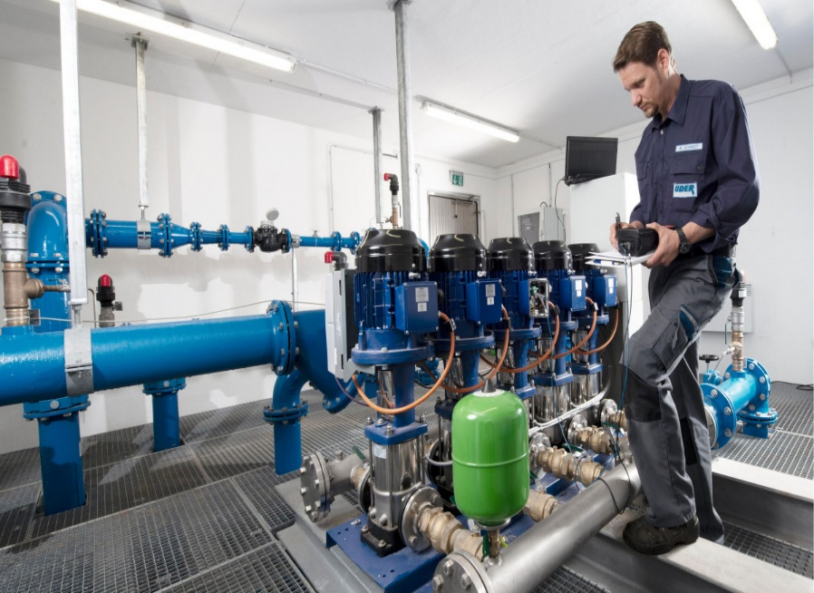
Problem statement
Most residents get overcharged due to inaccurate meter readings.
The municipal uses an analog system.
Raedings are checked on the reservoir.

Slide 3
South African water stats and facts
Currently, South Africa has access to surface water (77 percent of total use), groundwater (9 percent of total use), and recycled water (14 percent of total use)
The main rivers are the Orange River draining to the Atlantic Ocean, the Limpopo River, the Incomati River, the Maputo River, the Tugela River
Average rainfall is <470mm annually.
Mpumalanga receives approximately 620mm
South Africa is hot and dry, so much of the rain that does fall evaporates quickly
South Africa has approximately 550 water dams which colleck half of south African water rainfall.

Slide 4
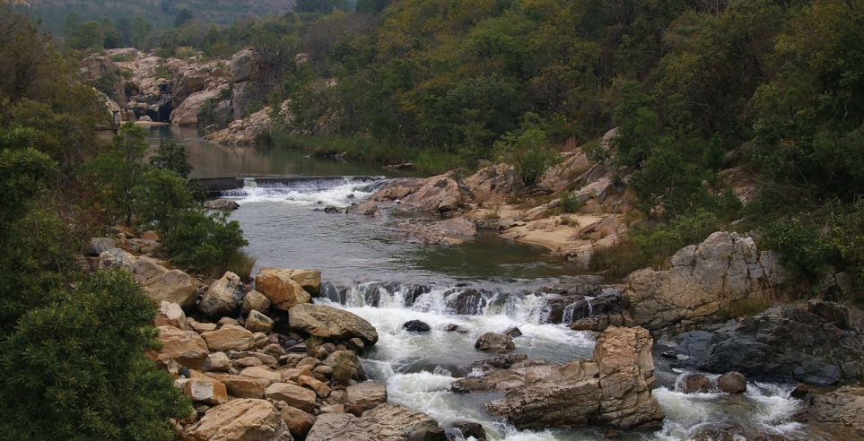
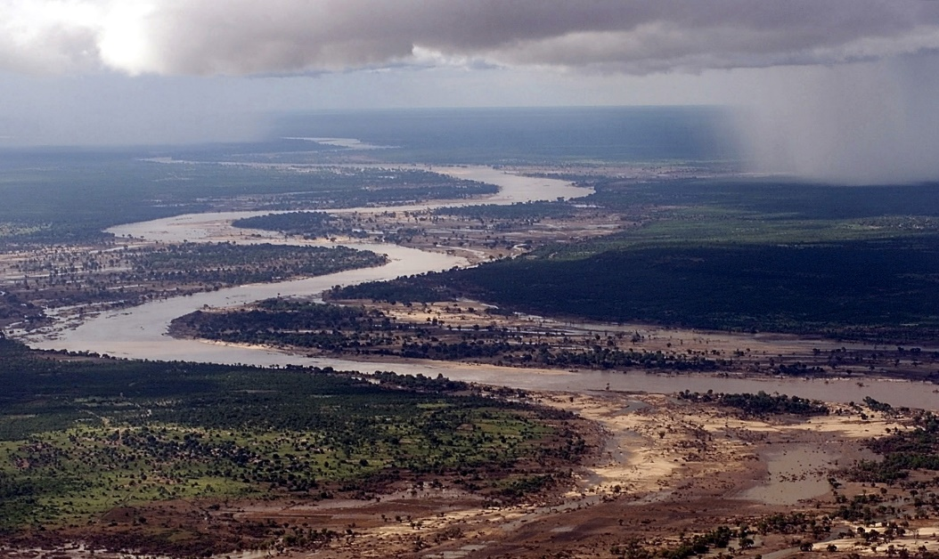
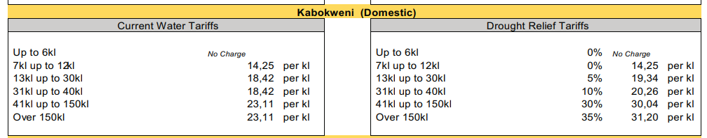

Slide 5
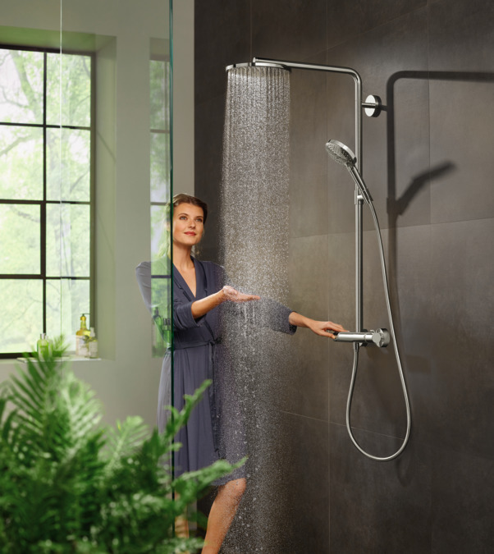
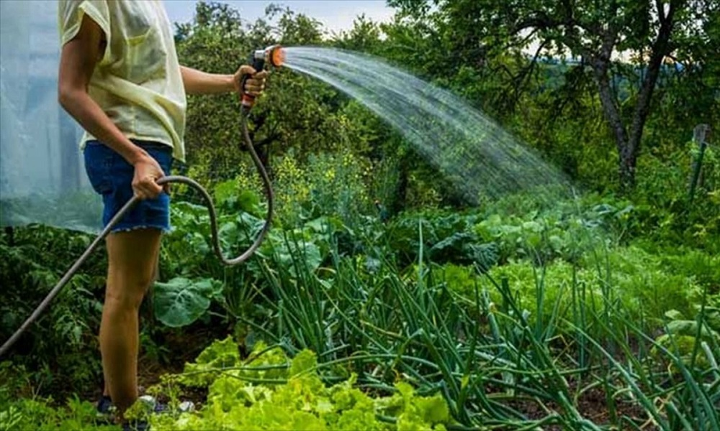
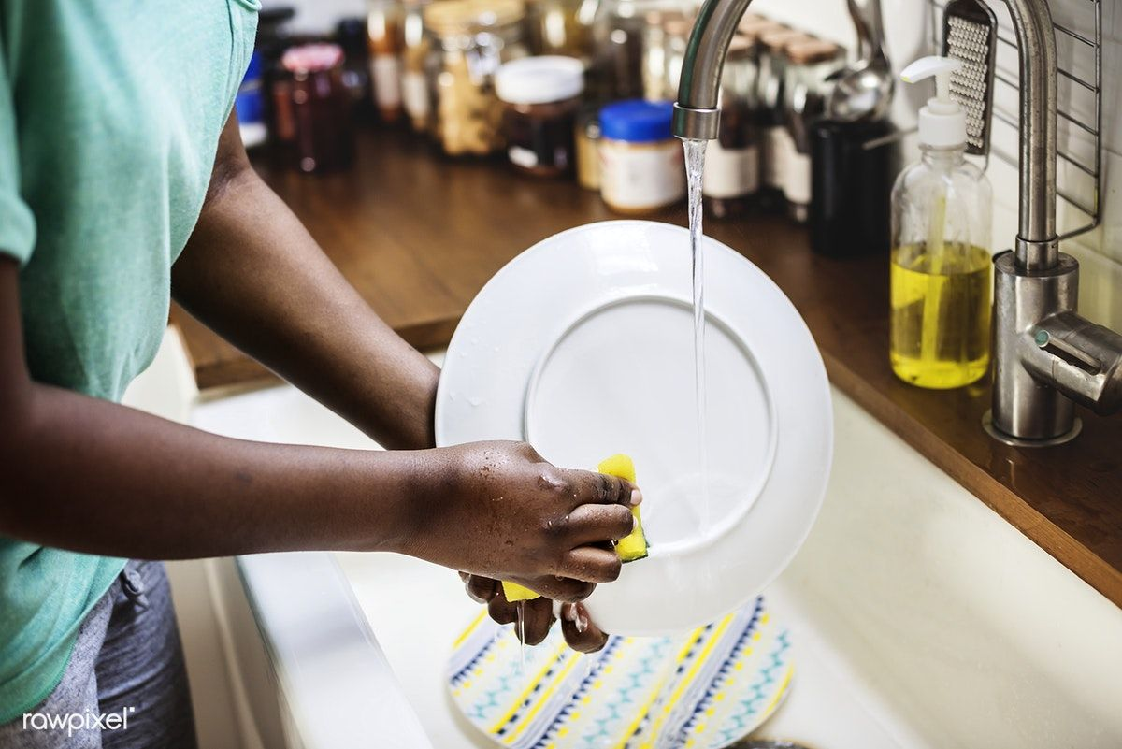
How Ndumiso regularly uses water
Uses tap water for irrigation.
Loses approximately 5 litters of water try to find the suitable shower temperature.
Uses water for domestic activities.

Slide 6
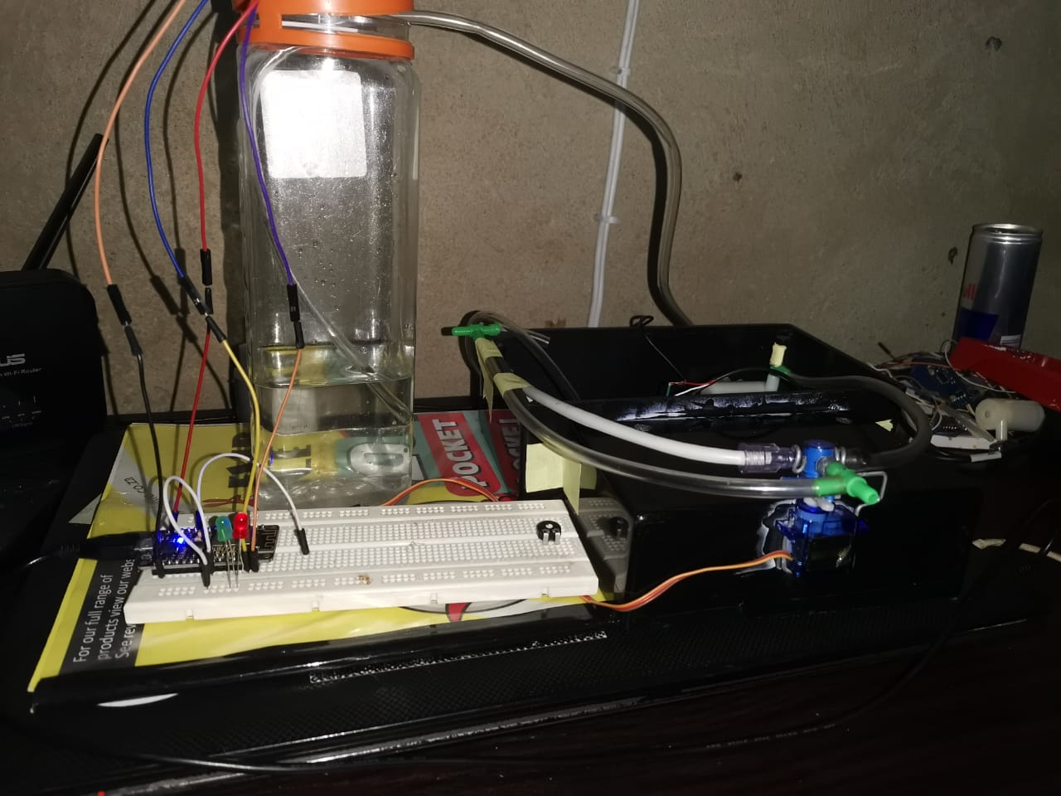
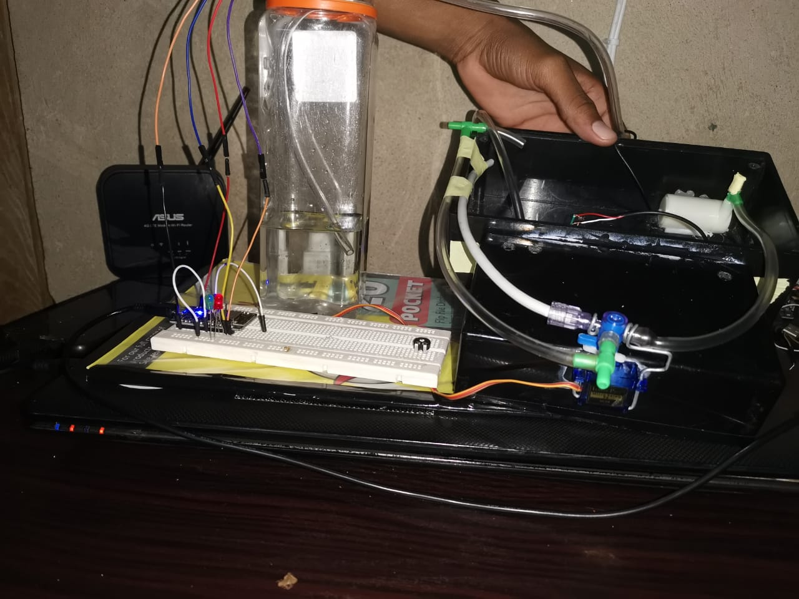
SOLUTION( Smart water regulator)

Slide 7
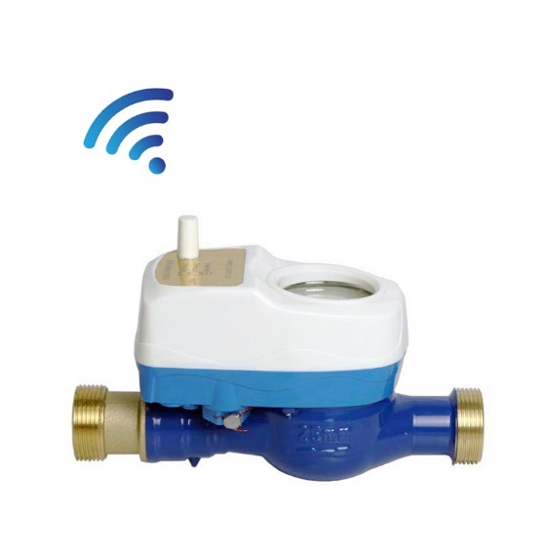
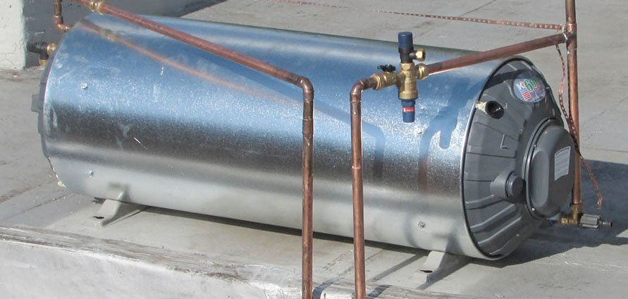

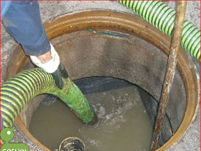
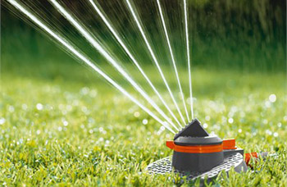
HOW IT WORKS

Slide 8
How the solution benefits Ndumiso and South Africa
Helps Ndumiso save water.
Helps the municipal to get real time accurate digital readings.
Helps the municipal get data that they need for annual analysis and stats .
Ndumiso can now get his water usage analysis and not get over charged.
Errors in the meter can be easily detected.
It will be easy for the municipal or the government to know which areas have pipe leakage.

Slide 9




BUSSINESS LAYOUT
The system cost around R2500,00 to build.
Sold to municipal or rand water, but we install it.
Maintenance free for the first 15 months then R350.00 after.
Charge the municipal, research commissions , and the department for data.

Slide 10
Technology used (prototype)
Arduino
Water flow sensors
Wifi modules
Temperature sensors
Electric Water valve
Water pump
Xamp
Andriod studio

Slide 11
THANK YOU FOR LISTENING!
QUESTIONS?..

