Slide 1

Presentation
Nqobile Makhoba

Slide 2
Problem
Durban Solid Waste Source: Community Survey 2016
59.4% Are getting refuse disposal from a local authority, private company or community members
Durban University of Technology (DUT) has three residents that are situated along St. Georges street which are Renaissance , Laurent House and Hlelo Properties
Students are taking this initiative to clean the streets
Maud Mfusi Street (from Dr Yusuf Dadoo Street right up to Alexandra Street)
Notes:
Situational Content

Slide 3
Problem Continues …
They are not the only one that are affected by the environment in this area other businesses too are affected such as Spar as a huge retail that is located in the area.
Shops that sell fries litter mosts ( potato peels and oil on the drains )
Municipality do not collect black plastic bags
Flats do not have bins to through the refuse
Homeless people are the one who contributes to crime
Notes:
Conflict

Slide 4
The Team
Nqobile Makhoba is the founding director and manager of Silowe Trading Enterprises.
Silowe Trading( PTY) LTD a wholly black female owned company that does waste management , cleaning and supply services.
She holds a National Diploma in Financial Information Systems graduate from the Durban University Of Technology.
She will be working a software developer in mapping illegal sites and developing the waste management application.
One Finance and Admin personnel.

Slide 5
Action Taken
Police visibility
More bins were added
Educate the community about illegal dumping , environmental safety
Educate business in the area especially the alcohol and food restaurants to take responsibility about educating their customers not to litter

Slide 6
Solution
Mapping Illegal dumping sites
Mobile Application for locating illegal dumping
This will help in sending data to the municipality , environmental specialist and service providers about Illegal dumping , so that they can come and get rid of the waste in the good way .
It will also help you to location legal dumping sites , locations and what kind of waste you can dispose
It will also help you with the data base of the service providers in the area that does waste management .
The Estimated Cost is R35000 including labour .

Slide 7
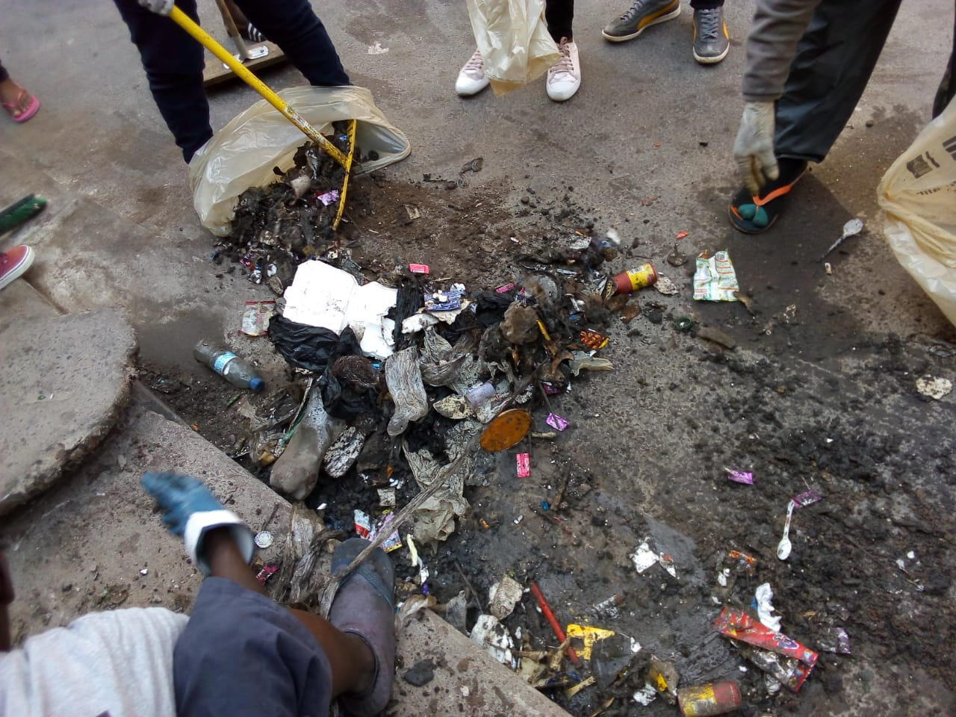
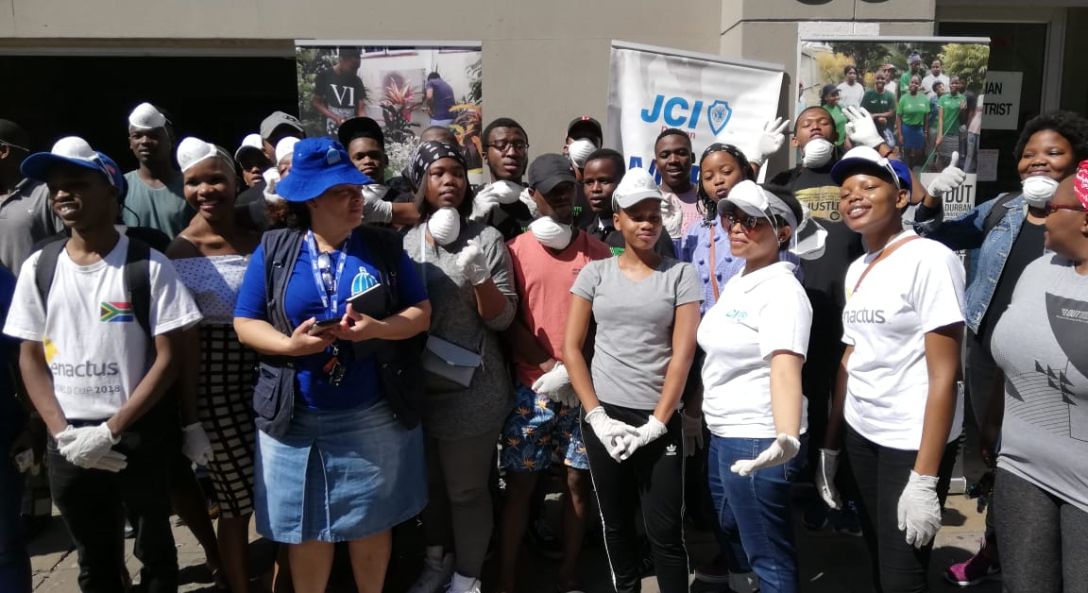
Pictures
This was some of the waste that was taken during waste mapping to some of the illegal dumping sites .
Awareness campaign project that was done in collaboration with ITRUMP , eThekwini Municipality , DUT students residing at St. Georges Street , Spar and Community Policing Forum.

Slide 8


Contacts
m. 072 693 9101
e. info@silowe.co.za

