Slide 1
SENTINALS
Analysis of the effect of lack of sight and hearing on the gender gap in TVET and HE Information Technology and Computer Science programmes in municipalities in the KwaZulu-Natal province.

Slide 2

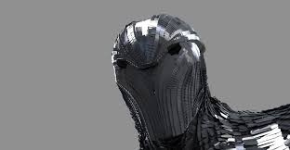
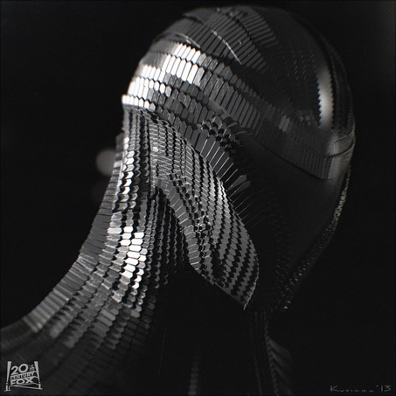
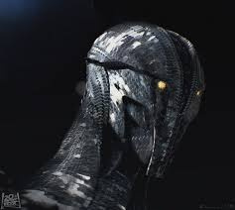
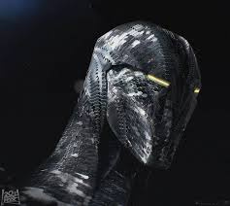
The Sentinels
Cyril Chironda
Linda Hasi
Musawenkosi Nyathi
Usaamah Obaidullah

Slide 3
PROBLEM STATEMEMT
We look at the population of male and female students at TVET Computer and Information Science programmes in different municipalities in the KZN province.
We hypothesize that female student attendance for these type of programmes will be less than that of males due to outdated gender norms. Furthermore, we will look at the added effect of lack of sight and hearing on Computer and Information Science programme admissions by both gender populations.

Slide 4
 |  | Summary statistics percentages
 |  | Male | Female
 | Sight | 35% | 65% |  | More females than males have difficulty in sight
 | Hearing | 41% | 59% |  | More females than males have difficulty in hearing
 | TVET | 54% | 46% |  | More males are enrolled in TVET IT subject
 | HE | 59% | 41% |  | More males are enrolled in HE IT subjects
Introduction
We get the (clean) data provided by the organizers (CS_2016 data sets). The data contains weights of persons with sight and audio difficulty per ward. We combined (connected) this with another data set provided that contained enrollment numbers in TVET and HE institutions per ward as well
Data suggest that there are more males than female in IT tertiary related programs in KZN province.
The data also show that there are more woman with hearing and sight difficulties than woman in the same region.

Slide 5
Test For Relationship
We utilized a ꭓ^2 test to test if there is any relationship between these sensory difficulties and enrolment into IT TVET and HE programmes.
The test showed that there is enough evidence to suggest dependency between the 2 variables at 95% level of significance.
To solidify this we performed a non parametric McNemar’s Test to see if this is just a coincidence but the test showed at 90% level of significance that there is enough evidence provided by the data to suggest that there is association between the two variables.
Hence we concluded that there is a relationship between the two variables, as the evidence is sufficient.
Furthermore, we fit a linear regression model with enrolment dependant on sensory difficulties.

Slide 6
Model 1
We fit a simple linear regression model enrolment in these programmes dependent on the number of females with sight difficulties.
The model shows that there is a strong positive correlation between enrolment in these programmes and sight difficulties. This is shown by coefficient of correlation (r) being 0.76.
The R-squared of the model is 64% meaning that 64% of the variation in the data is fully explained by the model leaving only 36% explained by other variables.
The goodness of fit test shows that the model is a good fit at 90% Level of significance.

Slide 7
Model 2
We fit a simple linear regression model
The model shows that there is a strong positive correlation between enrolment and Hearing difficulties. This is shown by coefficient of correlation (r) being 0.86
The R-squared of the model is 72% meaning that 72% of the variation in the data is fully explained by the model leaving only 18% explained by other variables .
The goodness of fit test shows that the model is a good fit at 90% Level of significance.

Slide 8
Model Fit Conclusion
The models show that not only women are marginalized but, more so, women with auditory and sight difficulties are almost neglected when it comes to IT education at tertiary levels.
This will leave women and women with auditory and sight difficulties technically unskilled in the 4th Industrial Revolution .
This begs a question: What is the worth of a revolution when it doesn’t address 2 of the burning issues of society?

Slide 9
Limitations in our Models and Analysis
More data needs to be collected. Larger data sets give better insight on the crisis. Furthermore, our study was solely based on data from different municipalities within the KZN province. We propose data to be collected at a national level as this issue could be more widespread.
To build better models we need more variables, as there could be more factors, such as income levels, that affect the issue of low of enrolment rates of women and women with sensory difficulties in these programmes.

Slide 10
Solutions
More data needs to be collected and research to be conducted on this issue, so better machine learning and statistical learning models can be made. Better models will give us a more accurate statistical analysis – from which we can assess the situation and its severity with greater insight.
Work alongside the education departments of local authorities and municipalities at a ward level (grass roots) so that resources can be adequately channeled to this marginalized group. These could include distribution of hearing and sight aids, better-suited facilities in schools and higher education institutions for them to be productive and thrive in and many more.
Work with the higher education and TVET institutions to lower the intake grades for females – particularly females with the mentioned sensory difficulties - in IT related programmes. In relation, a quota system could be employed at these institutions. Targeted educational funding for this marginalized group would be helpful. Examples of related initiatives for marginalized groups include the Black Economic Empowerment (BEE).

Slide 11
4. Acquisition and distribution of sight and hearing user-friendly devices such as laptops and tablets that are easy to use for people with hearing and sight difficulties. Additionally, we could utilize interactive and role-playing applications in these devices to tap into problem-solving skills and other skills related to this field of study and make technology more appealing to a greater number of female students. For example, those with an aptitude for coding, Creative ways to write code, have a special Integrated Development Environment (IDE) for those with seeing difficulty that uses voice over. For those with hearing difficulty Augmented Reality (AR) puzzle solving which will develop logic to code without any traditional line of code.
5. Dismantling Gender Stereotypes. Gender stereotypes and cultural reinforcement of stereotypes that discriminate and suppress women and women with sensory difficulties are still present. We propose that not only do theses outdated discriminatory values be demolished but to further encourage women and women with sensory difficulties to take up these programmes and build skills in this area. This could be accomplished through constant educational workshops at municipalities under study. Role models and mentors currently enrolled in these higher education programmes could assist women in lower levels of education. Organizations could be set up solely for the purpose of increasing enrolment for these marginalized groups.
6. Beyond teaching them hard skills and programming(limited access),creative and design thinking is very crucial in the 4IR. Thus, working around limitations to access to coding, we can rather design programmes that allow people with difficulty hearing and seeing into business and development decisions by joining as the creative brains of the team.
7. Strategic partnerships with big tech companies to create platforms and software that will allow access to the 4IR and participate and be able to impact the world.

Slide 12

END
Thank you
Any questions

