Slide 1


SA Statistics Report and Forecasts
Lemogang Matlou

Slide 2
Solving the problem of Unemployment using data
Data is really a valuable tool to have, we can use it for solving real world problems, but can we use it for solving the problem of unemployment ?
I decided to build a web application which makes the government aware of what’s happening in our country, anyone can also use the app to apply for jobs online and they can take a questionnaire to see whether they have a chance of getting employed or not
The policy I’m dealing is the Expansionary monetary policy which aims at stabilizing the economy

Slide 3
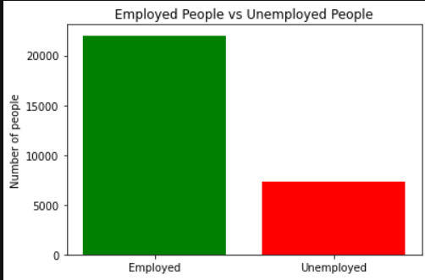
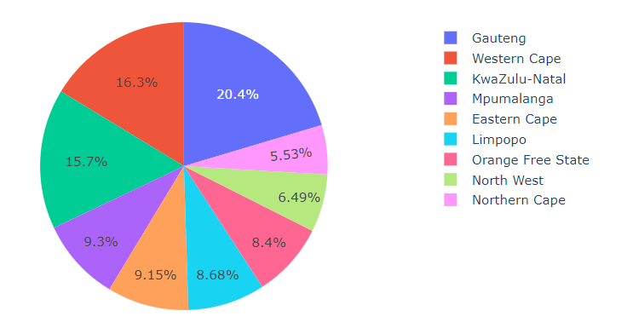
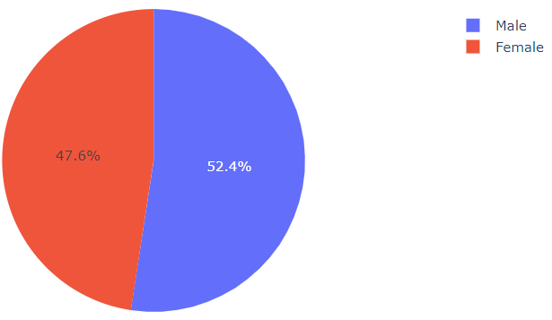
Results from Data analysis
In 2013, 22013 people were employed and 7309 were unemployed
Covid-19 has affected the unemployment rate badly, thousands of people lost their jobs

Slide 4
Why is Forecasting and Reporting really important
Allows businesses and governments to set goals based on predictions
Governments will manage their resources better after analysing the forecasts
Reporting makes the government aware of what’s happening in our country
Let’s walk through the web app ☺

