Slide 1
Solutions to medical service
My Implemention is a pharmacy automation technology strategies and address growth of medical and pharmaceutical costs
assuring that all consumer interactions and outcomes are easy, convenient, timely , streamlined
Delivery system transformation of medicine via partnership and collaborations between healthcare
Reducing costs means lower revenue for providers and
almost all of the players in healthcare

Slide 2
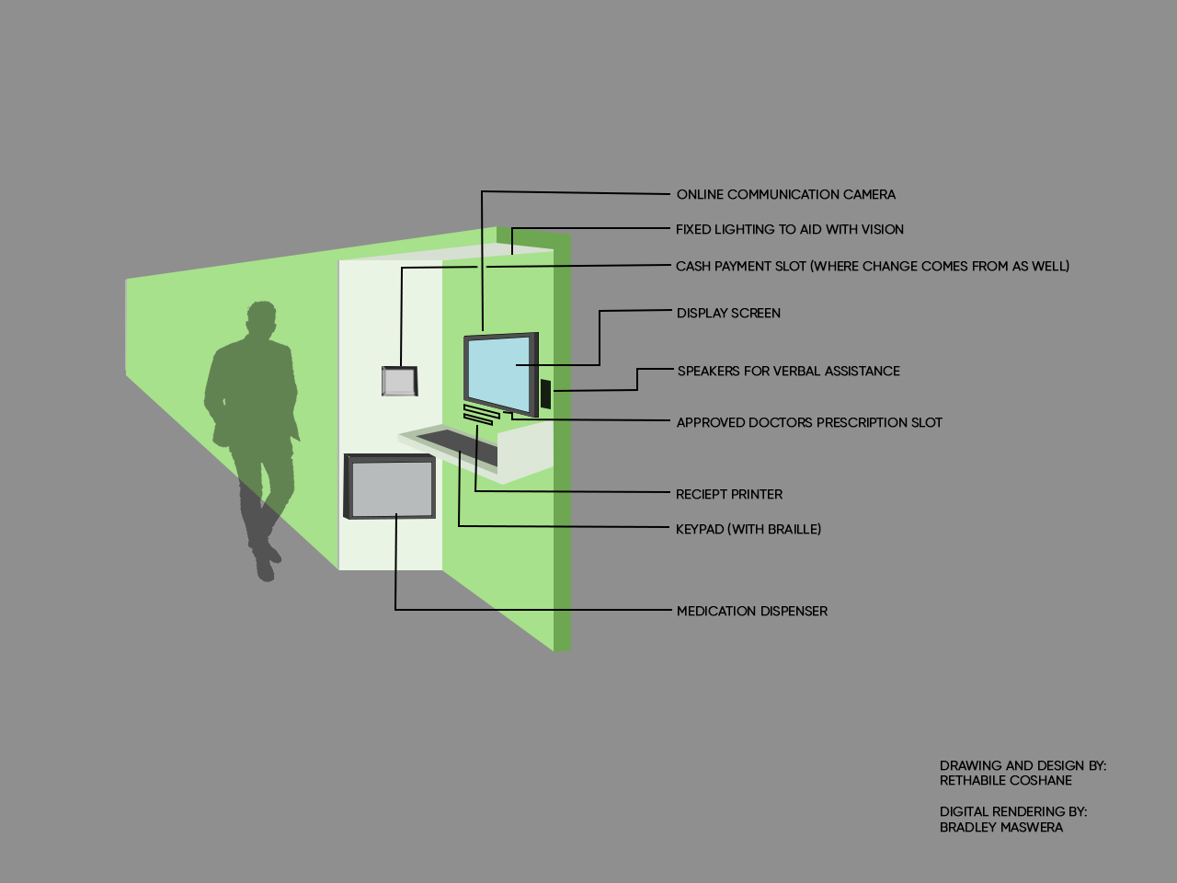

Slide 3
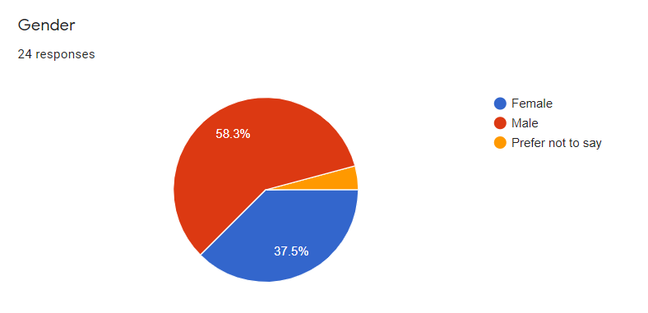
RESULTS OF SURVEY
A total of 116 patients participated in this study.Chi-square test showed that gender, age group, employment status, distance to the health facility and /or average waiting time at the clinic significantly influenced the prefer
preference for certain characteristics of the ATM medicine collection service.
Conclusion: Most participants were interested in collecting their medicine at shopping centre and complex instead of waiting in long queues especially those between 28 and 45 older

Slide 4
To ensure the availability and accessibility of essential drugs to all citizens.
to ensure the safety, efficiency and quality of drugs
! to ensure good dispensing and prescribing practices
! to promote the rational use of drugs by prescribers, dispensers and patients through provision of
the necessary training, education and information
! to promote the concept of individual responsibility for health, preventive care and informed
Whereby the current policy on management of patient waiting time can measure patients waiting time .
A GRAPH SHOWING AN INCREASED NUMBER OF CHRONIC PATIENTS

