Slide 1
Greetings
Name: Thabo Vincent Mhlamvu
Thabo.sifeukzn@gmail.com
0847179732

Slide 2
Platform for growth, empowerment and skills development

Slide 3
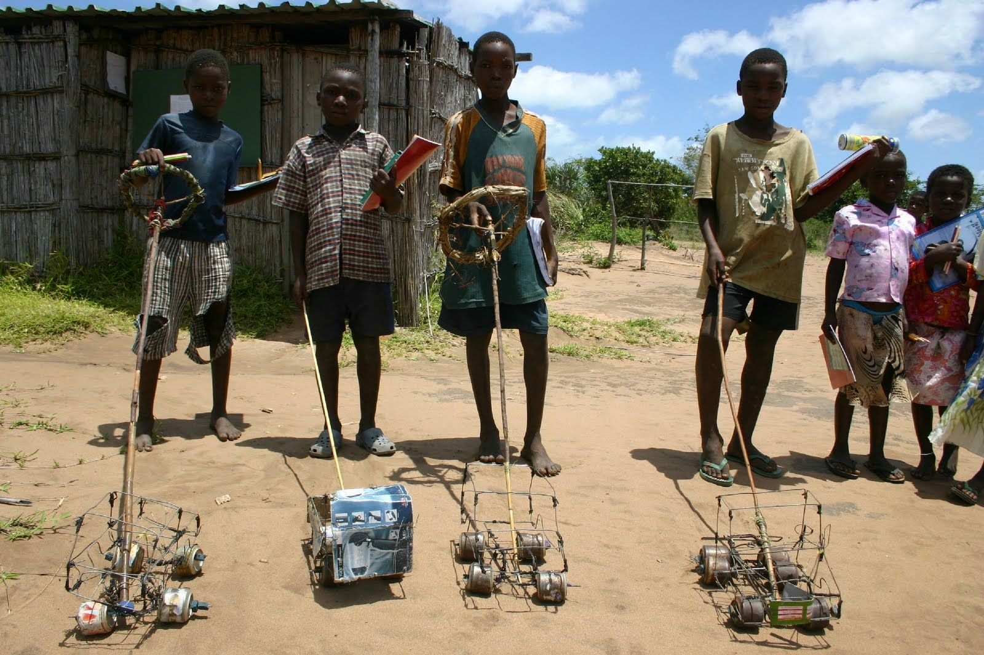
Youth Talent Scheme

Slide 4
Agenda
My story as a Talented being
Youth Talent Scheme conceptualization
Brand association (SASSA and South African post office)

Slide 5
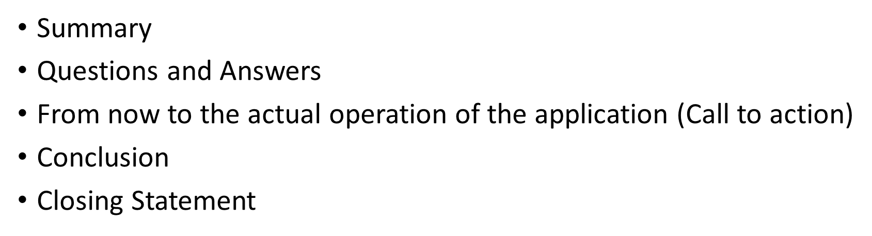

Slide 6
My story as a Talented being
Mina namajida we know why we failed.
( Amajida means …
Only if we grew up in the cities.
Marble Story and uncle story

Slide 7
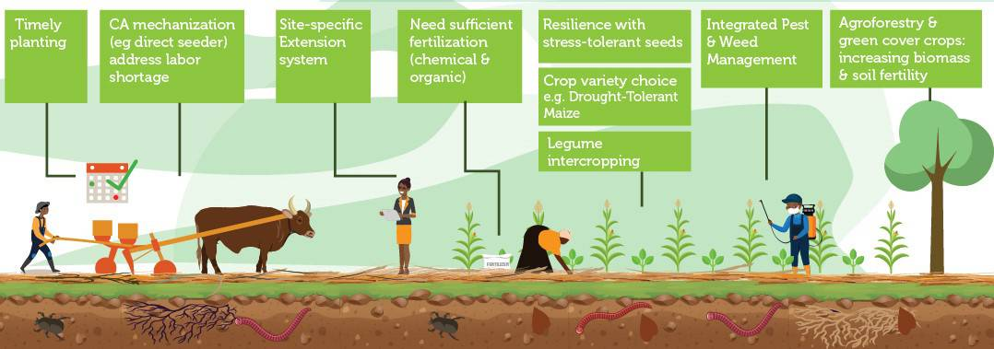
Uncle Story

Slide 8
EThekwini labour force
eThekwini, Labour Force | Jan-Mar 2015 | Apr-Jun 2015 | Jul-Sep 2015 | Oct-Dec 2015 | Jan-Mar 2016 | Apr-Jun 2016 | Jul-Sep 2016 | Oct-Dec 2016 | Jan-Mar 2017 | Apr-Jun 2017 | Jul-Sep 2017 | Oct-Dec 2017 | Jan-Mar 2018 | Apr-Jun 2018 | Jul-Sep 2018 | Oct-Dec 2018 | Jan-Mar 2019 | Apr-Jun 2019 | Jul-Sep 2019 | Oct-Dec 2019 | Jan-Mar 2020 | Apr-Jun 2020 | Jul-Sep 2020 | Oct-Dec 2020
Population 15-64 yrs | 2,344,036 | 2,349,389 | 2,355,030 | 2,360,844 | 2,366,645 | 2,372,467 | 2,378,672 | 2,385,157 | 2,391,639 | 2,398,117 | 2,404,883 | 2,411,793 | 2,418,704 | 2,425,616 | 2,432,592 | 2,439,472 | 2,446,342 | 2,453,202 | 2,459,984 | 2,466,533 | 2,473,099 | 2,479,643 | 2,486,029 | 2,484,436
Labour force | 1,373,204 | 1,317,935 | 1,332,795 | 1,336,238 | 1,358,572 | 1,401,498 | 1,430,303 | 1,484,560 | 1,506,271 | 1,513,868 | 1,508,797 | 1,493,871 | 1,512,722 | 1,514,507 | 1,480,111 | 1,506,749 | 1,506,455 | 1,483,850 | 1,506,905 | 1,505,473 | 1,531,250 | 1,074,113 | 1,232,242 | 1,396,294
Employed | 1,103,827 | 1,100,992 | 1,122,953 | 1,123,674 | 1,101,693 | 1,125,688 | 1,141,153 | 1,157,472 | 1,177,521 | 1,184,119 | 1,156,837 | 1,166,548 | 1,205,063 | 1,222,464 | 1,210,889 | 1,178,706 | 1,159,915 | 1,159,395 | 1,183,416 | 1,190,765 | 1,193,126 | 986,266 | 1,059,198 | 1,108,040
Unemployed | 269,377 | 216,943 | 209,842 | 212,565 | 256,878 | 275,810 | 289,149 | 327,088 | 328,749 | 329,749 | 351,960 | 327,323 | 307,660 | 292,043 | 269,222 | 328,042 | 346,540 | 324,455 | 323,489 | 314,708 | 338,124 | 87,847 | 173,044 | 288,253
Not economically active | 970,832 | 1,031,453 | 1,022,235 | 1,024,605 | 1,008,074 | 970,969 | 948,369 | 900,597 | 885,368 | 884,249 | 896,086 | 917,923 | 905,982 | 911,109 | 952,482 | 932,724 | 939,887 | 969,352 | 953,079 | 961,060 | 941,849 | 1,405,530 | 1,253,787 | 1,088,143
Discouraged work-seekers | 113,899 | 127,393 | 123,889 | 119,294 | 127,055 | 121,839 | 120,371 | 86,059 | 113,672 | 114,873 | 108,483 | 83,579 | 104,850 | 129,764 | 153,141 | 137,029 | 92,271 | 152,278 | 155,075 | 160,139 | 133,927 | 178,924 | 196,353 | 195,830
Other | 856,932 | 904,061 | 898,346 | 905,312 | 881,019 | 849,130 | 827,998 | 814,538 | 771,696 | 769,376 | 787,603 | 834,344 | 801,132 | 781,345 | 799,341 | 795,695 | 847,616 | 817,074 | 798,004 | 800,922 | 807,922 | 1,226,606 | 1,057,433 | 892,313
Unemployment rate % | 19.6 | 16.5 | 15.7 | 15.9 | 18.9 | 19.7 | 20.2 | 22.0 | 21.8 | 21.8 | 23.3 | 21.9 | 20.3 | 19.3 | 18.2 | 21.8 | 23.0 | 21.9 | 21.5 | 20.9 | 22.1 | 8.2 | 14.0 | 20.6
Employed / population ratio (absorption) % | 47.1 | 46.9 | 47.7 | 47.6 | 46.6 | 47.4 | 48.0 | 48.5 | 49.2 | 49.4 | 48.1 | 48.4 | 49.8 | 50.4 | 49.8 | 48.3 | 47.4 | 47.3 | 48.1 | 48.3 | 48.2 | 39.8 | 42.6 | 44.6
Labour force participation rate % | 58.6 | 56.1 | 56.6 | 56.6 | 57.4 | 59.1 | 60.1 | 62.2 | 63.0 | 63.1 | 62.7 | 61.9 | 62.5 | 62.4 | 60.8 | 61.8 | 61.6 | 60.5 | 61.3 | 61.0 | 61.9 | 43.3 | 49.6 | 56.2

Slide 9
Youth Talent scheme conceptualization

Slide 10
Ethekwini Skills development per ward
Drivers Licence | Ward No | Suburb | Skill Sector | Skill Description | Skill Experience Duration | Age | Highest Grade Passed | Informal Training Sector | Informal Training Description | Informal Experience Duration | Qualification
NO | 888 | NOT SPECIFIED | No Skill Sector |  |  | 29 | Grade 12/std 10 | No Informal Training Sector |  |  | No Qualification
NO | 72 | Risecliff, Demat | No Skill Sector |  |  | 57 | Grade 10/std 8 | Other Sectors and Industries | Security | 1 - 3 years | No Qualification
NO | 72 | Risecliff, Demat | No Skill Sector |  |  | 28 | Grade 11/std 9 | Other Sectors and Industries | Home Base Care | NOT SPECIFIED | No Qualification
NO | 76 | Umlazi V | Other Sectors and Industries | Security | 1 - 3 years | 34 | Grade 10/std 8 | No Informal Training Sector |  |  | No Qualification
NO | 72 | Risecliff, Demat | No Skill Sector |  |  | 28 | Grade 11/std 9 | Hotels, Restaurants & Catering | Catering | 1 - 3 years | No Qualification
NO | 82 | Umlazi N & R | No Skill Sector |  |  | 23 | Grade 12/std 10 | Wholesale, Retail Trade | Cashier | 6 months to 1 year | No Qualification
NO | 20 | KwaDabeka | Other Sectors and Industries | Human Skills | 3 - 5 years | 27 | SELECT | Other Sectors and Industries | Counselling | Below 6 months | No Qualification
NO | 79 | Umlazi F & G | No Skill Sector |  |  | 20 | Grade 12/std 10 | No Informal Training Sector |  |  | No Qualification
NO | 72 | Risecliff, Demat | No Skill Sector |  |  | 47 | Below grade 10/std 8 | No Informal Training Sector |  |  | No Qualification
NO | 87 | Umlazi Q | No Skill Sector |  |  | 29 | Grade 12/std 10 | No Informal Training Sector |  |  | No Qualification
NO | 99 | Craigieburn, Umkomaas | Handcraft | Hairdresser | NOT SPECIFIED | 28 | Grade 10/std 8 | No Informal Training Sector |  |  | No Qualification

Slide 11
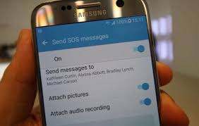
Change or choose Talent once every six months.
The youth Talent Scheme will bridge the gap as the talents integration and allowing young people move from one talent to the other every six months. The trail from the limited but allowed movement will create new businesses not just new businesses but also new industries as Vusi Thembekwayo simple puts it and say when two industries merge the new and better ones are formed.

Slide 12
Economy at Glance by Ethekwini economic development and investment promotion unit states that Africa remains the fastest growing region after East Asia averaging 4.2 % over the last 4 years. This is the data which was released in 2016 meaning this was happening from 2013 to 2016.
There is also a further drop in revenues in resources rich countries. In my view South Africa is there too. We are one of the biggest producers of mineral resources like gold.
Our gold should be our talents now. We have to purify this gold from age eight till age twenty five.

Slide 13
This is the graph showing the Employment per sector and GDP. The only common unseen motivating factor behind the numbers is talent. Can you be in agriculture if your talent to spot the rainy season is as unclear as a tortoise living somewhere in the Kalahari deserts. You need to have had someone sharpening your skill of math to be in mining, for no matter the talent you had in numbers but if there is no platform which tracks your progress and give you designed fun competitions in the form of games while growing up, you might find yourself going all the way to the age of 19 with government knowing your ID number, making sure you are well fed every month in the form of a SASSA grant yet having the very same keeper of your books for when you were born letting you go without knowing where to. Which post office are you going to? I believe each and every South African youth talent could be posted to the South African post office. The post office could take on from where SASSA left from.
Young people must have TALENT identity card after SASSA cards. This will help the post office if the talents are monetized then the post office will grow as the bank. However that will only happen if like SASSA the post office cares for its people. This would be done by hosting talents workshops in every post office during school holidays. However to keep up with the generation of today. I suggest a provincial to nation talent platform. This platform can have the app too, which is where the youth is allowed to change from talent to talent every after six months. The more you see which talent young people are choosing you see what as the government you should start to invest in. like building new grounds if they all want to be soccer players or examining the environment if all want to be soccer stars. In this way you start to see the need for new heroes as Vusi simple put it and say as the young people of today we are not looking for mentors we are looking for heroes. The talent app should therefore have heroes as brand ambassadors of each talent in the app or platform like website to be developed.

Slide 14
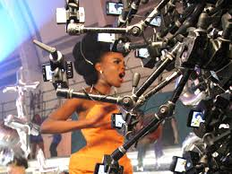
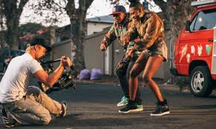

Brand association
Each Talent to have a hero chosen every 12 months.

Slide 15



Summary
8 year olds to 25 year olds register on Talent app.
Post office package and post educational programs for youth.
- Youth have bank accounts with the post office for when their talents get financial remuneration

Slide 16
Questions and Answers

Slide 17




From now to the actual operation of the application (Call to action)
Create Facebook page (Youth Talent Scheme)
Host Youth Talent sign up = R10 000 (prize give away for each most liked talent showcase)
Talent can be : the solved math equation, best sprint run, musical performance, a short poem or story.
R 5000 = Hire a computer science student to create a website for YTS)
TOTAL = R15 000

Slide 18
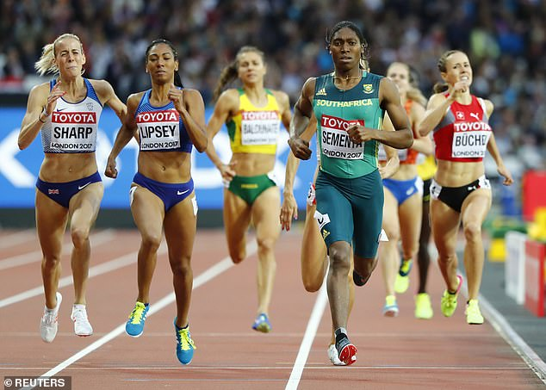
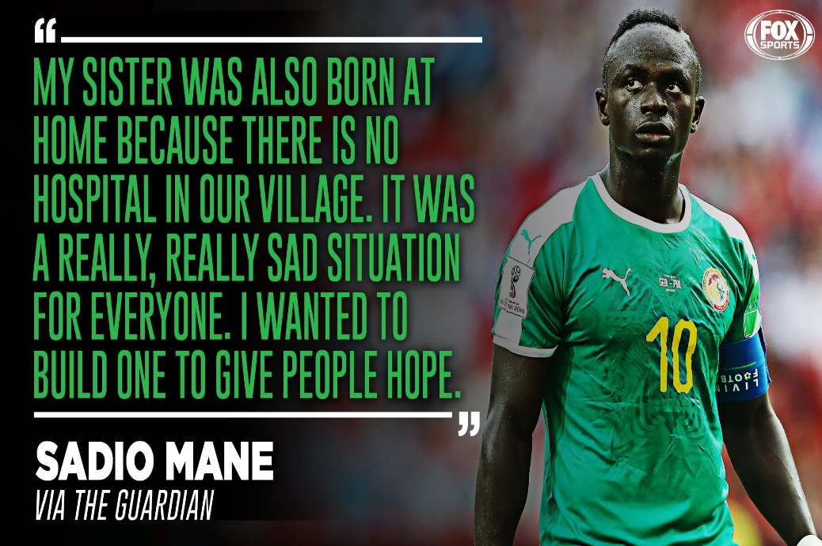
Conclusion

Slide 19
Closing Statement
Talent is revenue… And yes content is king.
That is why we got to know what our prince and princesses truly desire to be… because yes content is Queen.
In the words from Zola 7. He said-
“The struggle never ends, it’s just moves from one generation to the next. Whatever it is today, it is because of the generation before us. Whatever we choose to do or not to do today. The results of that will come in the future but it’s a pity we won’t be there to see what we have done”.
Let us be responsible while we are young for we are the ancestors of someone tomorrow. Let us be that incense that is going to light up and brighten up their future while they are young by helping them see & discover their talents while they are young. Let them not be like me NAMAJIDA.

Slide 20
References
https://edge.durban/dataset/durban-s-economy-at-a-glance

Slide 21
THANK YOU

