Slide 1

Digital Literacy to Promote Economic Growth
Connect to your world to grow the economy.
This Photo by Unknown author is licensed under CC BY-SA.

Slide 2
National Education Policy
The national policy is the policy we would like to contribute an update on after looking at and working with the datasets provided. The South African Schools Act, which is aimed at ensuring learners have access to quality education without the hassle of disadvantages. According to the JET.co.za website, in the State of Nation Address in 2020, President Cyril Ramaphosa highlighted that investing in early childhood solutions and early school will yield in great economic benefits in the next two decades and beyond.

Slide 3
National Education Policy
We would like to help promote economic growth through digital literacy by working with youth who are school leavers mainly while trying to develop fresh minds with younger in-school citizens at their earliest childhood. Which is what will be implemented by 2022 through government ,to teach children from grade R-3, Robotics and Coding.

Slide 4

ENVIROMENTAL SCAN DATASETS COLLECTION
This Photo by Unknown author is licensed under CC BY-SA-NC.

Slide 5
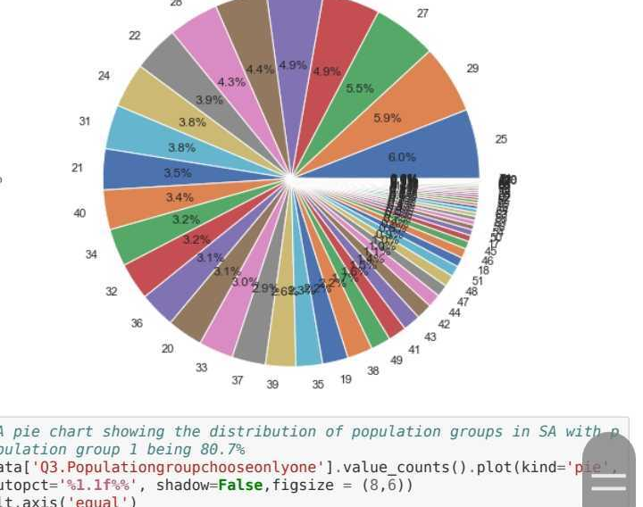
Graph 1
This data was collected between the period of January to April 2019.
A data collection procedure was done in order to understand the current state of digital literacy in South Africa. The age ranged between 19-83. this is a range wherein most citizens have either completed their Basic Education and Training and are off to embark on Higher Education and Training or have already been placed in working environments. If you look at Graph 1, you will see that the age age range of 19-25 with only a 6.0% in Information and Communications Technology. It is not a great number, although the highest. This serves as a disadvantage toward this age group as HET and many if not all workspaces are in use of some technology devices. This simply contradicts our readiness for the Fourth industrial Revolution as a country.

Slide 6
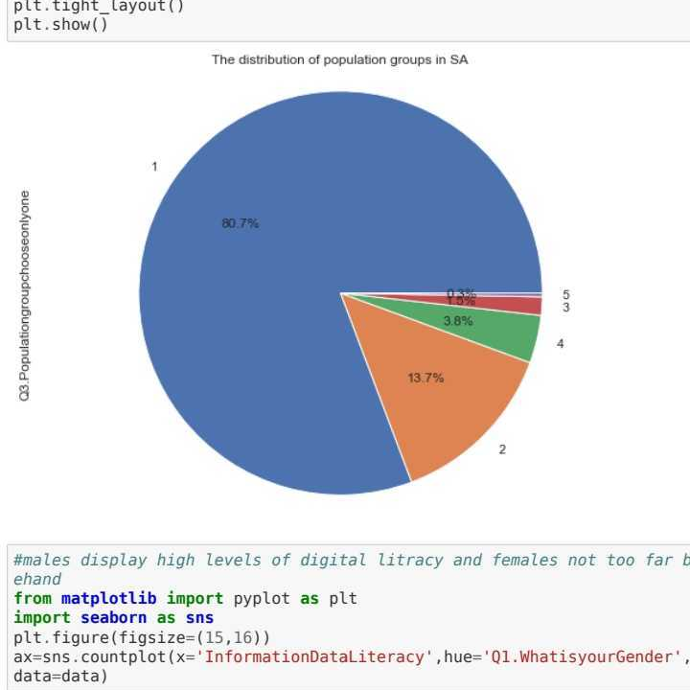
Graph 2
If you look at this graph you will how imbalanced the spread of ICT was/is being implemented from province to province. Urban areas were highly favoured throughout the country except Mpumalanga. Rural areas were/are the least favoured as not a lot of technological development has been done or as much as we hope there would be as looking at graph 3, the dominant population is that of an African child.

Slide 7

Data Preparation
This Photo by Unknown author is licensed under CC BY.

Slide 8
When preparing the data, we went through a series of procedures:
Cleaning the data is the first step.
Step two was to divide the data into structured, semi-structured or unstructured data.
We chose Jupyter as our Integrated Development Environment.
Performed summary stats using Data manipulation.
Pre-Processing data (Import Libraries(panda, numpy), Import Data, Handle missing data, Split data into Training and Testing.)
Use the Result set.

Slide 9

Data Modelling

Slide 10
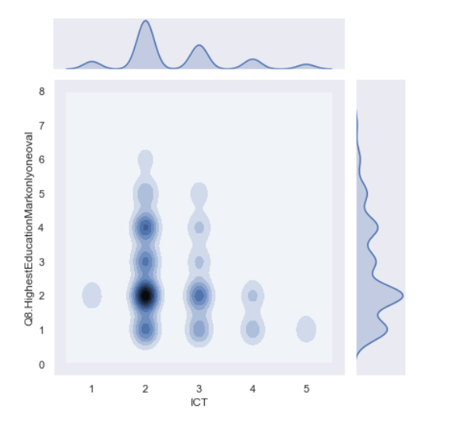
Naïve Bayes Model
Naive Bayes classifiers are built on Bayesian classification methods. These rely on Bayes's theorem, which is an equation describing the relationship of conditional probabilities of statistical quantities. In Bayesian classification, we're interested in finding the probability of a label given some observed features, which we can write as P(L | features)P(L | features). Bayes's theorem tells us how to express this in terms of quantities we can compute more directly:

Slide 11

Lack of Digital Literacy affects the economy.
This Photo by Unknown author is licensed under CC BY-SA-NC.

Slide 12
The lack of digital literacy is detrimental to our economy in the sense that parts of the businesses that make up our country's economy are not operating to their full potential. For example Banks and the Goods market have transitioned to a digital space. Looking at these datasets it is quite clear that there are factors that out of the South African citizens' control. For instance, lack of internet resources such as limited budget on data spend, type of device, lack of digital resources in or around their communities, especially in rural areas.​ The target market is low because of skepticism due security reason and no education about how safter these platforms are compared to previous methods of transacting with money.

Slide 13

SOLUTION

Slide 14
Project X
By 2030, the government aims to have completed the execution of the National Development Plan. We aim to execute this solution within this timeframe. Our is not a solution to the entire problem but rather is basically serves as a gateway as education is such a vast problem that cannot be solved using one problem. Digital inclusion is the new and soon to be dominant space. We want to develop a learning space that teaches you enough skills at Basic education level so that by the time they leave school ,they can find jobs as they will have the necessary. This will achieved by making the learning space pre-available by working with mobile phone makers. We want to create a platform for school-leavers to teach them premium skills that can s\help the pursaue their dreams free of charge. Gather resources from international accredited environments like Harvard or MIT TO PREPARE THEM INTERNATIONAL ROLES like Remote work.

