Slide 1
Are we building an inclusive economy?
Miss LSN Gule
Notes:
empowering the poor to create their own wealth not through picking crumbs from the rich as labor

Slide 2
Background
Provincial Priorities (State of the Province Address 2019)
Towards the quest of achieving the Provincial 2035 Vision developed in 2000:
By 2030, eThekwini will enjoy the reputation of being Africa’s most caring and liveable City, where all citizens live in harmony”
citizens live in harmony
The following achievements and priorities were highlighted:
Build an Inclusive Economy that Creates Decent Jobs
Transform Rural Areas
Build a United Nation and Promote Social Cohesion
Notes:
The Municipal Vision
“By 2030, eThekwini will enjoy the reputation of being Africa’s most caring and liveable City, where all
citizens live in harmony.”
The Municipal Vision was developed in 2000 through the development of the Long Term
Development Framework. The Vision provides the city with a single strategic statement which all line
departments should be working towards. The vision is developed along the principles of Outcome
Based Planning and is aligned to the visions of the National Planning Vision as well as the KZN
Provincial Growth and Development Strategy.

Slide 3
Build an Inclusive Economy that Creates Decent Jobs
Focusing on key sectors such as agriculture; manufacturing; tourism; freight and logistics sectors
for the purpose of growing the economy and creating decent jobs.
Promoting entrepreneurship through SMME and Cooperative Development Programs towards
achieving Radical Economic Transformation. Entrepreneurs will be assisted through a new
initiative identified as the Kwa Zulu Natal Bulk Buying and Warehousing Program.
Promoting Black Industrialists through the Black Industrialist Program.
Promoting the ‘Blue’ and ‘Green’ Economy through commercializing the aquaculture sector and
encouraging renewable energy initiatives within the province.

Slide 4
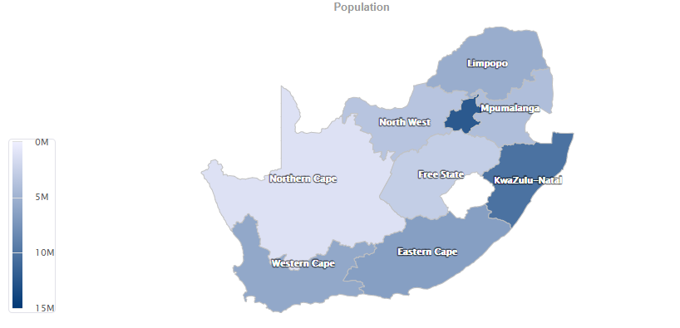
Source: Stats SA

Slide 5
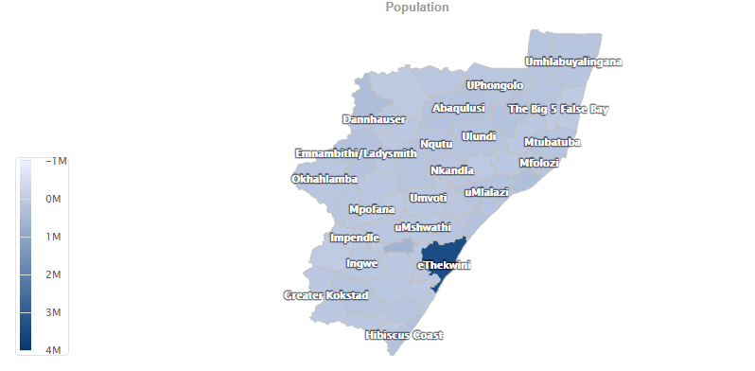
Source: Stats SA

Slide 6
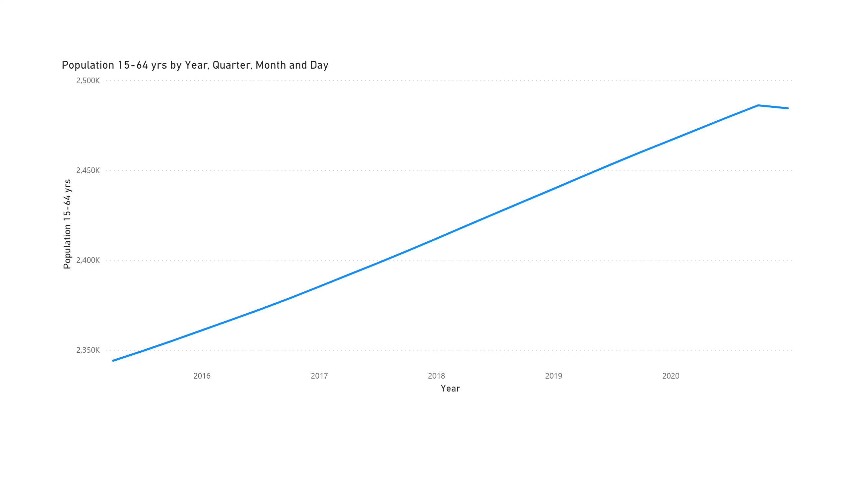
population
Notes:
lineChart
No alt text provided.

Slide 7
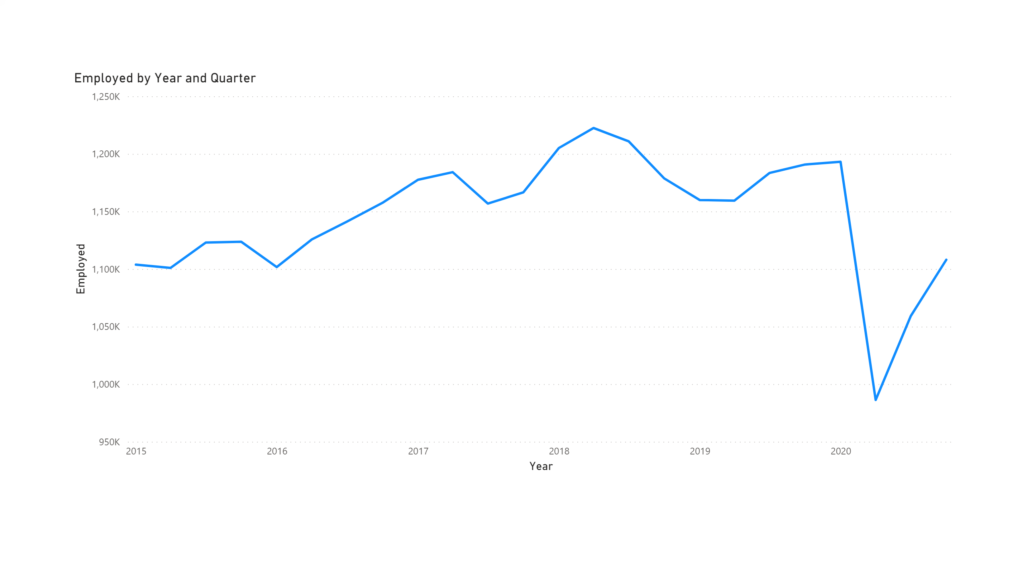
employed
Notes:
lineChart
No alt text provided.

Slide 9
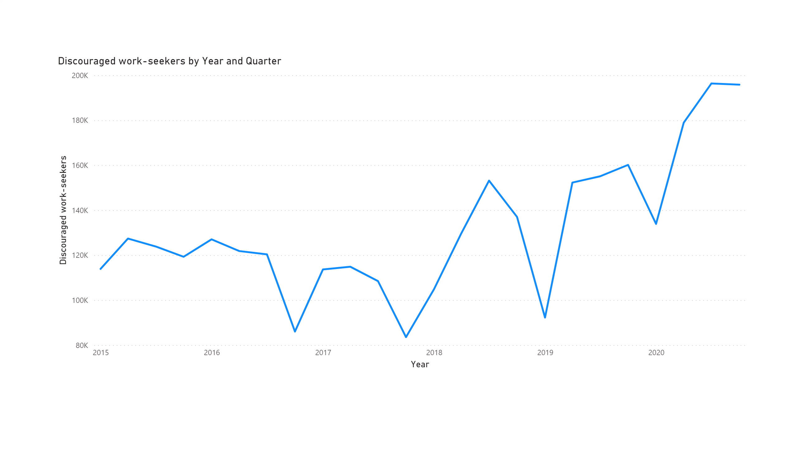
unemployment
Notes:
lineChart
No alt text provided.

Slide 10
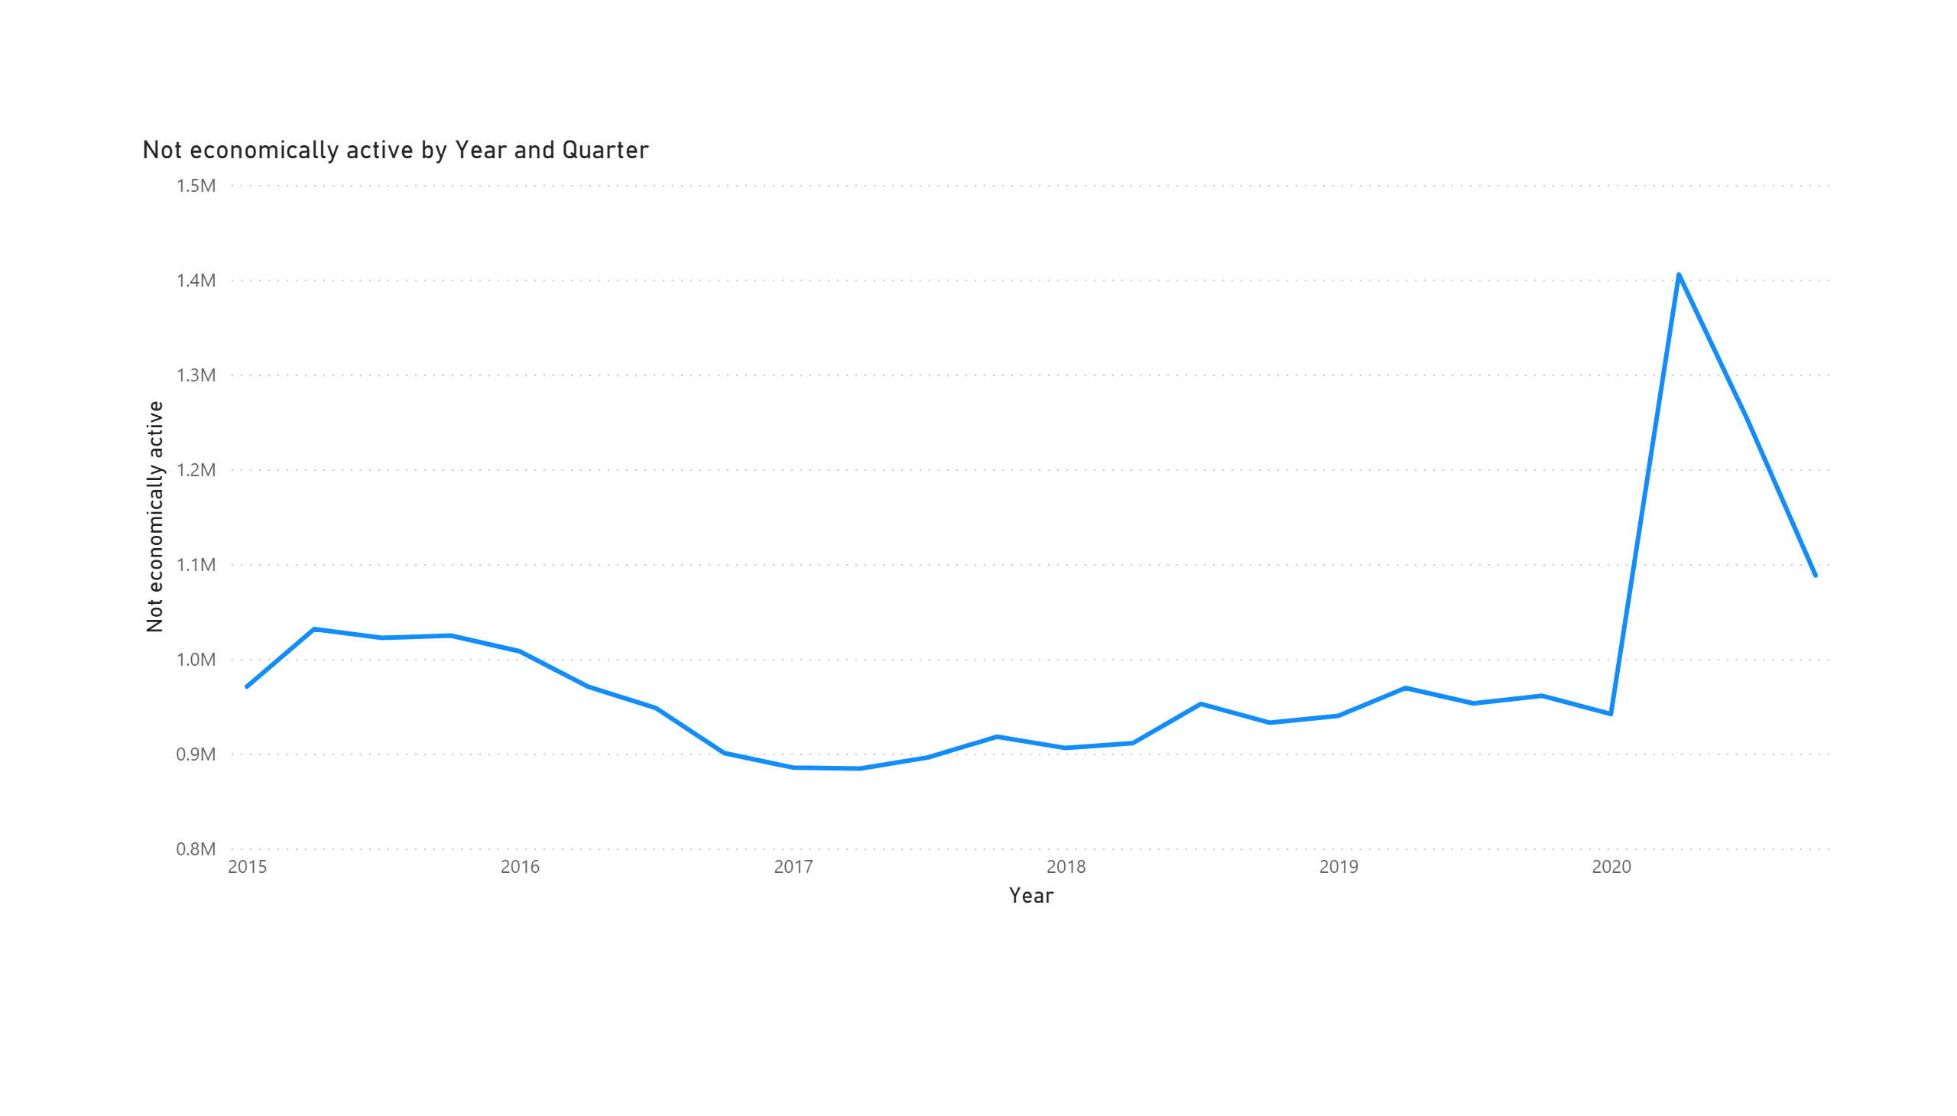
not economically active
Notes:
Economically inactive people are simply those who are neither employed nor unemployed; they're not in paid work, but they're also not looking for a job or available to start work. You might be economically inactive for a number of reasons, such as being retired, a student or too ill to work.

Slide 13
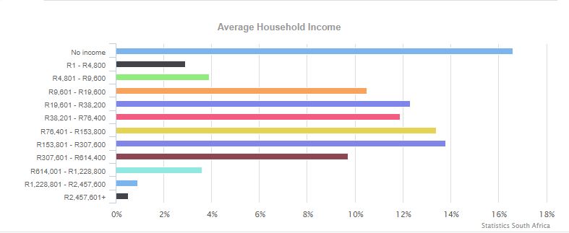
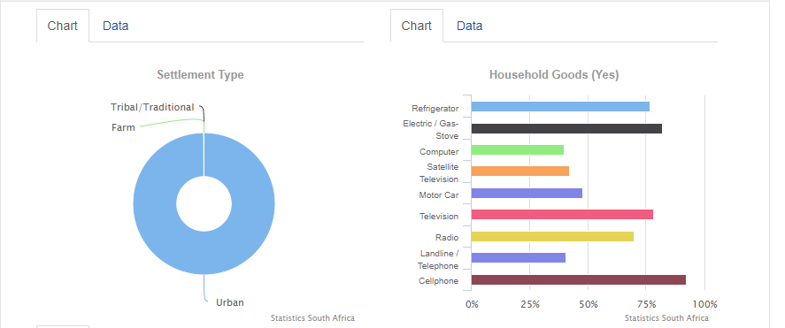
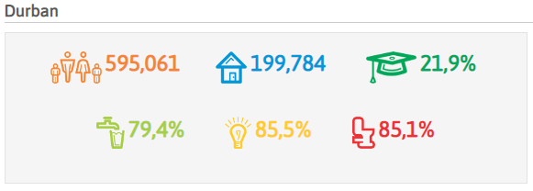

Slide 14
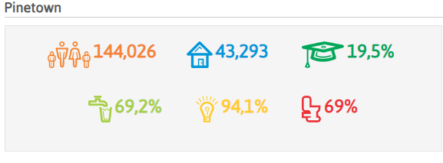
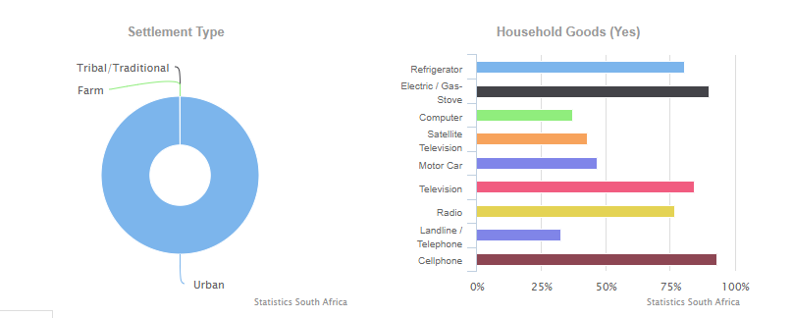
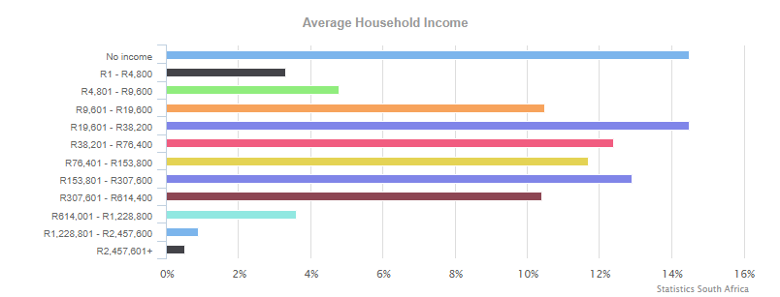

Slide 15
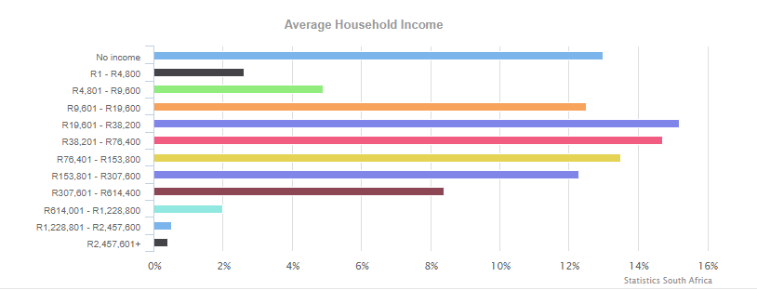
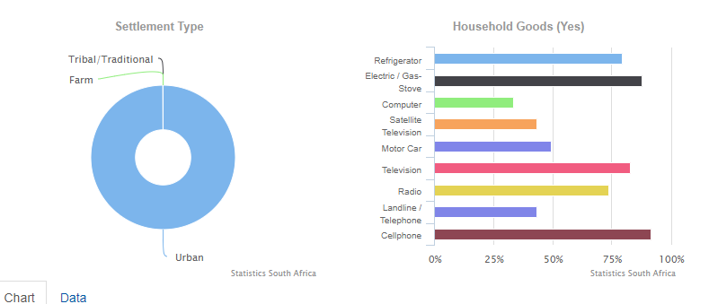
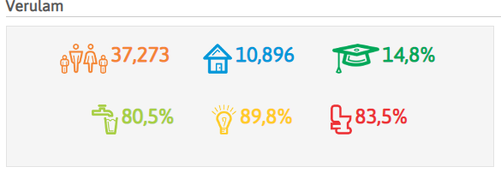

Slide 16
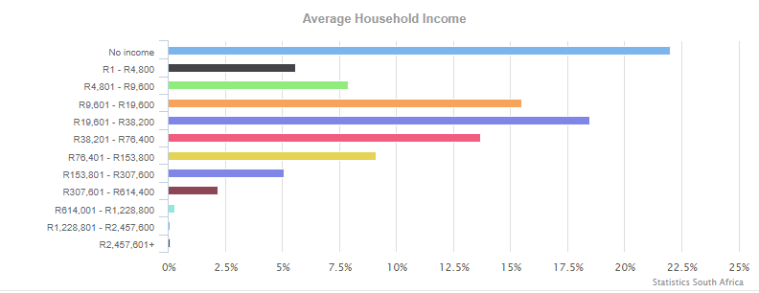
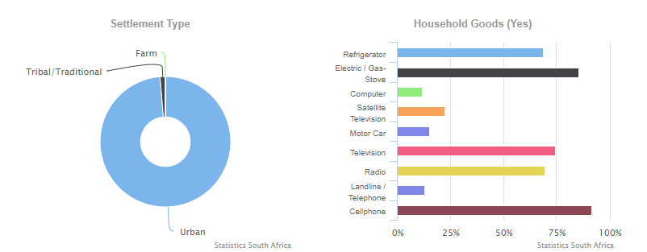
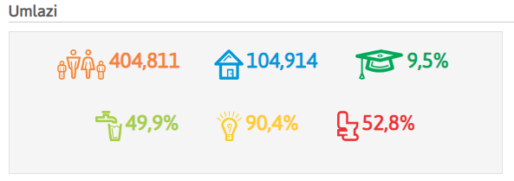

Slide 17
Solutions?
Prioritize the vulnerable and poor communities when it comes to funding and programs related to entrepreneurship.
Revise and re-analyze current policies as they are not really helping us reach the goal.
Data of how many people applied for the relief fund is not available, still if a limited number of people applied for the fund, it means there is not enough information and support offered to the people in vulnerable areas.
Introduce a more convenient way to apply for funds, the proof of residence, Copy of ID and all the works is just tacky and inconvenient.
Teach the old and illiterate in their mother tongue about the digital world.

Slide 18
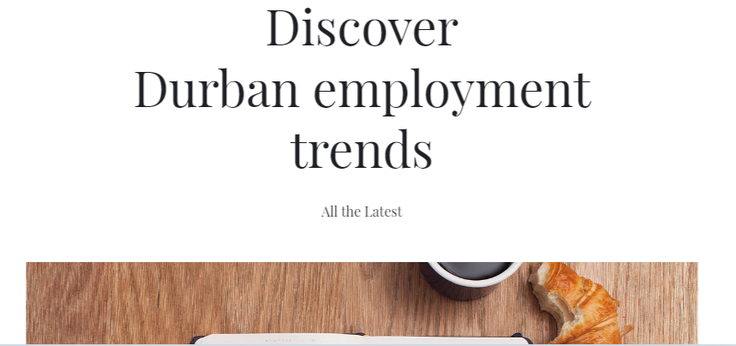

Slide 19


Slide 20
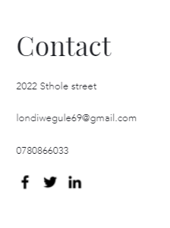

Slide 21
Software used
R (rstudio) used to run and analyze the data
Power BI and Excel to visualize

Slide 22
Any Questions?

