Slide 1



PROVIDE ACCURATE & RELIABLE BILLING SYSTEM FOR WATER USAGE.
PREMISE: TO MAKE SURE WATER READINGS ARE COLLECTED IN FAIR A AND ACCURATE MANNER
FUTURE WATER CONSUMPTION PREDICTED USING ANG (ARTIFICIAL NEURAL GENIUS)
ACCESS TO WATER TO CLEAN DRINKING WATER & RELATED SERVICES
TO ENSURE REVENUE GENERATION FOR FUTURE WATER INFRASTRUCTURAL PROJECTS
By GreenSalad: Gorden Radebe, Brian Gondo

Slide 2
DEFINED POLICY OBJECTIVE
HYPOTHESIS:
ACCESS TO WATER TO CLEAN DRINKING WATER & RELATED SERVICES FOR ALL CITIZENS
TESTING PARAMETER:
Everyone has the right to have access to sufficient water. (Bill of Rights, Constitution of South Africa, Section 27 (1) (b) )
Water conservation may be a better investment than new dams. We will have to adopt such new approaches to water management (White Paper on a National Water Policy For South Africa, April 1997)

Slide 3
DATA DESCRIPTION : SOURCE NEMISA HACKATHON DATASET
Date Set 1
Name | General household Survey-2019
Size | 20908 rows x 315 columns
Description | Across Provinces
Date Set 2
Name | cs-2016-household.sav
Size | 984627 rows x 138 columns

Slide 4
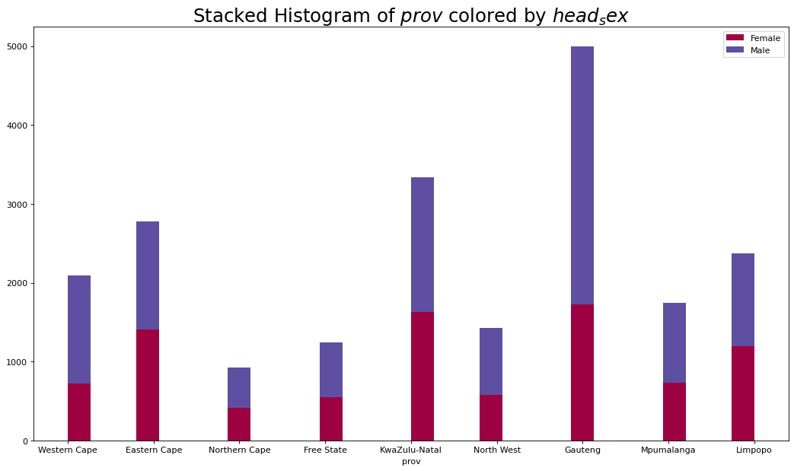
DATA DESCRIPTION : DATA SPREAD

Slide 5
HOW THE DATA WAS PREPARED
GOOGLE COLAB
PYTHON & PYTHON LIBRARIES (PANDAS)
NO DATA MANIPULATION CONDUCTED
QUANTITATIVE DATA ANALYSIS

Slide 6
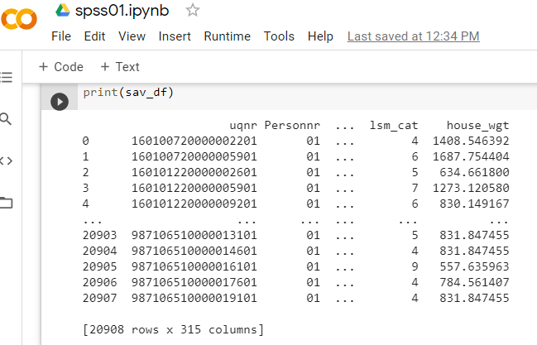
THE COMPLEXITY OF DATA MODELLING TECHNIQUES
DATASET 1

Slide 7
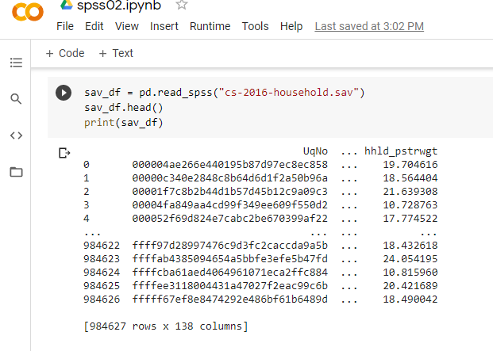
THE COMPLEXITY OF DATA MODELLING TECHNIQUES
DATASET 2

Slide 8
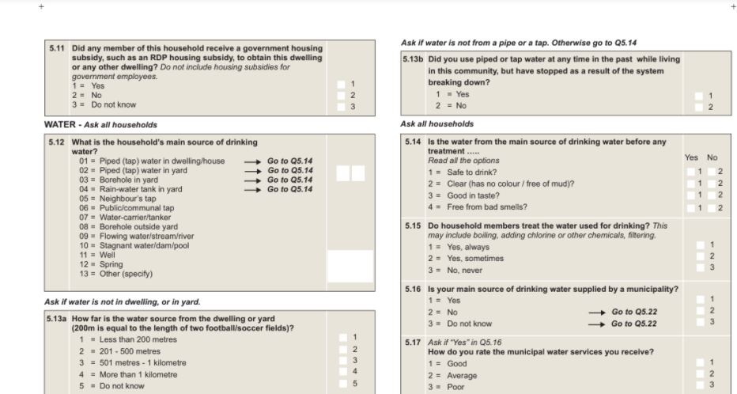
THE COMPLEXITY OF DATA MODELLING TECHNIQUES
SAMPLE: SURVEY QUESTIONAIRE USED

Slide 9
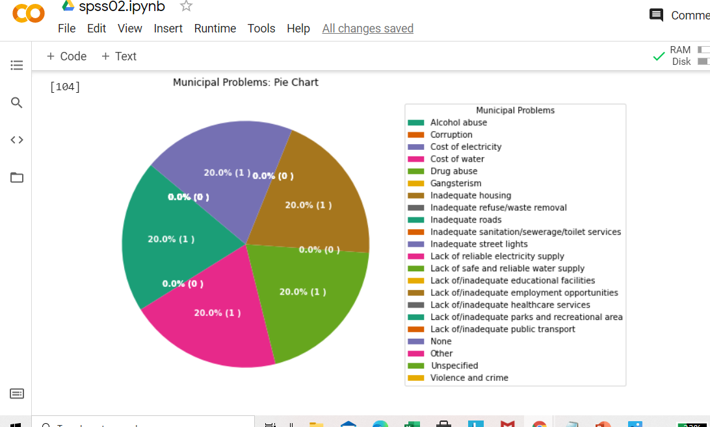
THE COMPLEXITY OF DATA MODELLING TECHNIQUES
PROBLEM IDENTIFICATION QUESTION

Slide 10
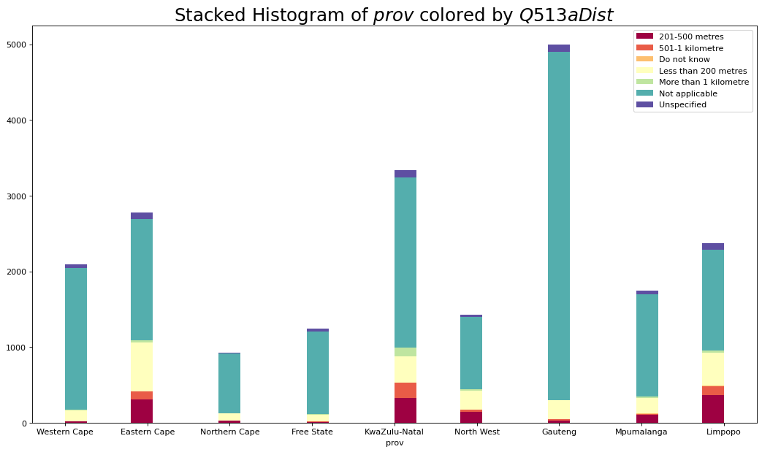
RESULTS TO SUPPORT THE POLICY OBJECTIVE
FURTHER INVESTIGATION: DISTANCE TO WATER SOURCE

Slide 11
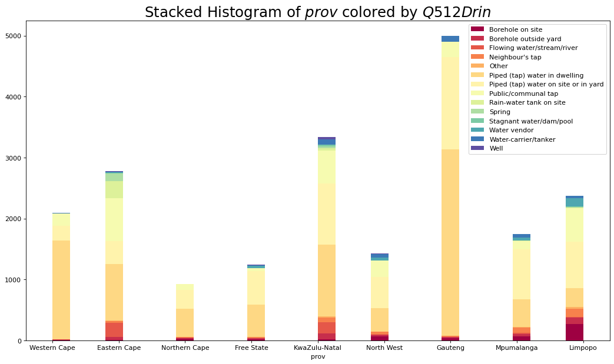
RESULTS TO SUPPORT THE POLICY OBJECTIVE
FURTHER INVESTIGATION: TYPE OF WATER SOURCE

Slide 12
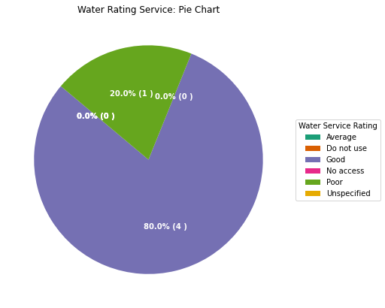
RESULTS TO SUPPORT THE POLICY OBJECTIVE
FURTHER INVESTIGATION: RATING OF WATER SOURCE

Slide 13
CONNECTING WITH OTHER DATASETS
TO SOLVE THE PROBLEM WE PROPOSE A WATER READER THAT USES ML TO RECOGNIZE IMAGES (OPTICAL IMAGE RECOGNITION)
USED A PRE-TRAINED MICROSOFT OCR SOLUTION ( COCO DATASET)
DATA COLLECTION METER IMAGES

Slide 14
CONNECTING WITH OTHER DATASETS
WATER ESTIMATION ( PREDICT FUTURE REVENUE & CONSUMPTION) - ANN (PROBLEM)
PROF. MARWALA ET.AL IN HIS PAPER 2008, PROPOSED USING AN ANN (VS SVM) DRIVEN SOLUTION FOR WATER PREDICTION IN THE SOUTH AFRICAN CONTEXT
MARWALA ET.AL FORMULATED AN ANG (ARTIFICIAL NEURAL GENIUS) MODEL FOR WATER PREDICTION, WHOSE EFFICACY IS SHOWN IN THE GRAPH BELOW:

Slide 15
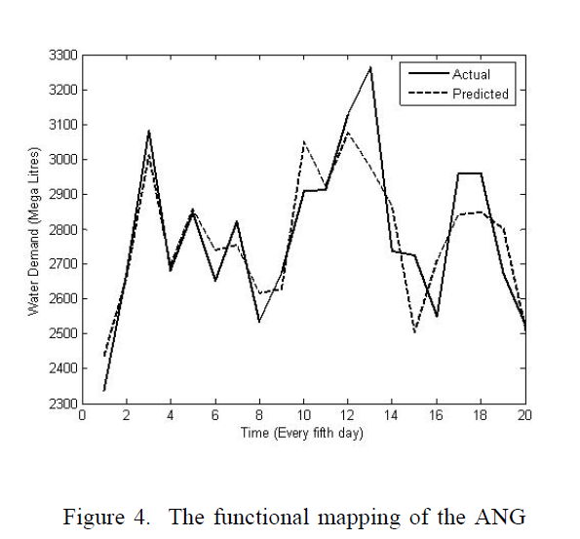
CONNECTING WITH OTHER DATASETS
FEED FORWARD OUR DATA INTO THIS MODEL

Slide 16
CONNECTING WITH OTHER DATASETS
TO IMPROVE THE CURRENT (DEMO) MODEL FURTHER WE PROPOSE THE FOLLOWING ML TRAINING APPROACHES FOR OUR PROJECT:
LOW LYING FRUIT:
1. ALAN PAED (SA) – A MICROSOFT MENTOR HAS DEVELOPED AN ODOMETER RECOGNITION SYSTEM (OCR). USING TRANSFER LEARNING WE CAN PIGGY BACK ON THIS SOLUTION.
2. TRAIN OUR OWN MODEL – CONDUCT OUR OWN DATA COLLECTION AND AUGMENTATION

Slide 17
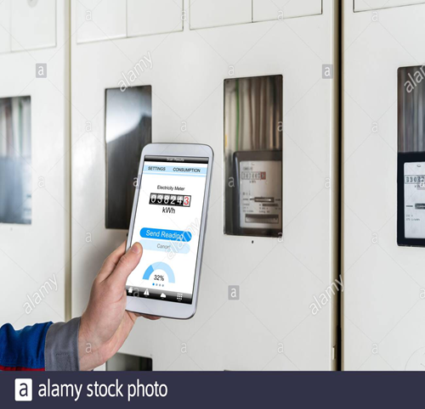
COMPLETENESS OF THE SOLUTION: LAST MILE
mClick app…Prof. Lumumba “Let your deeds speak for you”

