Slide 1
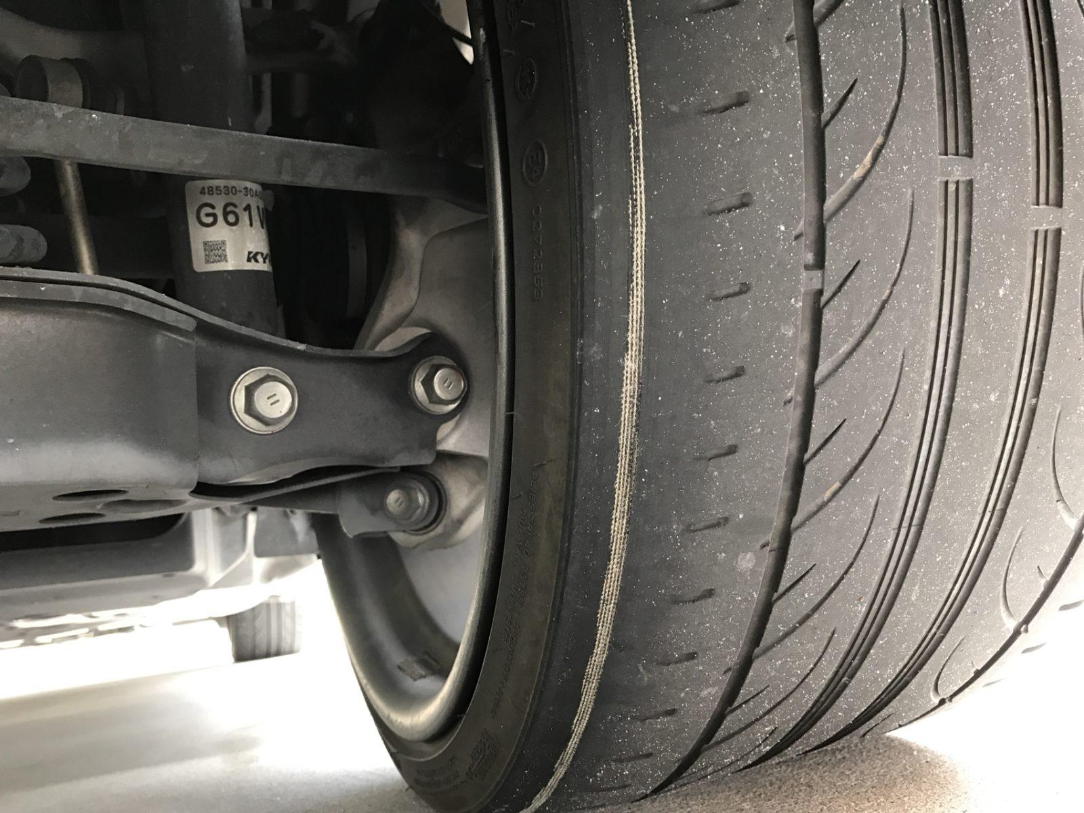

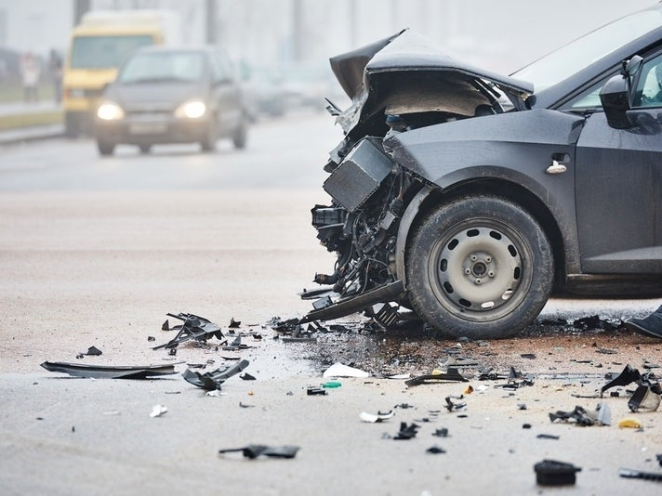
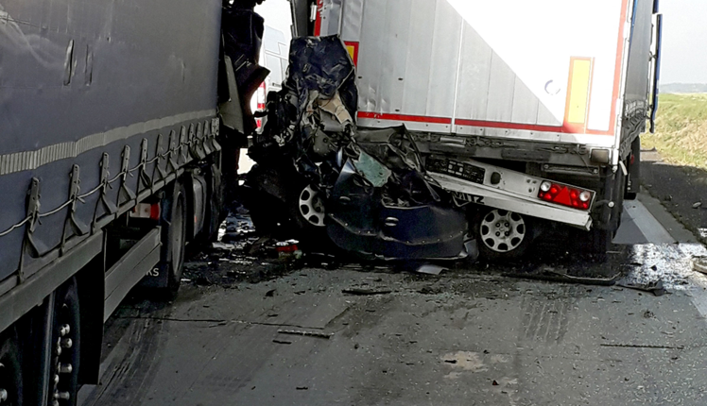
Smart Traffic Management System
PROBLEM STATEMENT
THE 2018 RTMC REPORT INDICATED 9.39% OF NON ROAD WORTHY VEHICLES (Smooth Tyre).which result in causing 60.6% OF FATAL ACCIDENTS IN SA per year.
Road Accident Fund is currently facing Financial Crises

Slide 2
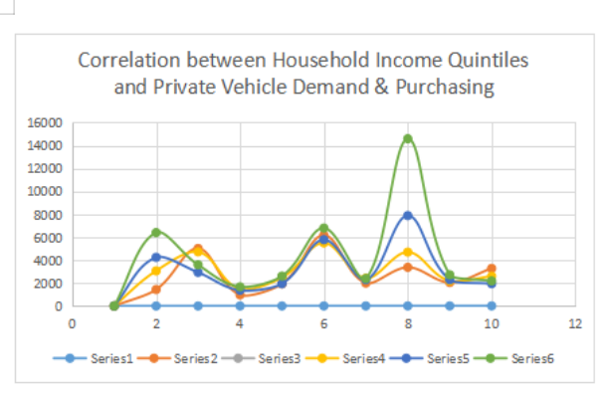
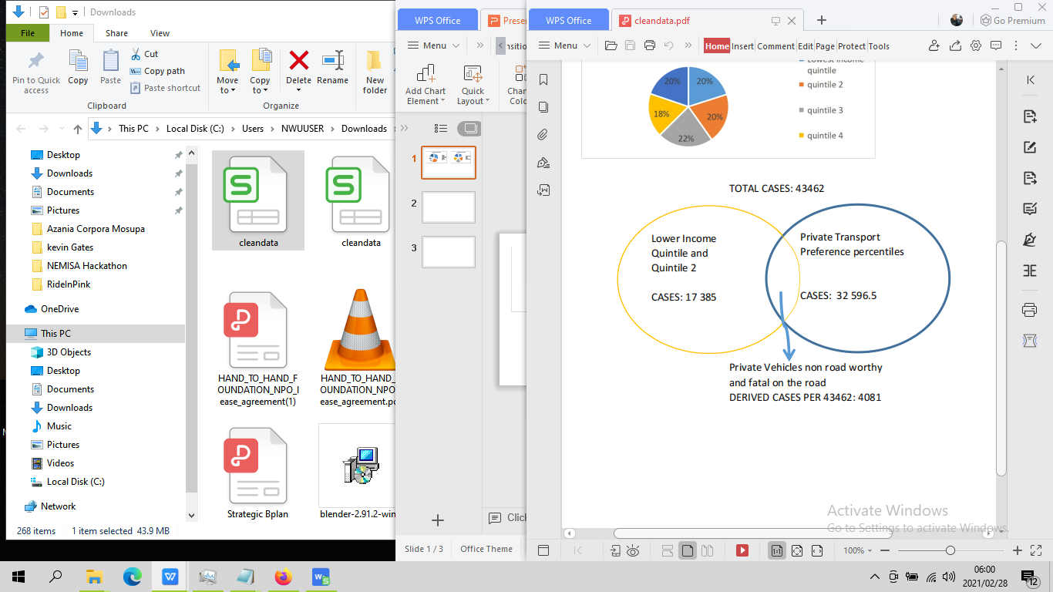
DATA ANALYSIS
The scatter graph is showing a negative correlation between household Income Quintiles and Vehicle Demand alarmingly validates that the less fortunate are buying non road worthy vehicles at a high degree
Choice of Mode of Transport per province

Slide 3
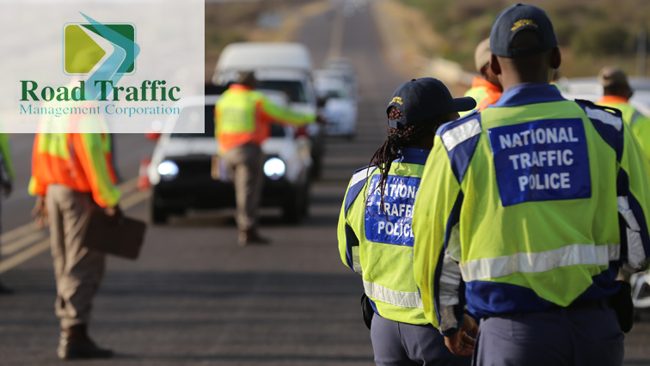

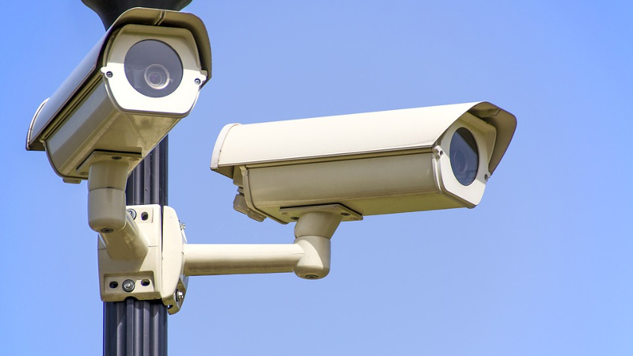

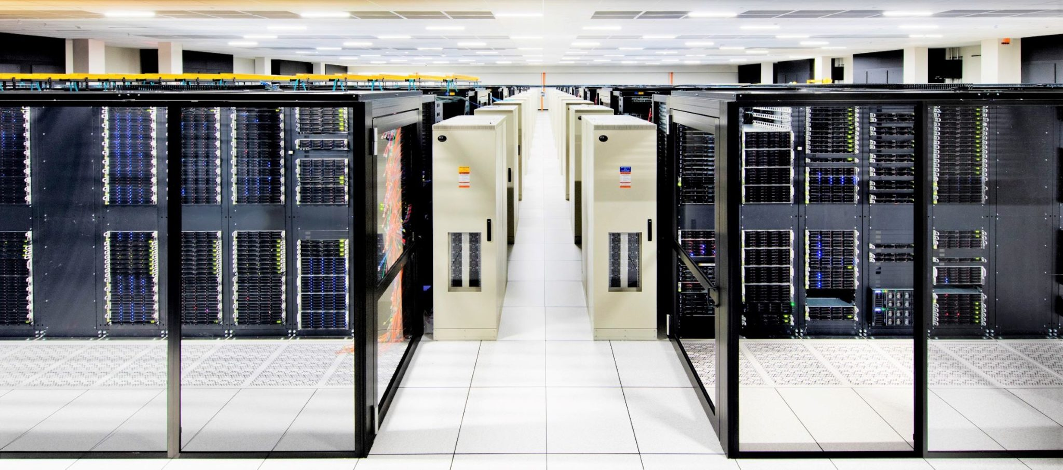
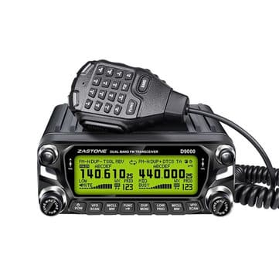

Solution: Our Smart Traffic Systems Architecture
Policy/Regulation and Source
-RTMC( section 54 summons)
-Dept of Justice (s 55(2)(a) criminal procedure
-Dept of Transport, Roads
And Community safety( Drivers License facial recognition)
-In compliance with National Road Traffic Act, 93 0f 1996 Traffic Control Device
Camera Collects Tyre threats, vehicle plate number and driver facial feature in real time ORT
Our call center feeds the Traffic officers to enforce the law

Slide 4

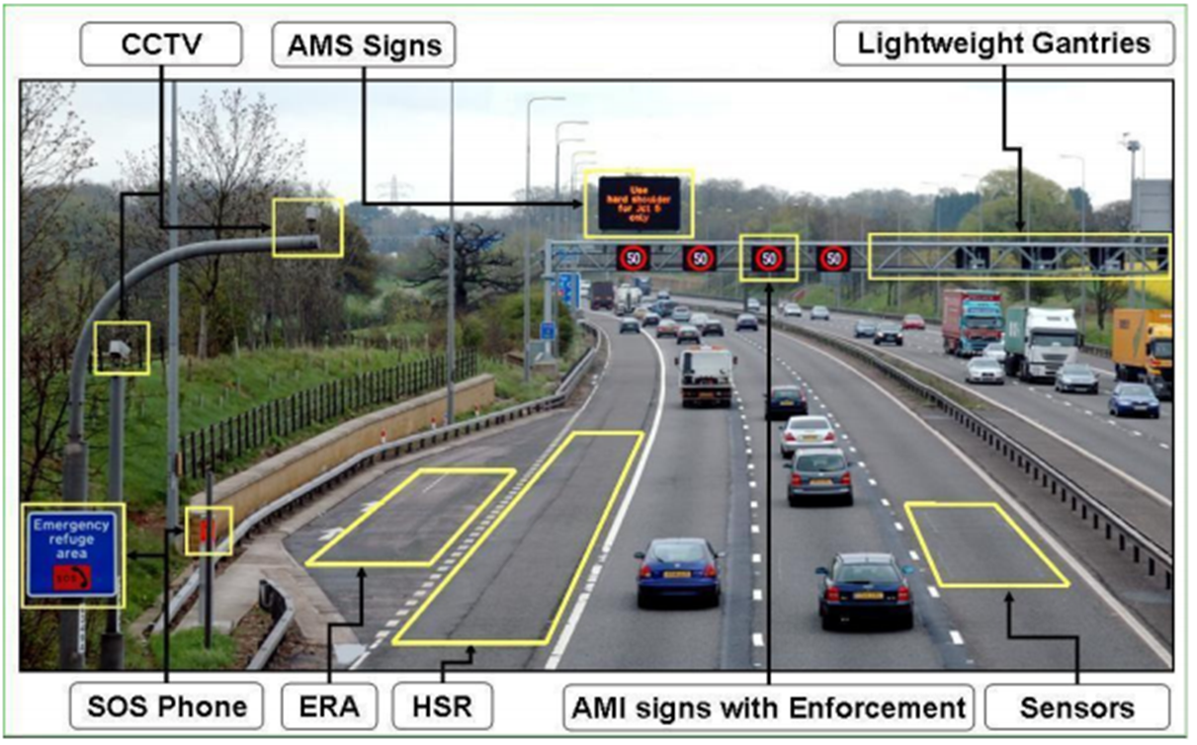
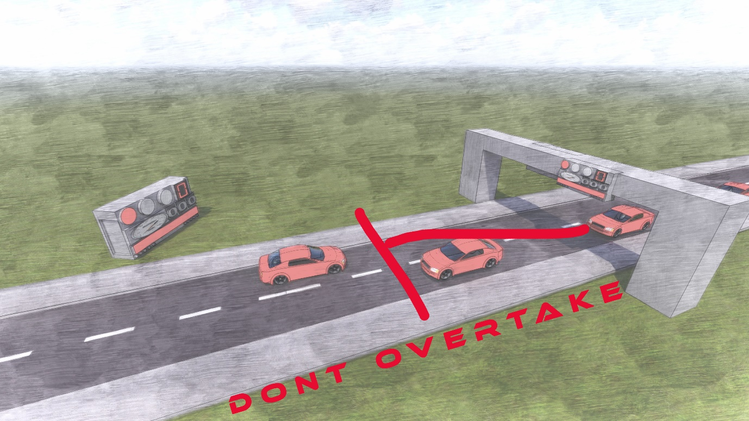
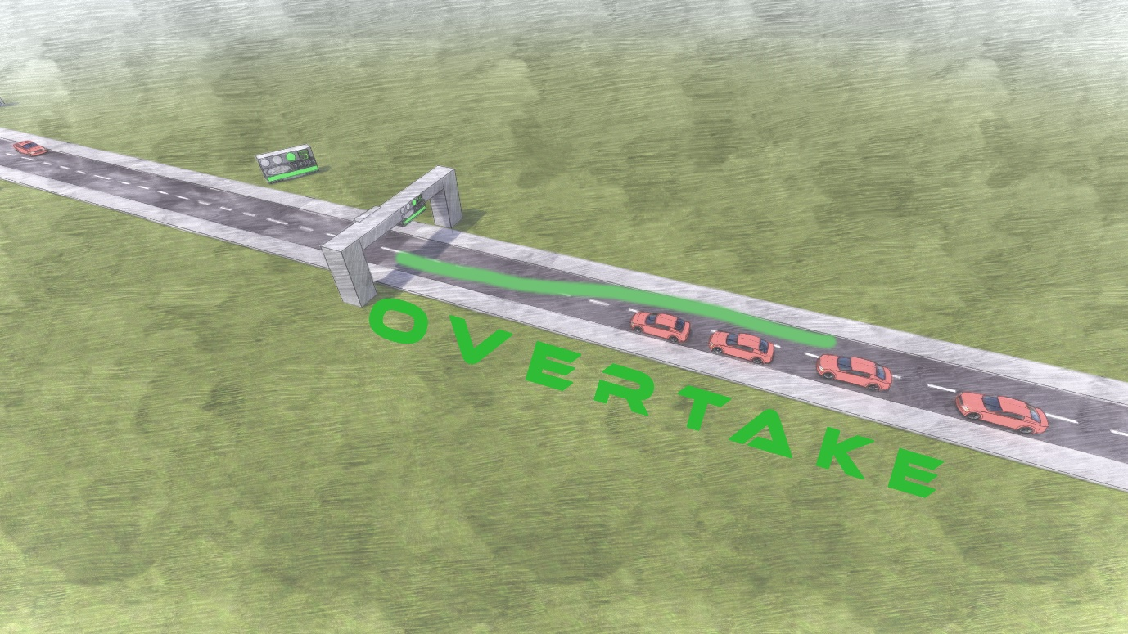
Prototype Solution
Revenue Stream from Clients
1.Insurance Companies (Santam, Sanlam)
2.Road accident Fund
3.Legal Practice firms
4.Actuarial Analyst
Non Road Worthy Vehicle Tyre Detecting Droid
Projected Future Revenue per year R4Billion
At full scale production
Patent Rights and Copy Rights
France Monaco (similar)

