Slide 1
My Environment Monitor
By Team Butter Hackers

Slide 2
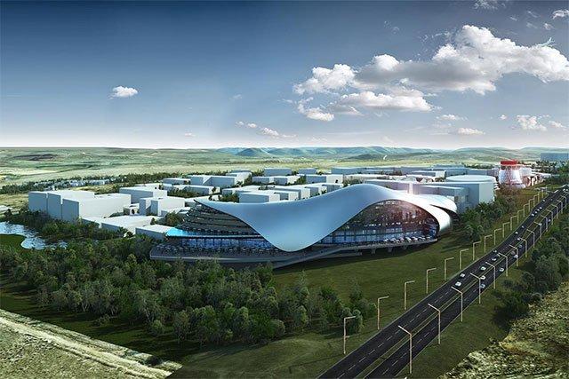
BUILDING A SMART CITY
Lanseria Airport City

Slide 3
BUILDING A SMART CITY
A smart city is a technology-intensive urban area that integrates Information and Communication Technology (ICT) into the city’s governance and management system. It ensures transparent, secure, and efficient public services. A smart city is connected by a self-reliant network of Internet of Things (IoT) to collect, process, and analyze data.
Concepts:
Availability
Accessibility
Affordability
Accountability

Slide 4
BUILDING A SMART CITY
Some of the core elements:
Clean and Smart Energy
Smart Technology
Sustainable Environment
Clean and breathable air
Sustainable Infrastructure
Smart mobility
Robust connectivity and digitization
Good governance

Slide 5
BUILDING A SMART CITY
Some of the core elements:
Clean and Smart Energy
Smart Technology
Sustainable Environment
Clean and breathable air
Sustainable Infrastructure
Smart mobility
Robust connectivity and digitization
Good governance
1
2

Slide 6
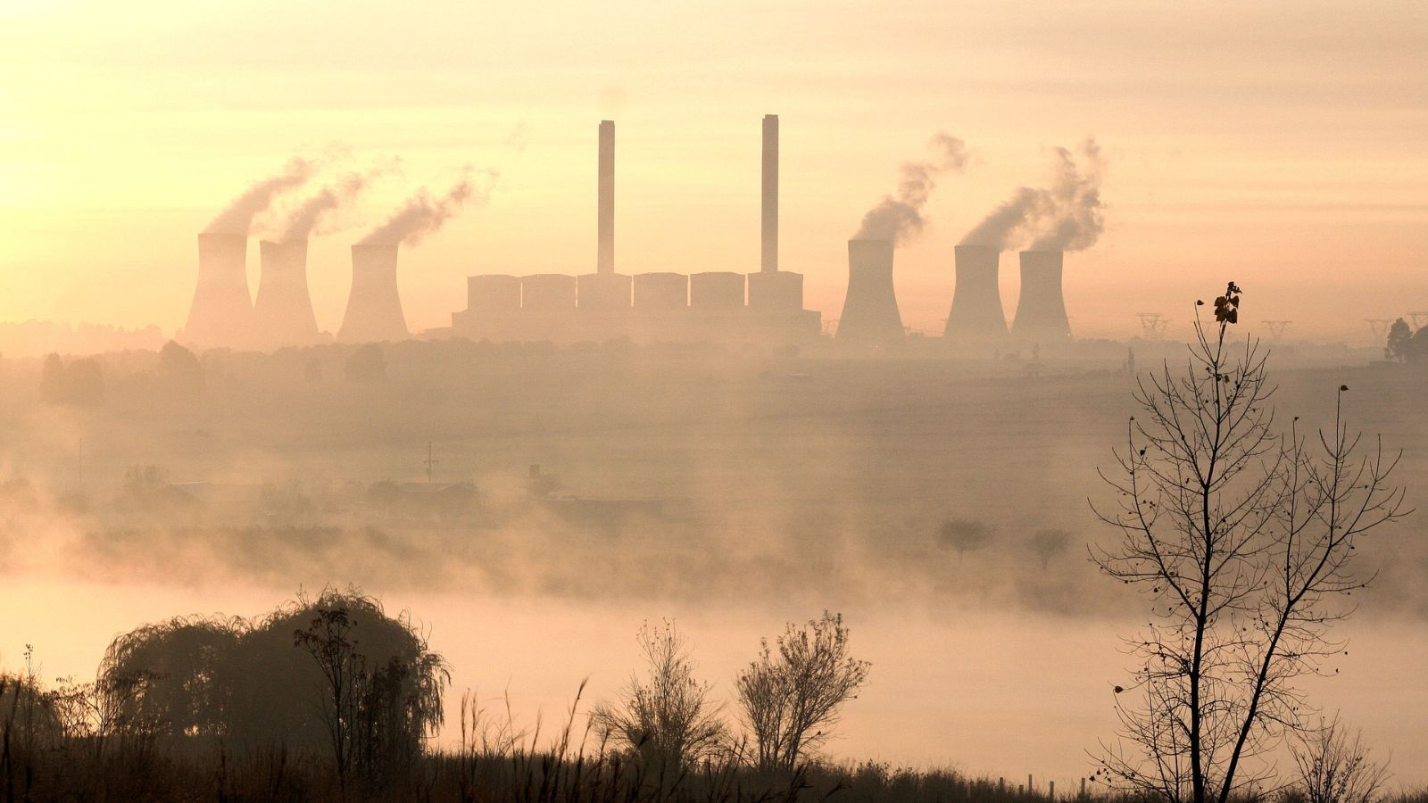
BUT...
Being able to breathe clean air that's free from pollutants such as NO2 and SO2 is but a dream for most Mpumalanga residents primarily due to the mining, power generation and petrochemical industries particular those living in close proximity to these sites...
Eskom - Tutuka Power Station

Slide 7
HOW DO WE MOVE TO SMART CITY LIVING IN MPUMALANGA REGION?

Slide 8
PROPOSED TECHNOLOGICAL SOLUTION
The Environment Monitor - A monitoring, communication and alert system
The Vision is to transform the Environmental Legislative Framework of The South African Air Quality Act to one that fully safeguards the health and wellbeing of the people.
Our Mission is to create innovative data analysis tools and finding creative ways of communication pre-existing and future government data in a way that encourages constructive engagement between government and the public.

Slide 9
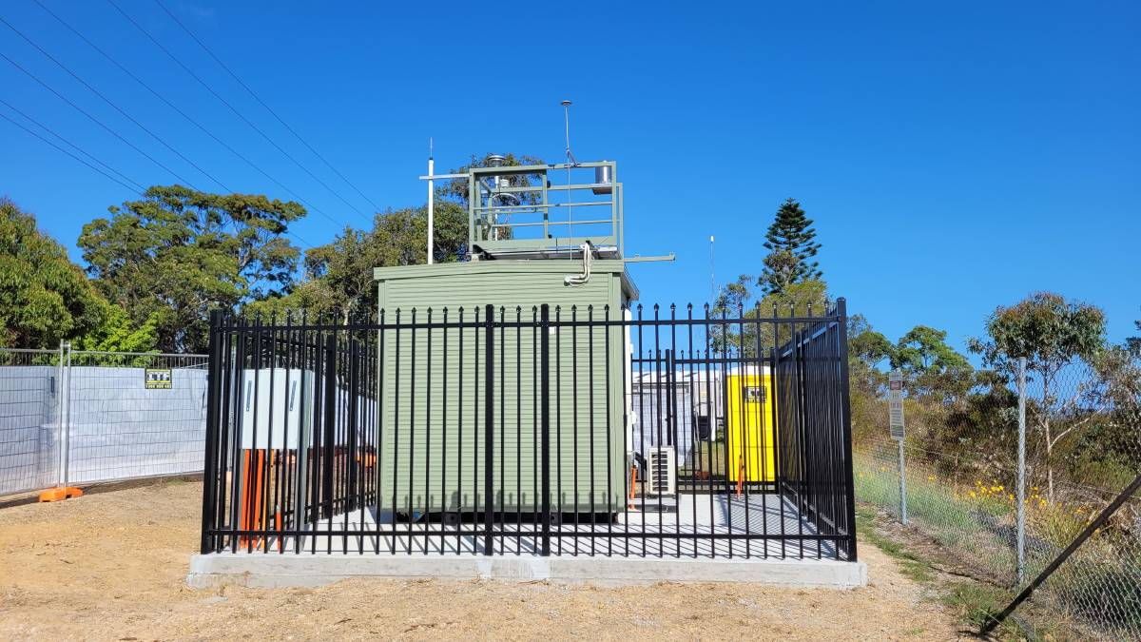
DESCRIPTION OF SYSTEM
Air Quality Monitoring System

Slide 10
DESCRIPTION OF SYSTEM
A centralised Data Visualization dashboard is an interactive dashboard that allows users (and policy makers) to track key metrics across multiple data channels, visualize the data points, and create reports that improve startegic planning and governance.
Data Pipeline:
1. Raw Streamed Data (Monitoring Stations)
2. Processed Data (Jupyter Notebook)
4. Data Visualisation (Data Studio)
3. Centralised Database (BigQuery)

Slide 11
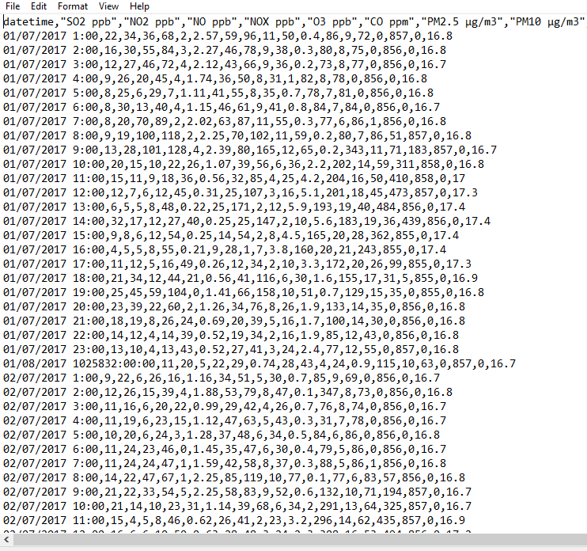
1. Raw Streamed Data (Monitoring Stations)
Unprocessed
Incomprehensible
Not useful

Slide 12
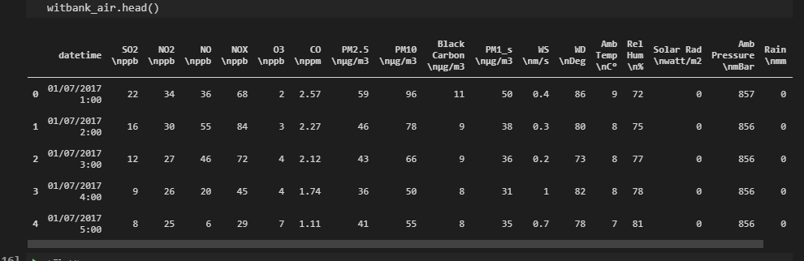
2. Processed Data (Jupyter Notebook)
Preprocessing...

Slide 13
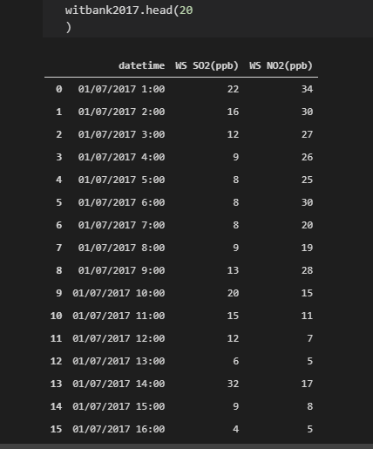
2. Processed Data (Jupyter Notebook)
Preprocessed!
Easier to read
Easier to Manipulate

Slide 14
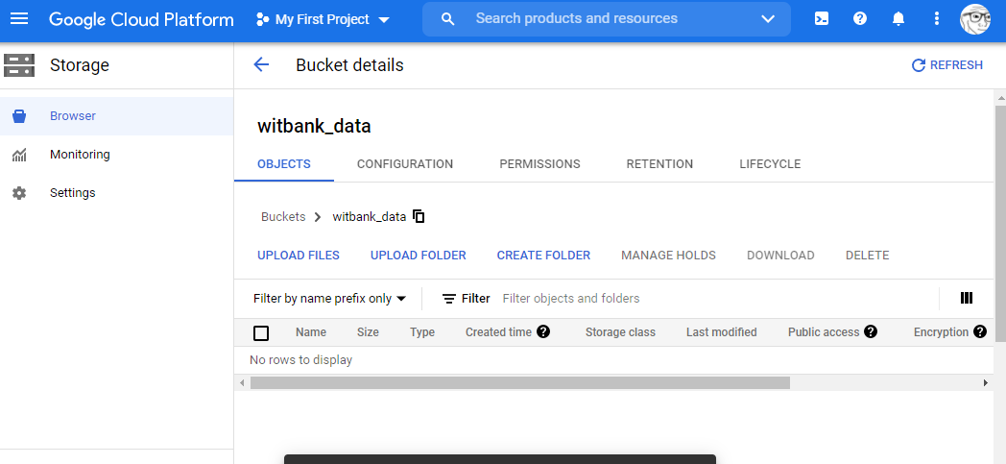
3. Centralised Database (BigQuery)
Cloud Storage
Stores data from Jupyter Notebook

Slide 15
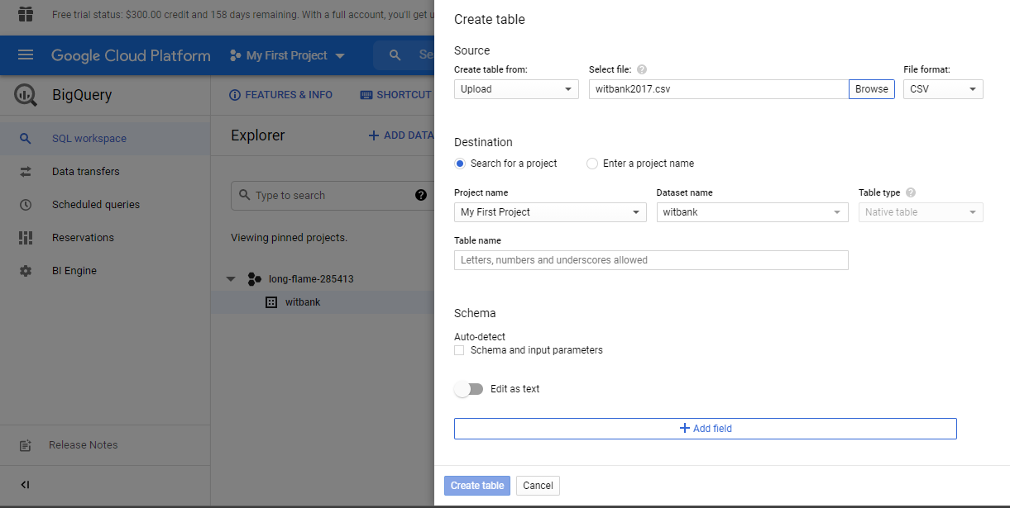
3. Centralised Database (BigQuery)
Cloud BigQuery
Transform uploaded dataset into Query-ready database

Slide 16
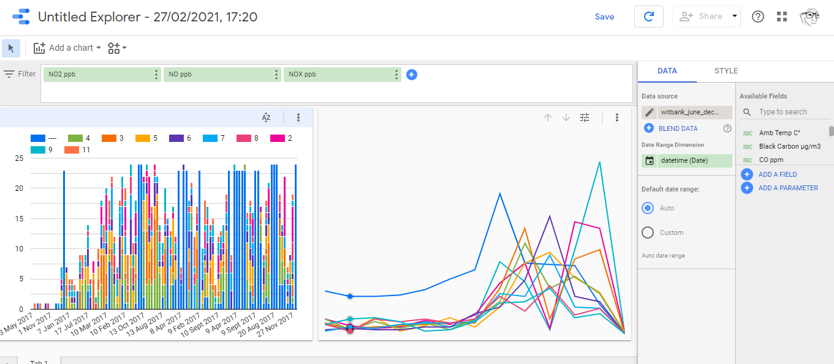
3. Centralised Database (BigQuery)
Cloud DataStudio
Fancy data visualisation!

Slide 17
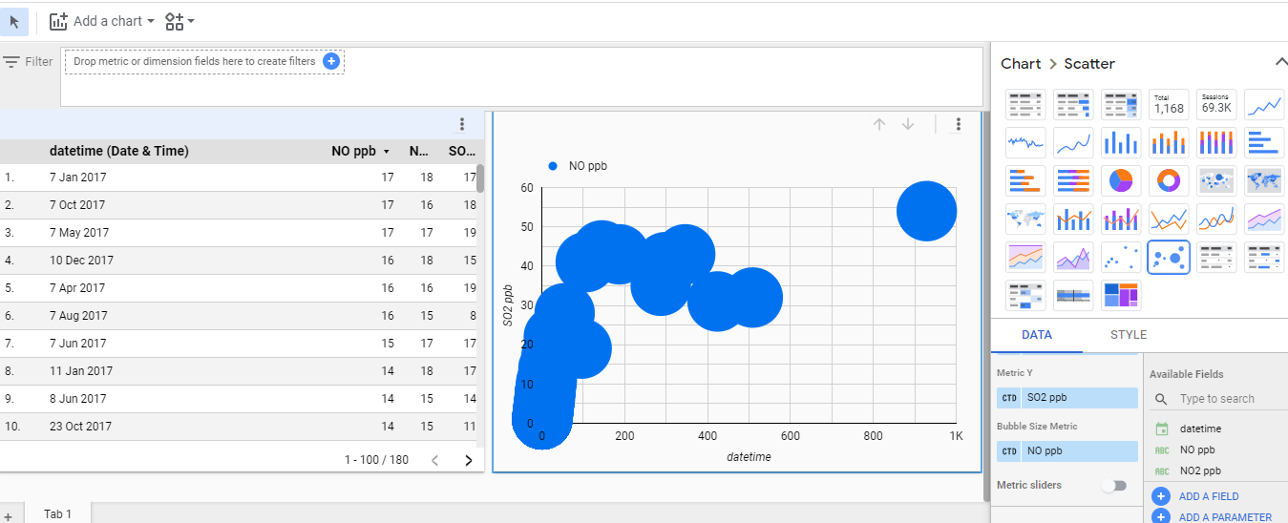
3. Centralised Database (BigQuery)
Cloud DataStudio
Fancy data visualisation!

Slide 18
Research Data
https://saaqis.environment.gov.za
https://www.greenpeace.org/static/planet4-africa-stateless/2019/03/8a84b69a-air-quality-and-health-impacts-of-eskoms-noncompliance.
pdf
https://opendataza.gitbook.io/toolkit/open-data-resources/healthcare-data-resources
h t t p s : / / w w w . h s t . o r g . z a / p u b l i c a t i o n s / D i s t r i c t % 2 0 H e a l t h % 2 0 B a r o m e t e r s /
District+Health+Barometer+2018-19+Web-403-411.pdf

