Slide 1
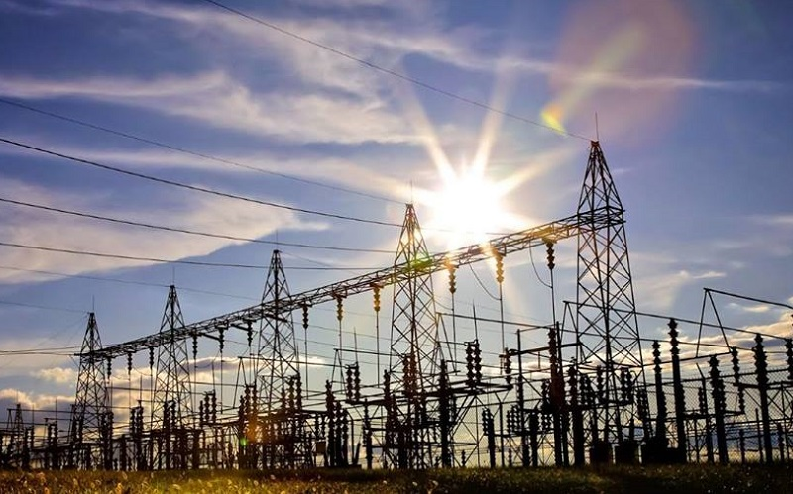


NEMISA Data Science Hackathon 2021

Slide 2
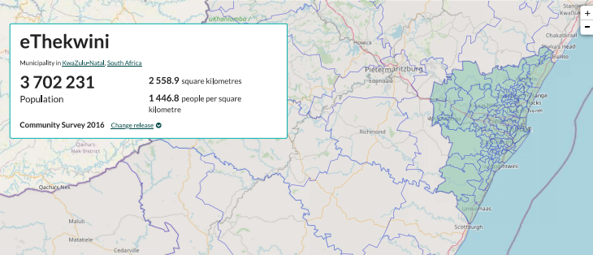
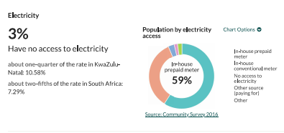
ETHEKWINI MUNICIPALITY

Slide 3
POLICY OBJECTIVE
Energy (kWh) shortage in EThekwini municipality.
https://edge.durban/dataset/electricity-usage/

Slide 4
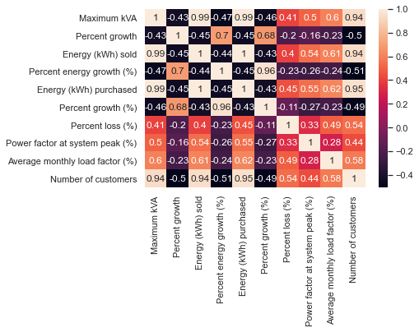
LINEAR REGRESSION MODEL
Datasets relationship
Null hypothesis: The number of customers determines the amount of energy purchased.

Slide 5
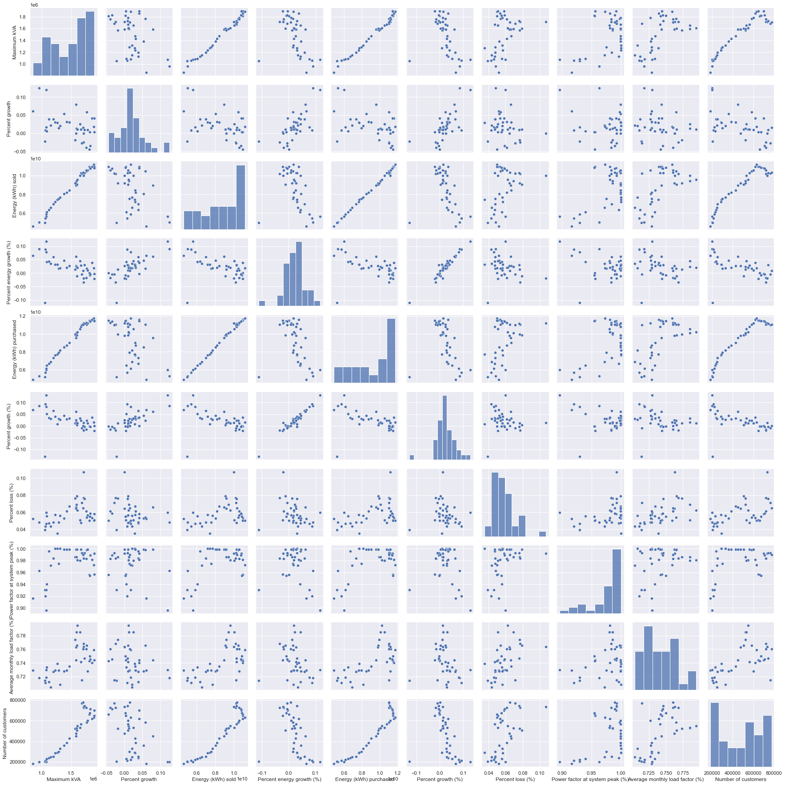
CONT...

Slide 6
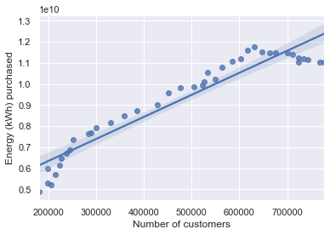
REGRESSION
Regression between energy(kWh) purchased and number of customers.

Slide 7
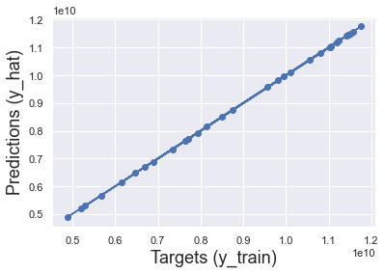
MODEL PREDICTIONS
Trainging the model which is implementing the model.
Target (actual) against predictions...
There is a positive linear relationship between the number of customers and energy(kWh) purchased.

Slide 8
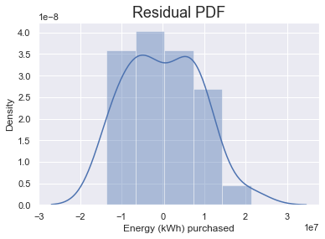
CAN WE USE THIS MODEL?
We can use this model because its residual is normal distributed.
The R² equals to 0.9999844445606445, this means that there is a large posistive linear association.

Slide 9
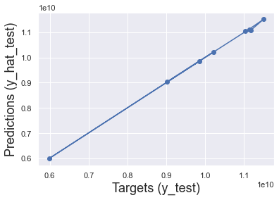
TESTING THE MODEL
Validation of the model.
Most of the points are on the 45 degree line, our predictions are reliable.

Slide 10
THE END...
THANK YOU...
BY: Mvubu Tholumuzi

