Slide 1

Team mlGurus
Job.ai

Slide 2
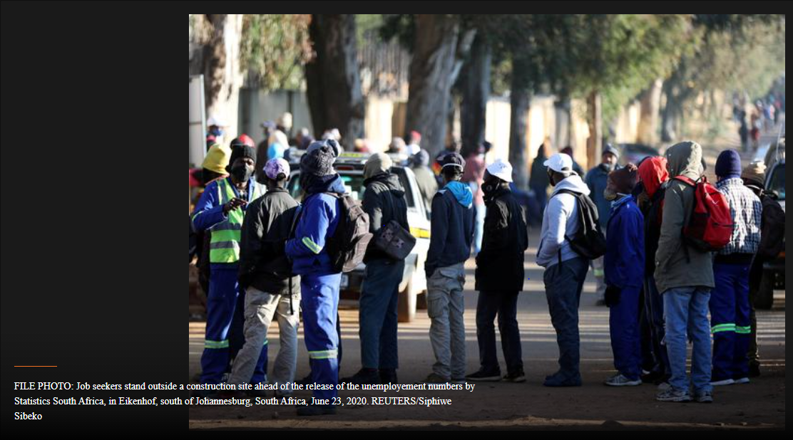
Problem identified
Statistics South Africa stated that the unemployment rate stood at 32.5% in the October-December quarter,
meaning 7.2 million people had been unemployed, up from 30.8% in the previous three month
Also, as of 2020 covid-19 had a very huge impact in terms of high unemployment rate
Reference: https://www.reuters.com/article/us-safrica-economy-unemployment/south-africas-unemployment-rate-jumps-to-new-record-high-idUSKBN2AN0S1

Slide 3
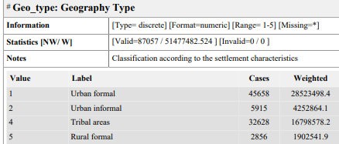
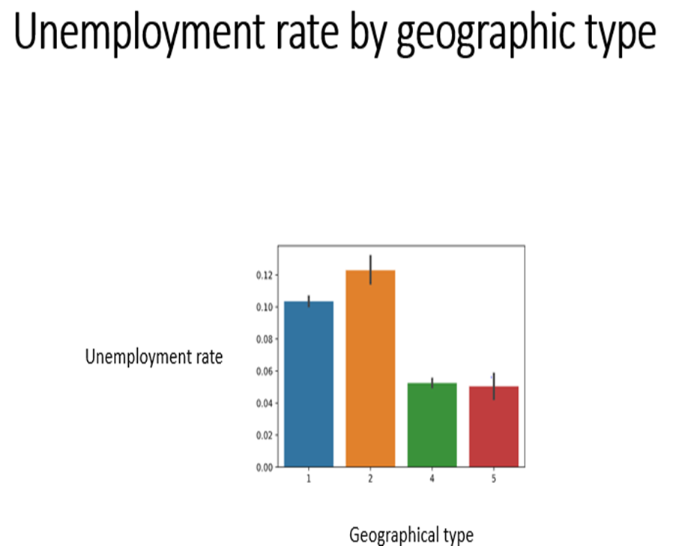
DATA INSIGHTS

Slide 4
SOLUTION
Building a machine learning based system which identifies individuals at high risk of long-term unemployment so the government can provide more resources according to their needs, this may be new skills or new jobs based on their skills.
Recommend new skills in demand to individuals
Using shap values, identifying factors such as discrimination and many more when employers are hiring,
Our system achieved an accuracy of around 99%
ASSUMPTION:
Assume the system predicts high risk of long-term unemployment, and then using shap values we find out that the fact that the individual is a female contributed 90% to the prediction, we can flag a discrimination and the government may perhaps create new regulations which stated there must be an equal number of females and males at workplaces.

Slide 5
Datasets used
The dataset used is the Quarterly Labour Force Survey (3RD Quarter 2013)

Slide 6
THANK YOU !!!!!

