Slide 1

Hactives
Creatively reducing unemployment

Slide 2



The Hactives team
Nkamogeleng
Nomthandazo
Nduduzo
Dan
Mosa

Slide 3

Unemployment related policies
Two main causes of unemployment
Recession (Demand increase)
Natural Growth (structural unemployment/ supply)
Two main policy strategies
Demand side policies to reduce demand-deficient unemployment
Supply side policies to reduce structural unemployment

Slide 4
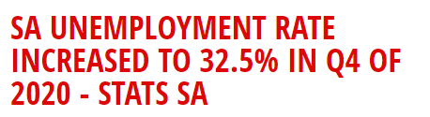
The Data
Digital Behavior - Organization and Government
Employee | Manager | HR Manager
EDA - Python
Visualization - Python, Power bi
Packaged Solutions - moqups, Visual studio

Slide 5
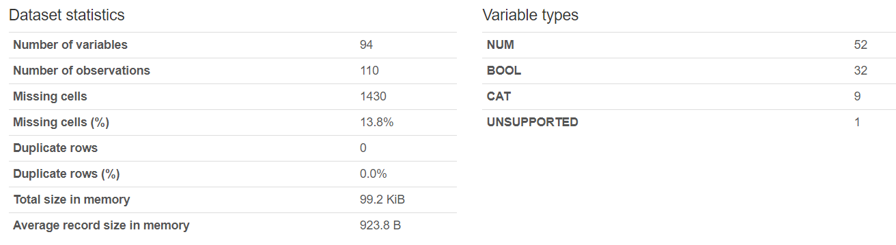

Managers and HR Managers - EDA
1
2
3
Labels
1- Insudstry code
2 - Job title
3 - Audit
4 - Upskill
5- Negative/positive policy impact
6 - Budget allocated technology
7 - Gender
8 - Educational level
9- Race
4
5
6
7
8
9
1
2
3
4
5
6
7
8
9

Slide 6
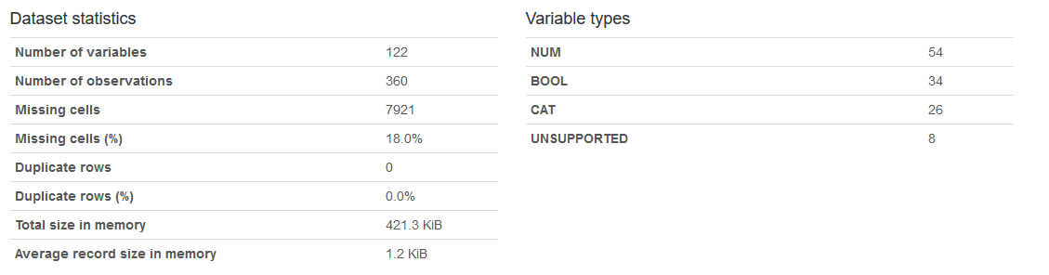
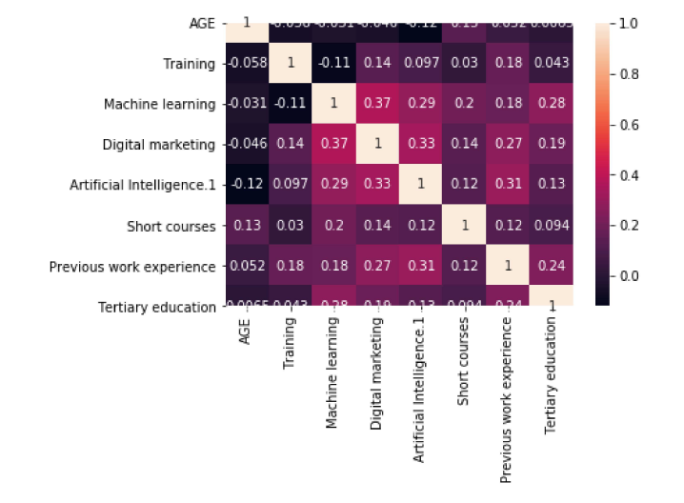
Employee - EDA

Slide 7
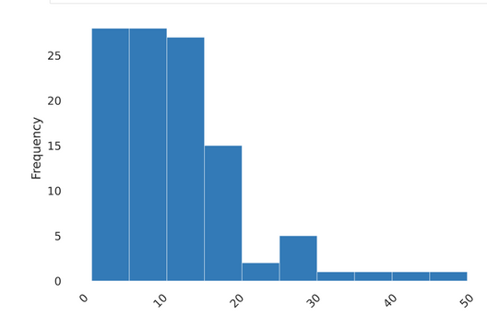
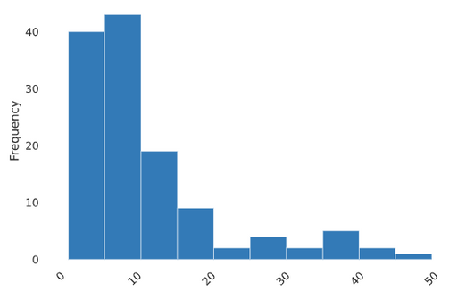
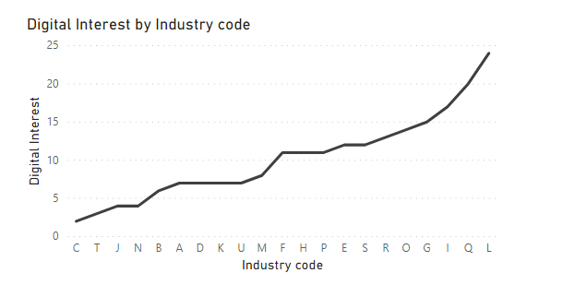
HR Manager
Manager
Employee
Years of experience
Agreements
ABILITY TO QUICKLY LEARN NEW
SOFTWARE (MS PACKAGES, ACCOUNTING PACKAGES,
DESIGNING PACKAGES ETC.)
DIGITAL TECHNOLOGY IS AN UMBRELLA TERM FOR MOBILE, INTERNET AND COMPUTER-BASED
PRODUCTS AND SOLUTIONS
THE USAGE OF DIGITAL TECHNOLOGY IS TOO COMPLICATED FOR ME
I CAN STILL USE MY TRADITIONAL
TOOLS, THERE IS NO REAL NEED FOR DIGITAL TECHNOLOGIES
DIGITAL TECHNOLOGY ENABLES
KNOWLEDGE SHARING ACROSS
ORGANISATIONS.

Slide 8
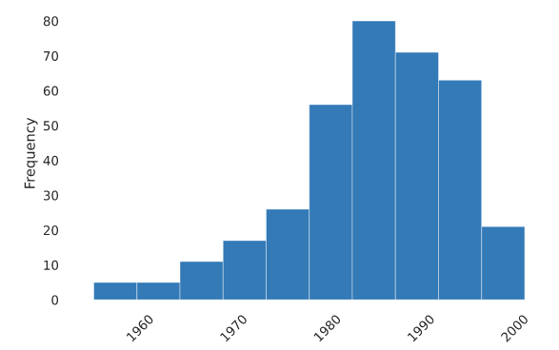
Employee
Year of Birth

Slide 9
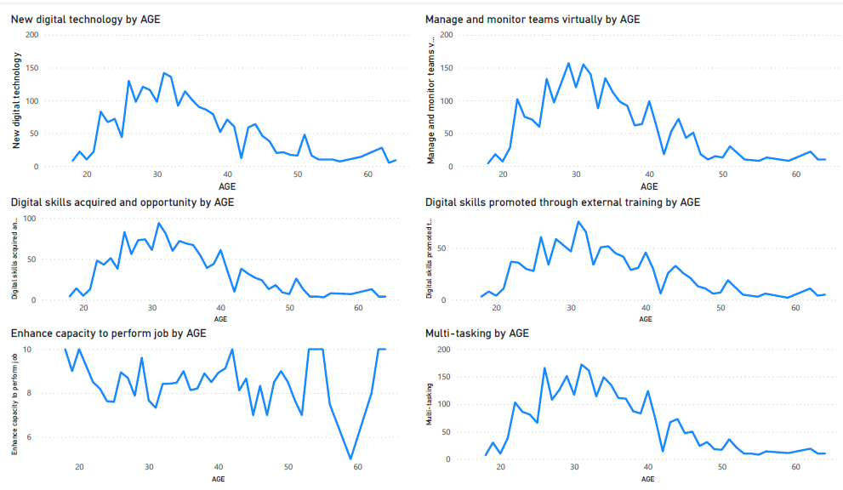
Employee

Slide 10

Solution
An employee/ seeker's App
An APP that will help employees find the right skills to learn in order to remain employed and for job seekers to find skills they could learn that are aligned with demand.

Slide 11
Thank you so much

