Slide 1


HYDRATING ETHEKWINI
Water and Sanitation Made Easy

Slide 2
A Friend’s Story That Opened My Eyes
Mayville, Durban, KwaZulu Natal, South Africa
https://www.google.co.za/maps/place/29+Putney+Pl,+Wiggins,+Durban,+4091/@-29.8567548,30.9546538,194m/data=!3m1!1e3!4m21!1m15!4m14!1m6!1m2!1s0x1ef707559606bc11:0x551d18601b7a8e60!2s15+Berriedale+Rd,+Musgrave,+Berea,+4001,+South+Africa!2m2!1d30.9919345!2d-29.8455595!1m6!1m2!1s0x1ef7aa76798e28f1:0x25624b8cbff03258!2sNsimbini+Primary+School,+160+Borough+Rd,+Wiggins,+Durban,+4091!2m2!1d30.9573013!2d-29.8565311!3m4!1s0x1ef7aa77defbd123:0x5f197362e54d5a8b!8m2!3d-29.8567499!4d30.9548689
Verulam, Durban, KwaZulu Natal, South Africa
https://www.google.co.za/maps/place/Zama+Zama+Tuck+Shop/@-29.6223319,31.0347084,389m/data=!3m1!1e3!4m8!1m2!2m1!1s92+area+2,+Mhlasini,+Verulam,+4340!3m4!1s0x1ef71bd797843975:0x86be425006847315!8m2!3d-29.6223998!4d31.0354777

Slide 3
Access to water
Population size = 25 056 People
Access to water = 86.1%
Population without access to water = 3 483 People
Annual Income = R30 000
Monthly income = R2 500
https://wazimap.co.za/profiles/ward-59500060-ethekwini-ward-60-59500060/#elections

Slide 4
Problem Statement
Water scarcity in eThekwini is a huge problem which needs to be addressed especially in townships and outskirts of the municipality

Slide 5
Proposed Solution To The Problem
Water conservation through recycling and reuse
Desktop water purification RIG
RIG must be cheap, easy to make & accessible to everyone
Target the poorest communities, e.g. ward 60 of eThekwini municipality

Slide 6
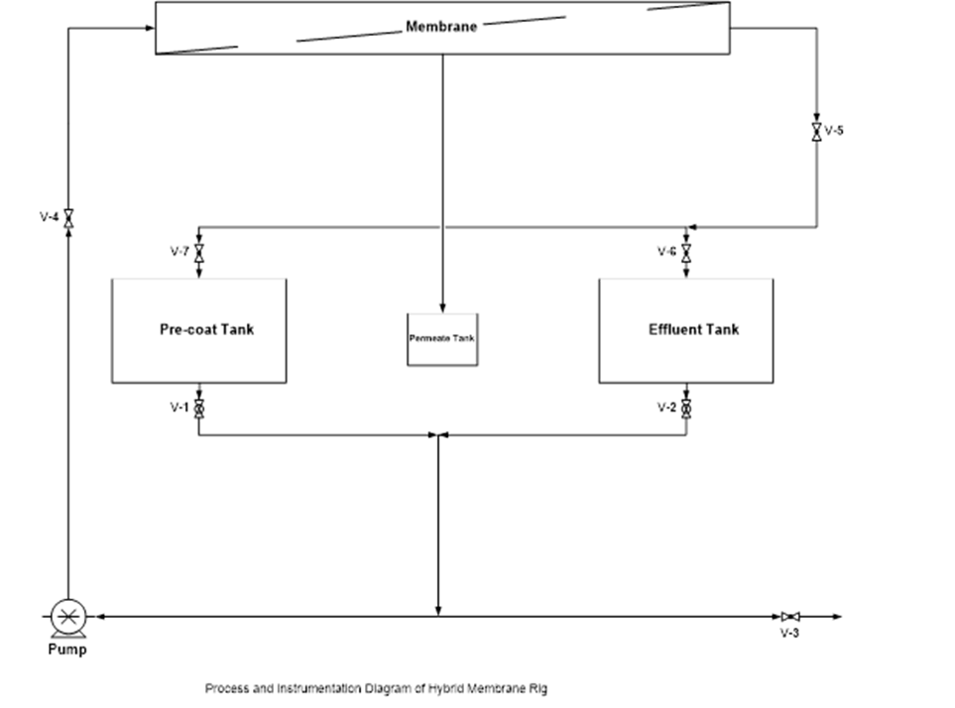
Hybrid Membrane Filtration Rig
The test rig consist of two 5litres buckets, effluent tank and pre-coat tank and 2 litter bucket for permeate, this bucket can be removed
Both the feed tank and the pre-coat tank are connected to a single pump which functions as feed pump and pre -coat pump.
The effluent tank has an out let V-6 and a valve leading to pump V-2.
The pre-coat tank also consists of an outlet V-7 and a valve leading to the pump V-1.
After the pump there is V-4, which is used to collect the feed and to obtain the feed flow rate.
After V-4, follows a flat sheet membrane used to obtain the permeate volume, which is followed by V-5 which is used to obtain dead end flow.

Slide 7
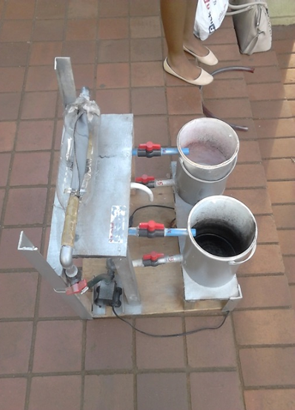
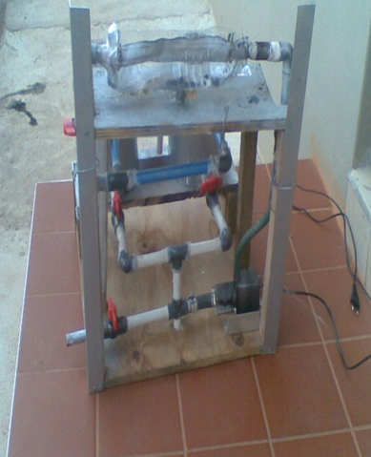
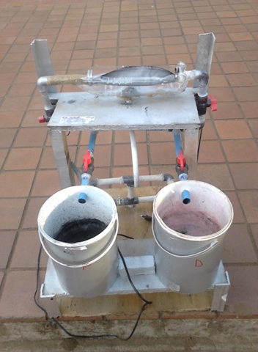
Typical Prototype of the Rig
Top view
Back view
Front view

Slide 8
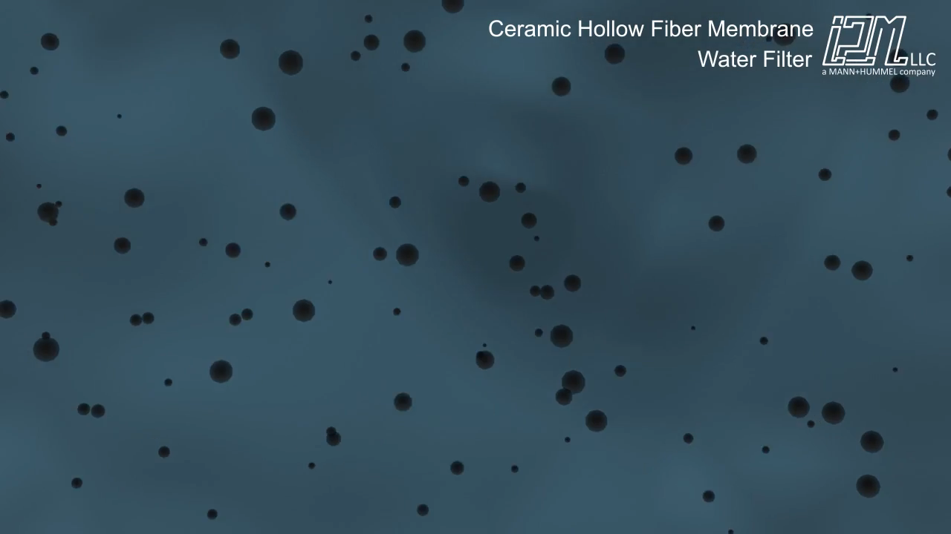
Notes:
24x9=216 h

Slide 9
Pros & Cons of Membrane Technology
Advantages
Disadvantages
Energy saving: Since there is no phase change required for processing.
Raw material recovery is easily achieved : valuable permeate and product streams may be reused
Membrane process operate at ambient temperatures and are suitable for processes which are heat sensitive
Membrane technologies can produce treatment that meet the regulatory requirements
Activated carbon is very popular among homeowners because it is easy to replace during scheduled maintenance.
Membrane technology is relatively low in cost
Membranes require regular replacement due to membrane fouling
This system requires a lot of manual labor
Activated carbon membrane filters may not be able to neutralize biological contaminants which can only be neutralized by UV light

Slide 10
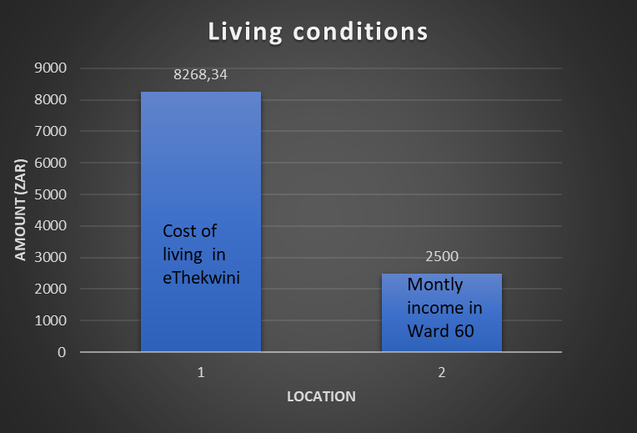
Costs Compare
https://www.numbeo.com/cost-of-living/in/Durban

Slide 11
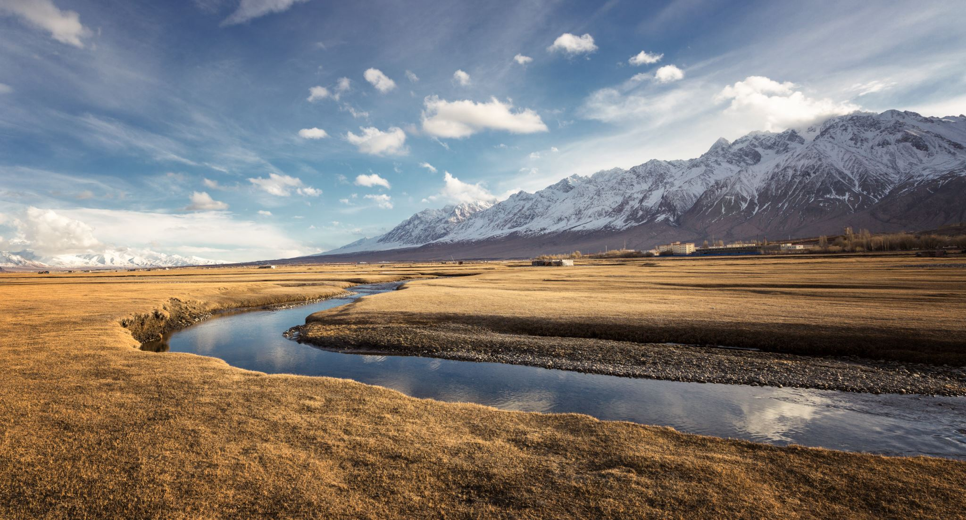
Making Conservation of Water in EThekwini easy and affordable to all who live in the municipality

Slide 13
Questions ?

