Slide 1
Good governance and responsive local government
A hackathon presentation done by
Francis djumo

Slide 2


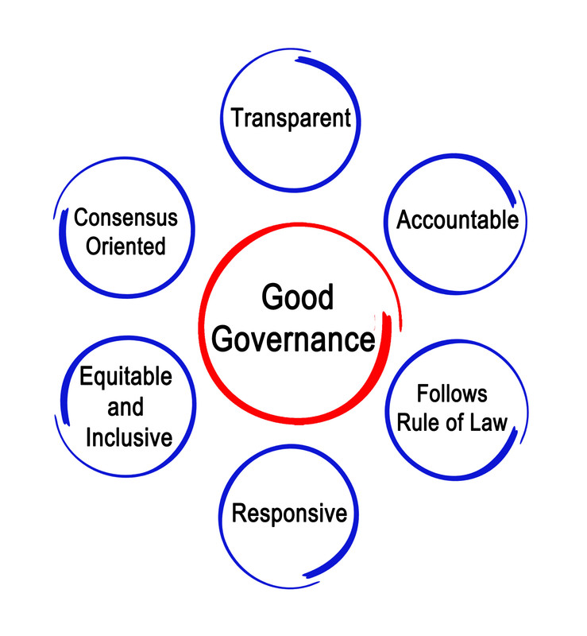
Why Governance?
In A time like this, Media and people have something to say about:
Mishandling of Resources
Corruption
Debt & unemployment
However, it is necessary to find out the Metrics and the feelings of the public on the government’s Activities.

Slide 3

Our Metrics
We will be looking at Water & Sanitation, mainly:
Sales
Costs
Issues

Slide 4

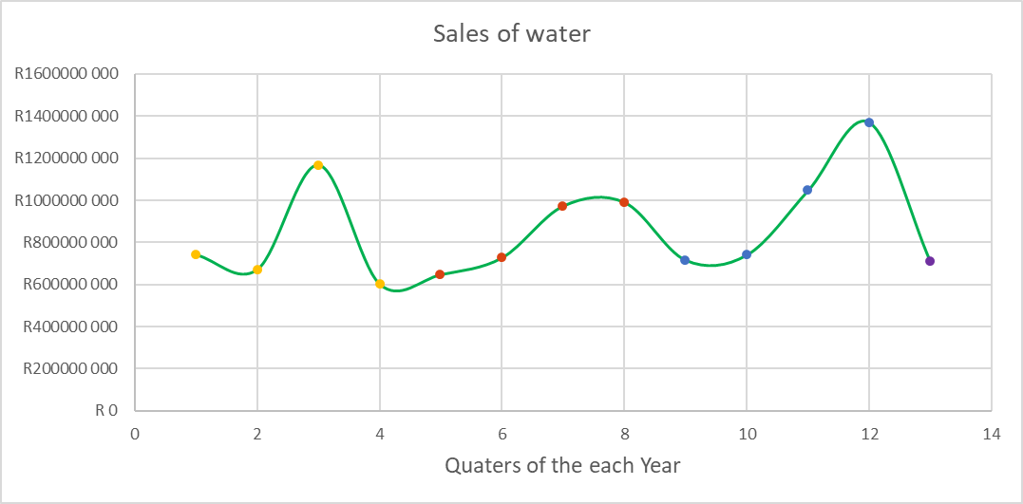
Legend:
2016
2017
2018
2019

Slide 5
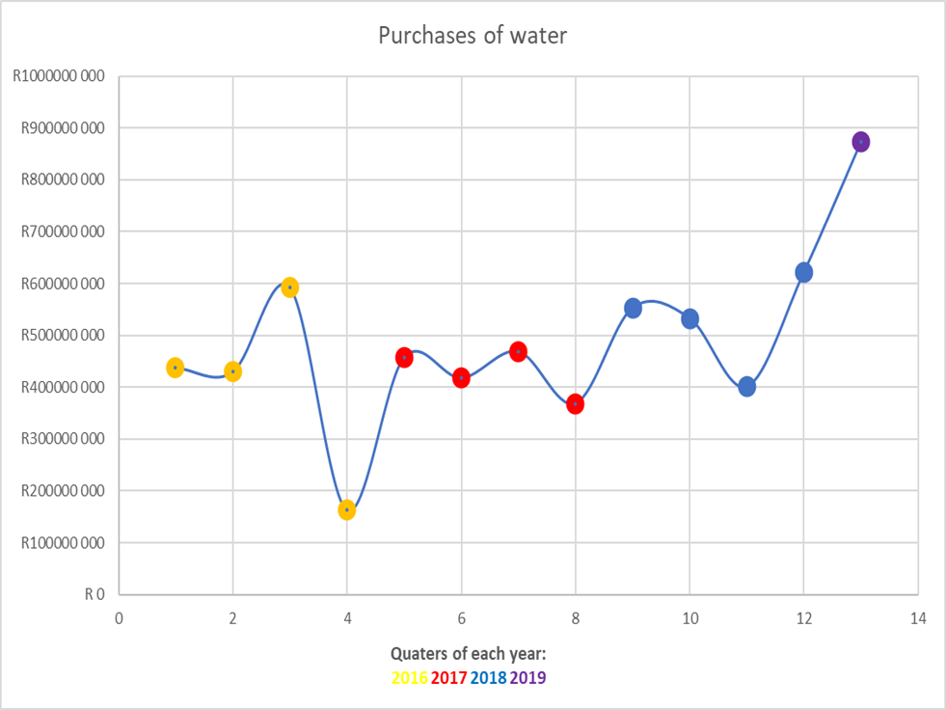


Slide 6
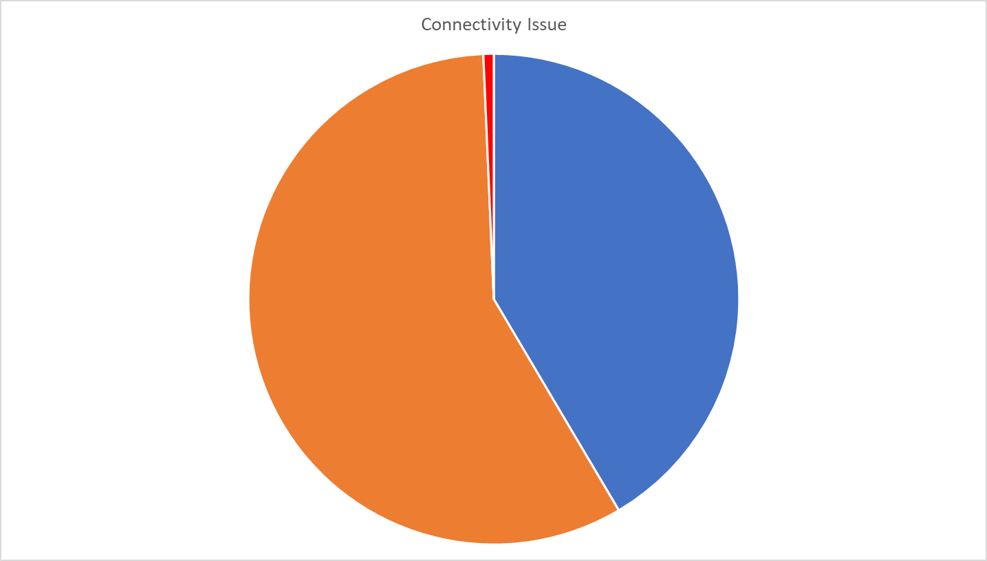
41% of the issue were closed
57% of issue were pending
2%

Slide 7
Result: More data is needed
In this era we need more precise data for governance to make smarter decisions, Obviously!
More importantly:
To reduce idle responsiveness
To make further, accurate short-term predications in it’s budgeting

Slide 8
Solution: GIVE PEOPLE TO TOOLS TO GOVERN THEIR RESOURCES
Royaume is building a smart meter that tracks water usage and shut the main water supply when a leak is detected.
Important aspect:
Collecting and packaging that data of water usage from that household
Users alerting local municipals with a PING messages for burst pipes from water mains, making municipals react quickly to the PING’s location.

Slide 9
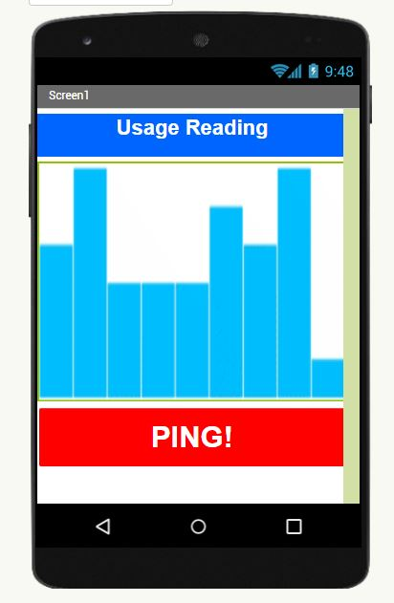

DATA

