Slide 1
Exit code Zero Team
Eliminating Fake news

Slide 2

What is fake news?
Real News – Tweets which are from verified sources
And give useful information on COVID-19.
Fake News - Tweets, posts, articles which make claims
and speculations about COVID-19 which are
verified to be not true.

Slide 3
Eliminating Fake news
Developing a Website for Government, whereby South Africans can access to check if what they have seen on Social media or internet regarding the countries affairs is true or fake news.
The “Why” , it will help individuals know immediately through using the website if news are fake and also cost the Government less money to correct the spread of fake news.

Slide 4
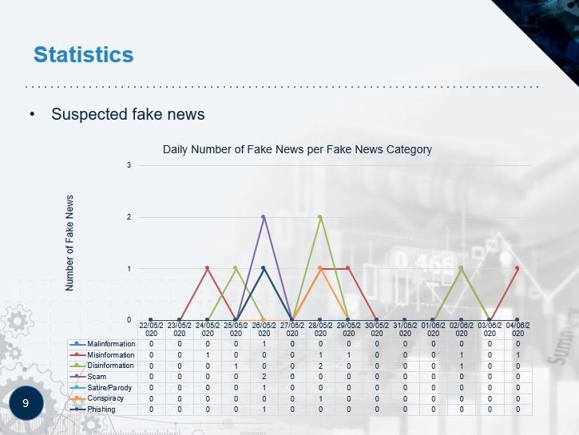

Slide 5
Impacts of fake news
Democratic impacts
Citizens loose trust in news on the media
Causes Fear and panic of the unknown, such as taking vaccines
Financial impacts and impacts on my health
Racist ideas
Bullying and violence against innocent people

Slide 6
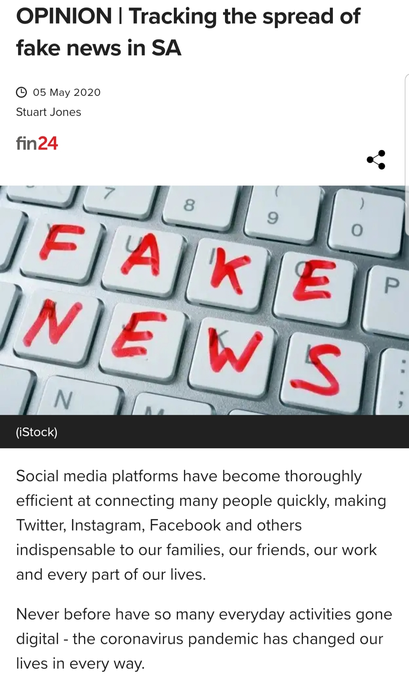

Slide 7
How do we plan to do this using machine learning?
ML Algorithms - for classification, we experiment
with Logistic Regression (LR), Support Vector Ma-
chine (SVM) with linear kernel, Decision Tree
(DT) and Gradient Boost (GDBT). All algorithms
are implemented using sklearn package. All exper-
iments run in approx 1 minute on an i7 CPU

Slide 8


