Slide 1

e-Clean
Driving smart city by ensuring a clean city
NEMISA Data Hackathon
DevStack
Mzwakhe Besho
Mxolisi Ngwenya

Slide 2

Question?
How do we engage with government data to unlock insights that could inform policy decisions?

Slide 3

Before…
HIGHLIGHT:
Local municipalities do their utmost to inform and educate residents regarding illegal dumping and using the available waste removal services.
The cost involved in the removing and cleaning of illegal dumping is exorbitant

Slide 4

278 749
77% (aged 15-64)
7.3% drop
That’s a population
And a great percentage
In weekly refuse removal

Slide 5

Answer to the question
Our solution generates classified data for municipalities, in the process youth can be catalyst in bettering service delivery and sustaining the environment, but that can only happen if they get something in return.

Slide 6

Social issues that went viral bcoz of youth.
Fees Must Fall
was a student-led protest movement that began in mid-October 2015 in South Africa.
Black Lives Matter
is a decentralized political and social movement protesting against incidents of police brutality and all racially motivated violence against black people.

Slide 7
Electronic Clean (e-Clean)
a mobile app that rewards you by reporting illegal dumping, lack of rubbish removal, and any service delivery issues in communities .

Slide 8

Our process is easy
Image is analyzed and end-user gets rewarded
End-user uses e-Clean mobile app to report.
03
01
02
End-user takes a picture and submit it.

Slide 9


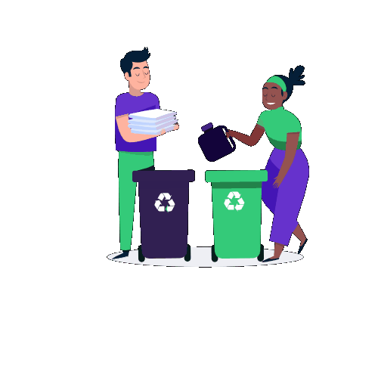

Slide 10
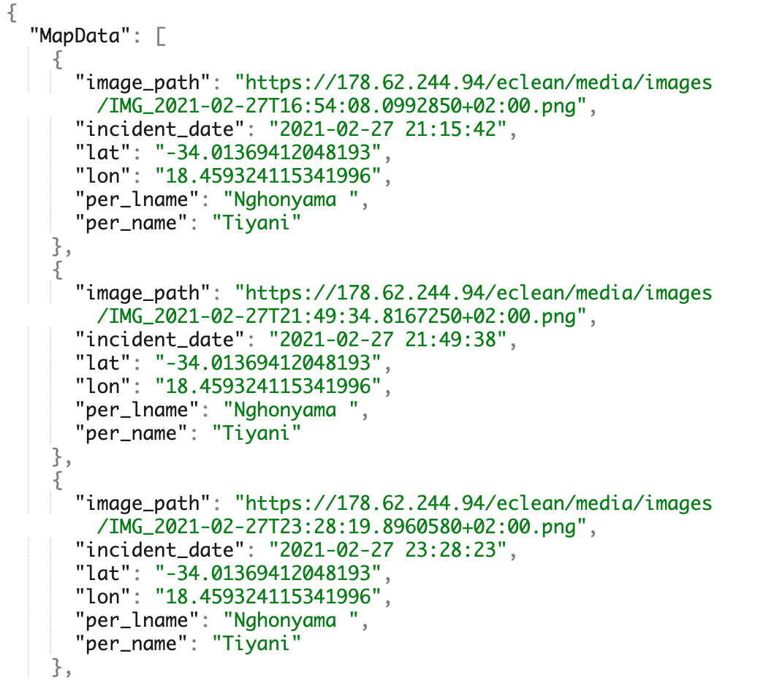
Data we providing to municipality
JSON FORMAT

Slide 11
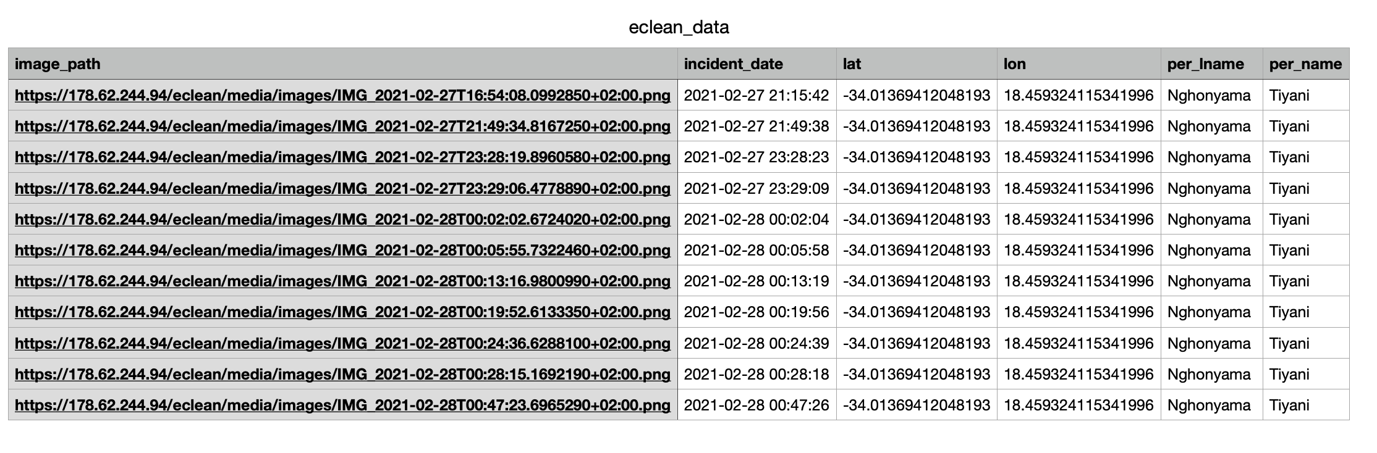
Data we providing to municipality
CSV FORMAT

Slide 12
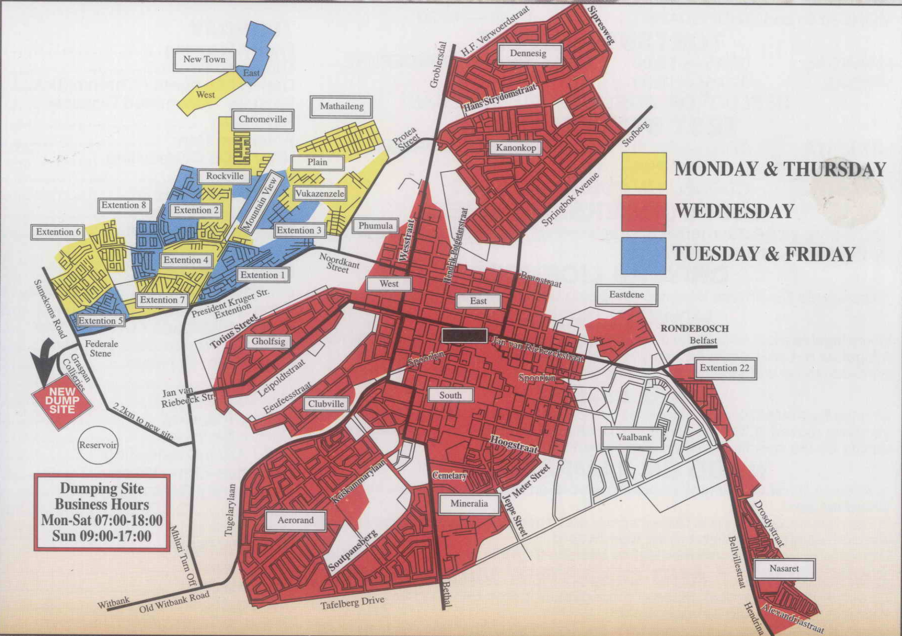
Our process is easy

Slide 13







Rewards we have in mind…
Food Vouchers
Data/Airtime
Book Vouchers

Slide 14

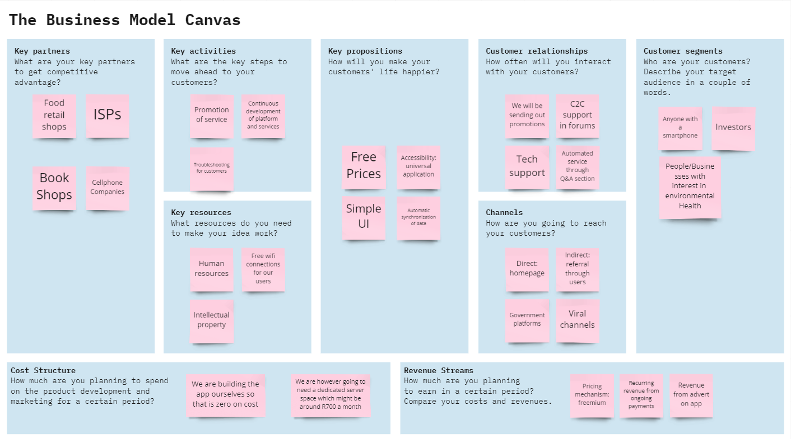

Slide 15
Limitations
Waste image processing.

Slide 16
Thanks!
ANY QUESTIONS?

