Slide 1




Introduction To Digital Skills in South Africa
Living in an unequally divided country with various speculatory levels of gender inequality, poverty in Digital Skills.
We will be looking at the impact these factors have in various sectors such as rural, suburban and township areas in South Africa on the overall rate of implementation with regards to the 4IR.

Slide 2


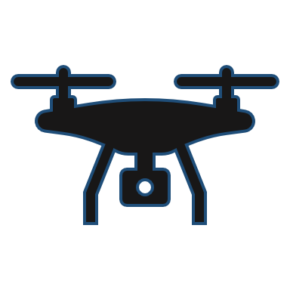
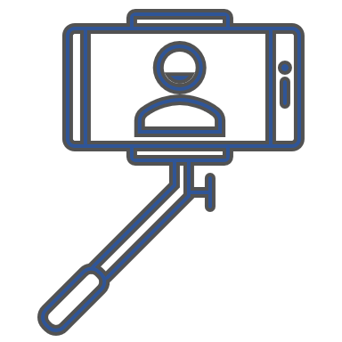


Digital Literacy In The 21st Century
The world is moving fast when it comes to new technology and adapting to them and many believe that we are already in the 4IR.
When it comes to access to technology in South Africa, learners do not have access to technology and therefore at a disadvantage. To have good Digital Literacy/skill depends on the household expenditure and area for example Rural areas have a lower Digital Skill compared to Urban areas.

Slide 3


Different Types Of Digital Skills
Digital Ownership: Having the permission to access data and information on knowledge you wish to know.
Digital Access: Able to fully participate in digital society, includes computers and the Internet.
Digital Awareness: Able to understand technology and how to use it in a manner where you can now understand digital interaction and work in it.
21st Century Skill: Able to succussed in today's world, with knowledge from school, college and employers and have a set of skill in technology.

Slide 4




Poverty & Social Inclusion In Digital Skills
The digital division is caused by poverty, unemployment and inequality. There are skilled programmes that lack the right technology that they could use, and woman are denied the chance to access the digital services with equal rights as those of their male counterparts (What do think of this yellow-highlighted line?)
Balancing urban and rural communication infrastructure
With access to digital skills the poor can arm themselves with knowledge to eradicate poverty. This strategy of providing people in developing countries with digital skills can be adopted:
Train the citizens with skills to make them employable, with internships
Uplift the community by teaching them digital skills
Educate people about the negative impacts of socio-cultural norms on women
Cybercrimes and Cybersecurity

Slide 5


Understanding History and Appreciating the future
Learning ,using and understanding of information communications technologies will assist on being technological literate to participate and adapt obsolete tech changes and appreciate new and evolving kind
It is important for South African as a developing country make sure that its citizens attain and acquire these essentials technological skills to break through in to the corporate world for an entry level job
The schools need to introduce the narrative and make it its part of everyday vocabulary. Digitization and digitalization must be brought up in the Department of education as a tool to prepare students and teachers for upcoming 4IR evolution as it unfold.

Slide 6
Level of Skillset | Beginner | Intermediate | Expert
Infomation | Compliling and saving of ifomation and documents | Reaserch,mine diferent types of data | Producing and evaluating data and infomation
Computer | Learn how to use the hardware machine | Installing both hardware, software and detect faults | Repair, assemble and DE-assemble of the the computer machine
Multimedia | Searching,Playing and Communicating through the web interface and email | Resolution and aspect ration grapphics,audio and sound enginnering and Social media | Format distinguish

