Slide 1




Policy Implementation with Data
Johannesburg
Classification sprint presentation
LimpopoGeeks
Data Crushers
Team 5
John Sekgobela
Lazola Javu
Kgauhelo Mokwaga
Presca Mashamaite
Josias Sekhebesa

Slide 2



Problem Statement
The world as we know it has changed and evolved, We have seen a spike in the population growth in South Africa. We are going to explore Government historic data to help South African Government to incorporate Traditional Healers as mainstream health practitioners.
Notes:
Market analysis has improved how businesses globally interact with their customers and stakeholders, with the rise of Business Intelligence companies are at the peak of their competitive advantage, with the right tools companies have the opportunity to predict future outcomes based on recent observed trends.

Slide 3







Introduction
We have been presented with health and socio-economic data of south african Individuals by the Limpopo Province Government.
These are the tools we used to achieve our objective:
Pandas(Data Preprocessing & data mining)
Matplotlib(Analysis)
Scikit learn( Modelling)
Notes:
The purpose of this task is to analyse trends using twitter data,EDA allows the opportunity to understand the underlying data structures, from data and understanding specific items of the data. Often times Real-World data is incomplete and inconsistent. classification model.data has to be formatted in a structure that is easily interpreted by Machine learning Algorithms.Data Modelling produces descriptive relationships between the information stored in the data.

Slide 4
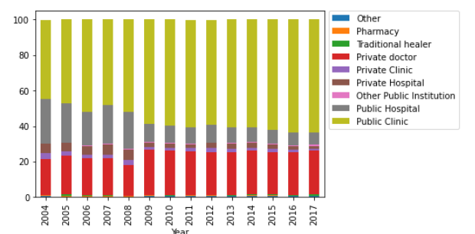
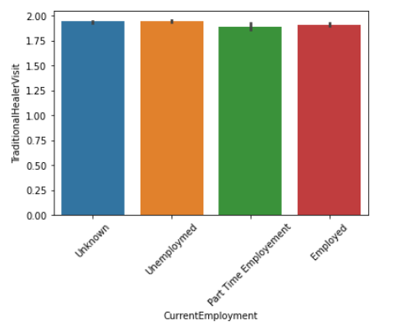
Data from StatsSA
Limpopo Province

Slide 5

Hosting and Accessibility
+

Slide 6

Conclusion & Recommendations
Insights & value

Slide 7

The Traditional Health Practitioners Act
The establishment of a new Council
Mandatory registration for all SA THPs
The proposed regulations
Minimum training standards for student THPs
Well-being to uphold the same standards by being transparent in practising.
This is crucial because several South Africans use Traditional healers.
Type of THP should be documented and limit the use of word to mouth for consistency to provide higher standards for other official to regulate them as they do with other health practitioners.
Notes:
There are regulations that are already implemented by the Government with the use of Traditional Healers. The involves regulations such as the
The Traditional Health Practitioners Act
The establishment of a new Council
Mandatory registration for all SA THPs
The proposed regulations
Minimum training standards for student THPs
"Consequently, The THP Act finally provides legitimisation of an overwhelmingly popular indigenous healthcare system. However, as a consequence of the legal acknowledgement of THPs, traditional medicine products must now also be brought under regulatory measures. If traditional medicines are to be prescribed, marketed and sold as part of a healthcare system recognised under SA law, they must meet the same stringent standards."[5]
Regulations are meant to be followed and a policy is an agreed upon statement which states what needs to be achieved and how this should be done. Thus, we propose that every person who is responsible for aiding South African citizen on their health and well-being to uphold the same standards by being transparent in practising. This is crucial because several South Africans use Traditional healers on a daily basis. In addition, The standard procedure to be become any type of THP should be documented and limit the use of word to mouth for consistency to provide higher standards for other official to regulate them as they do with other health practitioners.

Slide 8


