Slide 1
BIO HACKERS
ALIEN PLANT ERADICATION PROJECT

Slide 2
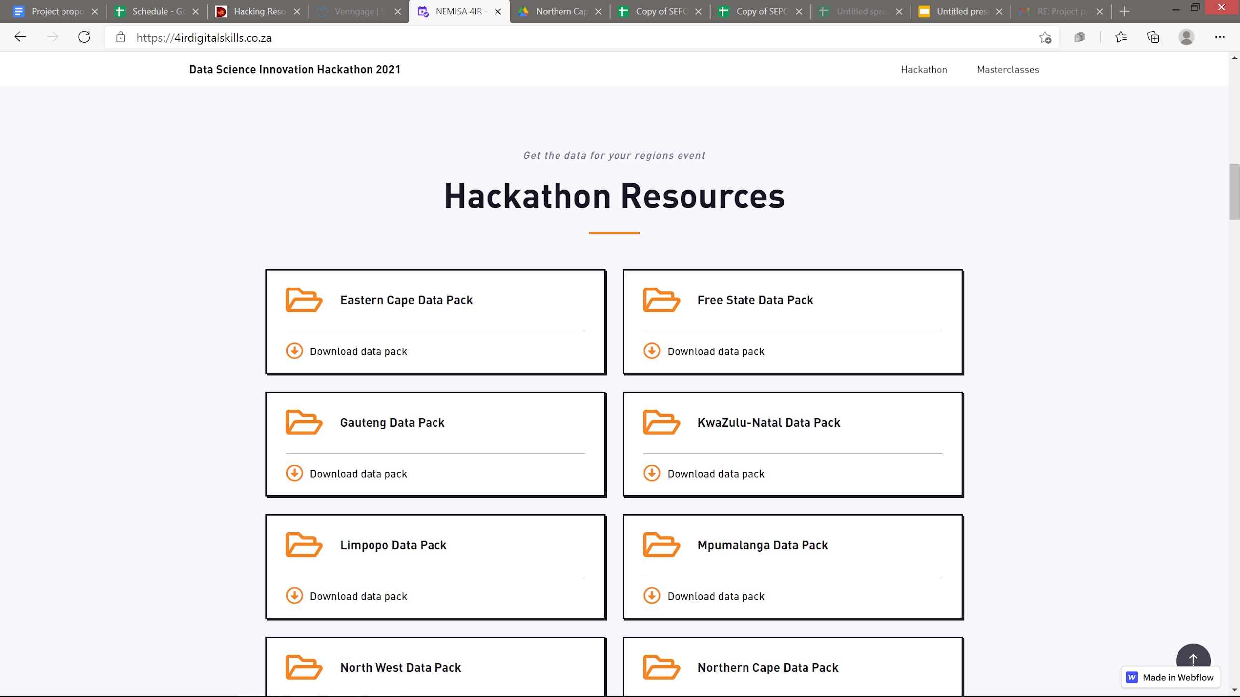
Our Data Came From?
We were provided with a dataset carrying all kinds of statistics in the Northern Cape, we identified two statistics which are the agricultural potential, availability of water and environmental sensitivity

Slide 3
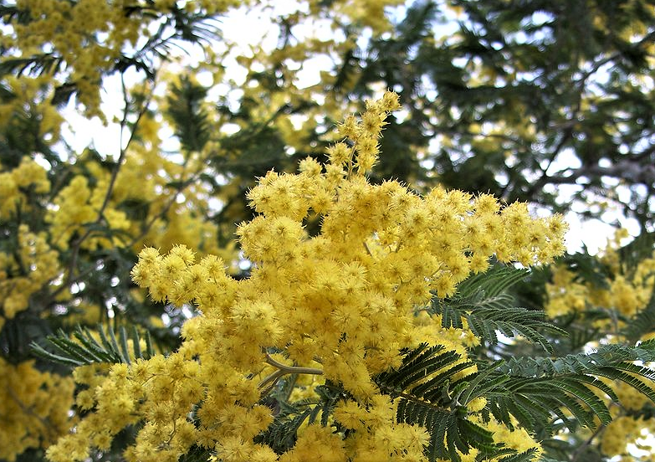
Problem Identified
Based on the statistics we chose conducted we research and proposed that the agricultural potential was quite low and the availability of water were all related to a common cause, which is the growth of foreign invading alien plant species, also known as alien plants.
Acacia decurrens Willd, and hybrids, varieties and selections Green wattle

Slide 4
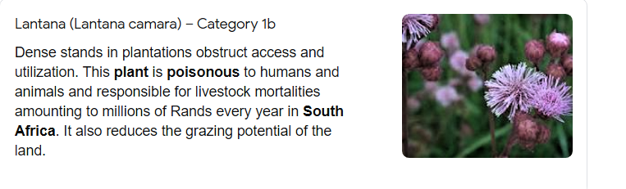
Just one poisonous pretty alien killers

Slide 5
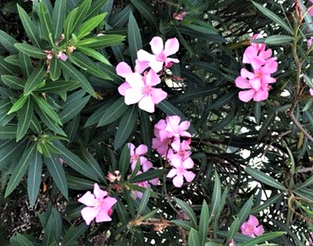

case reports calculated that 4 grams of oleander leaves would be extremely fatal to a human

Slide 6
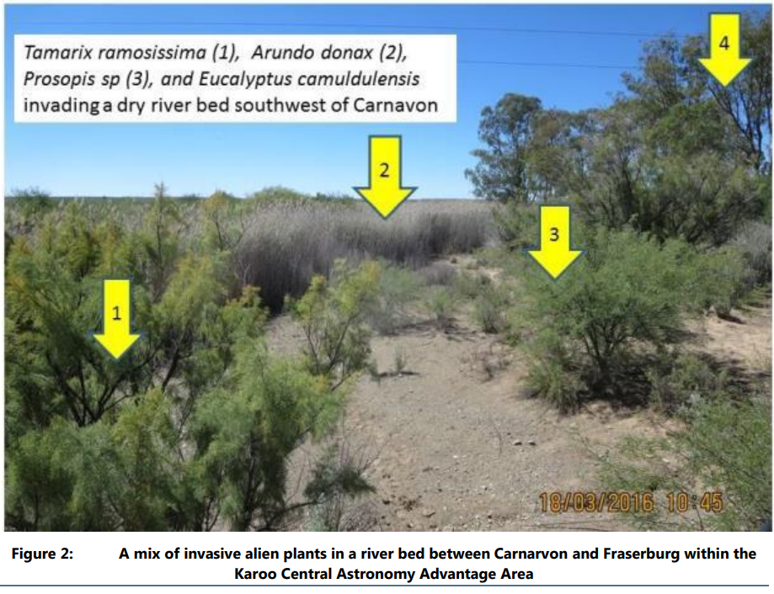
WHAT ARE ALIEN PLANTS?

Slide 7
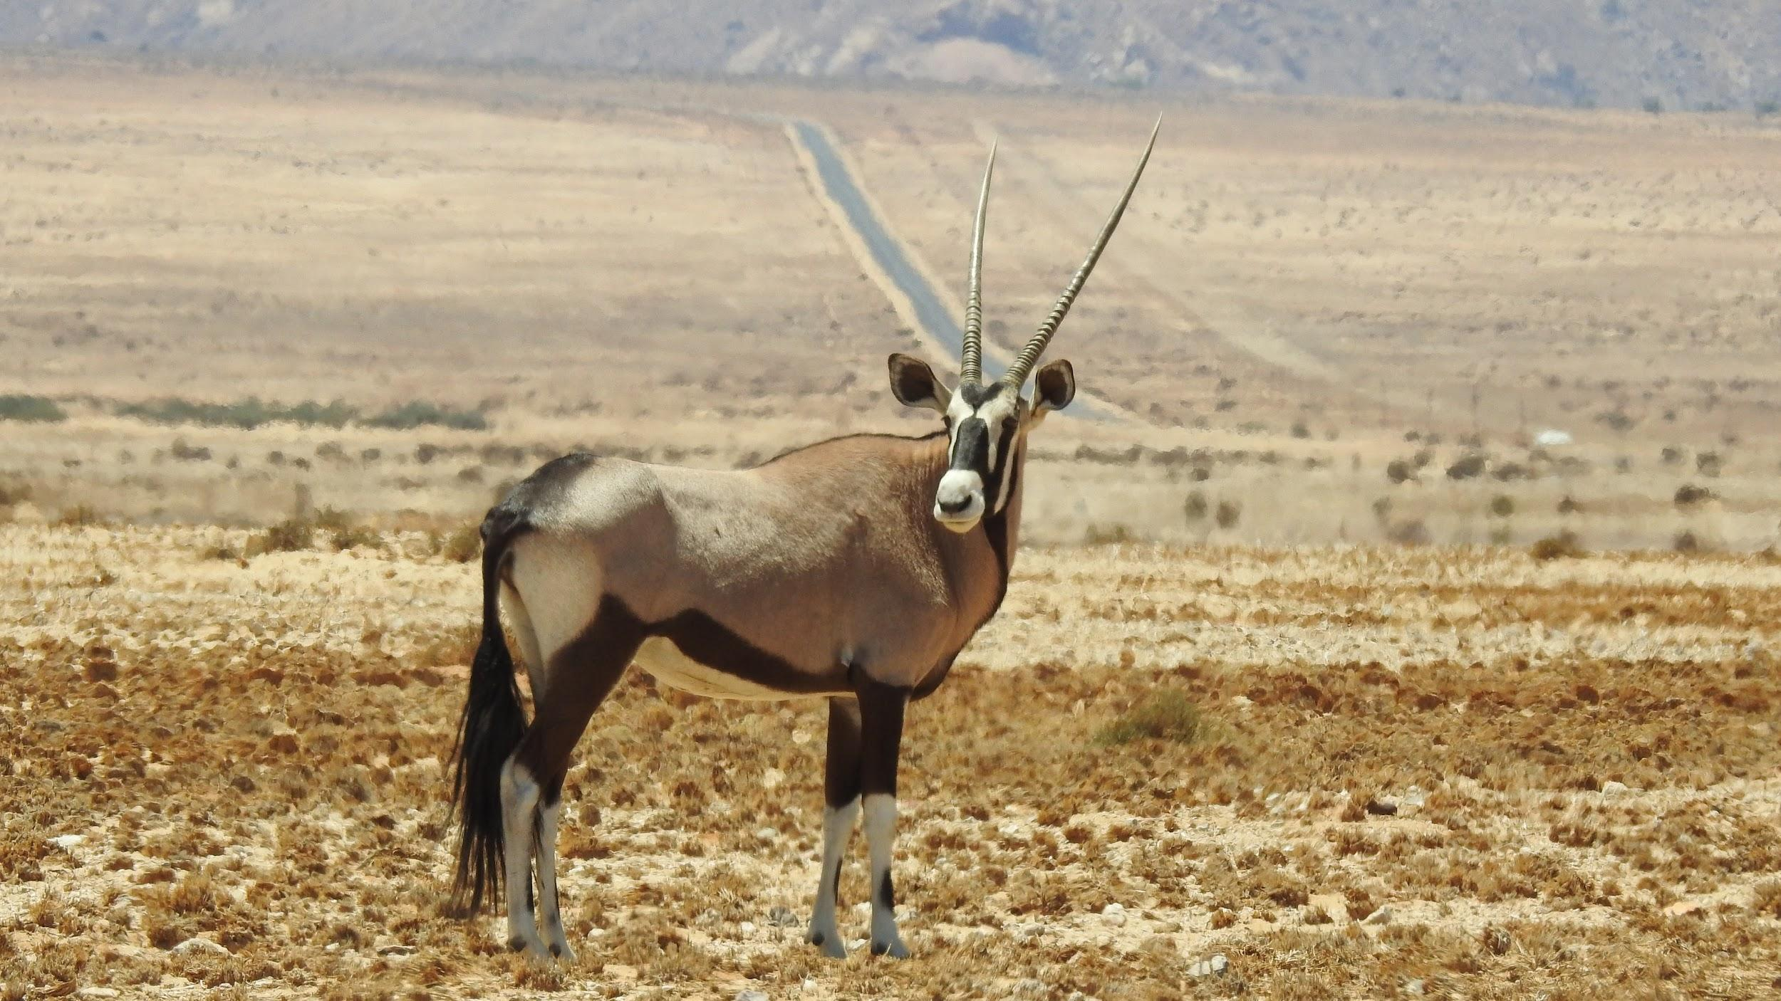
What are the Impact Of these Plants?

Slide 8
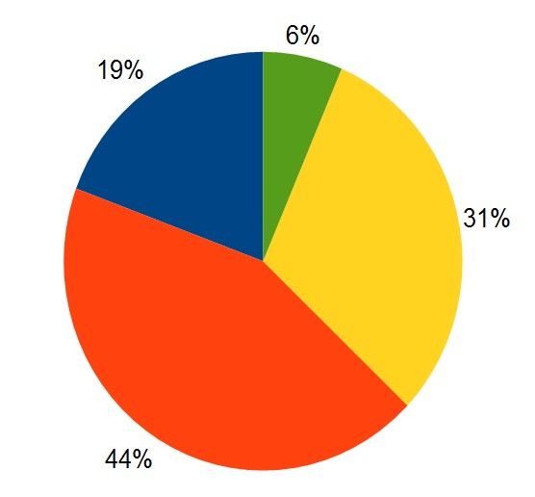


Preparing the data

Slide 9
Policy Objectives Identified
Ensure the conservation, protection, rehabilitation and recovery of depleted and degraded natural resources.
To build an efficient and internationally competitive agricultural sector
To conserve our agricultural natural resources and put in place policies and institution for sustainable resource use

Slide 10

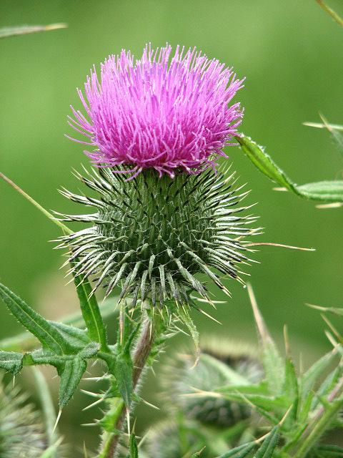
Solution

Slide 11
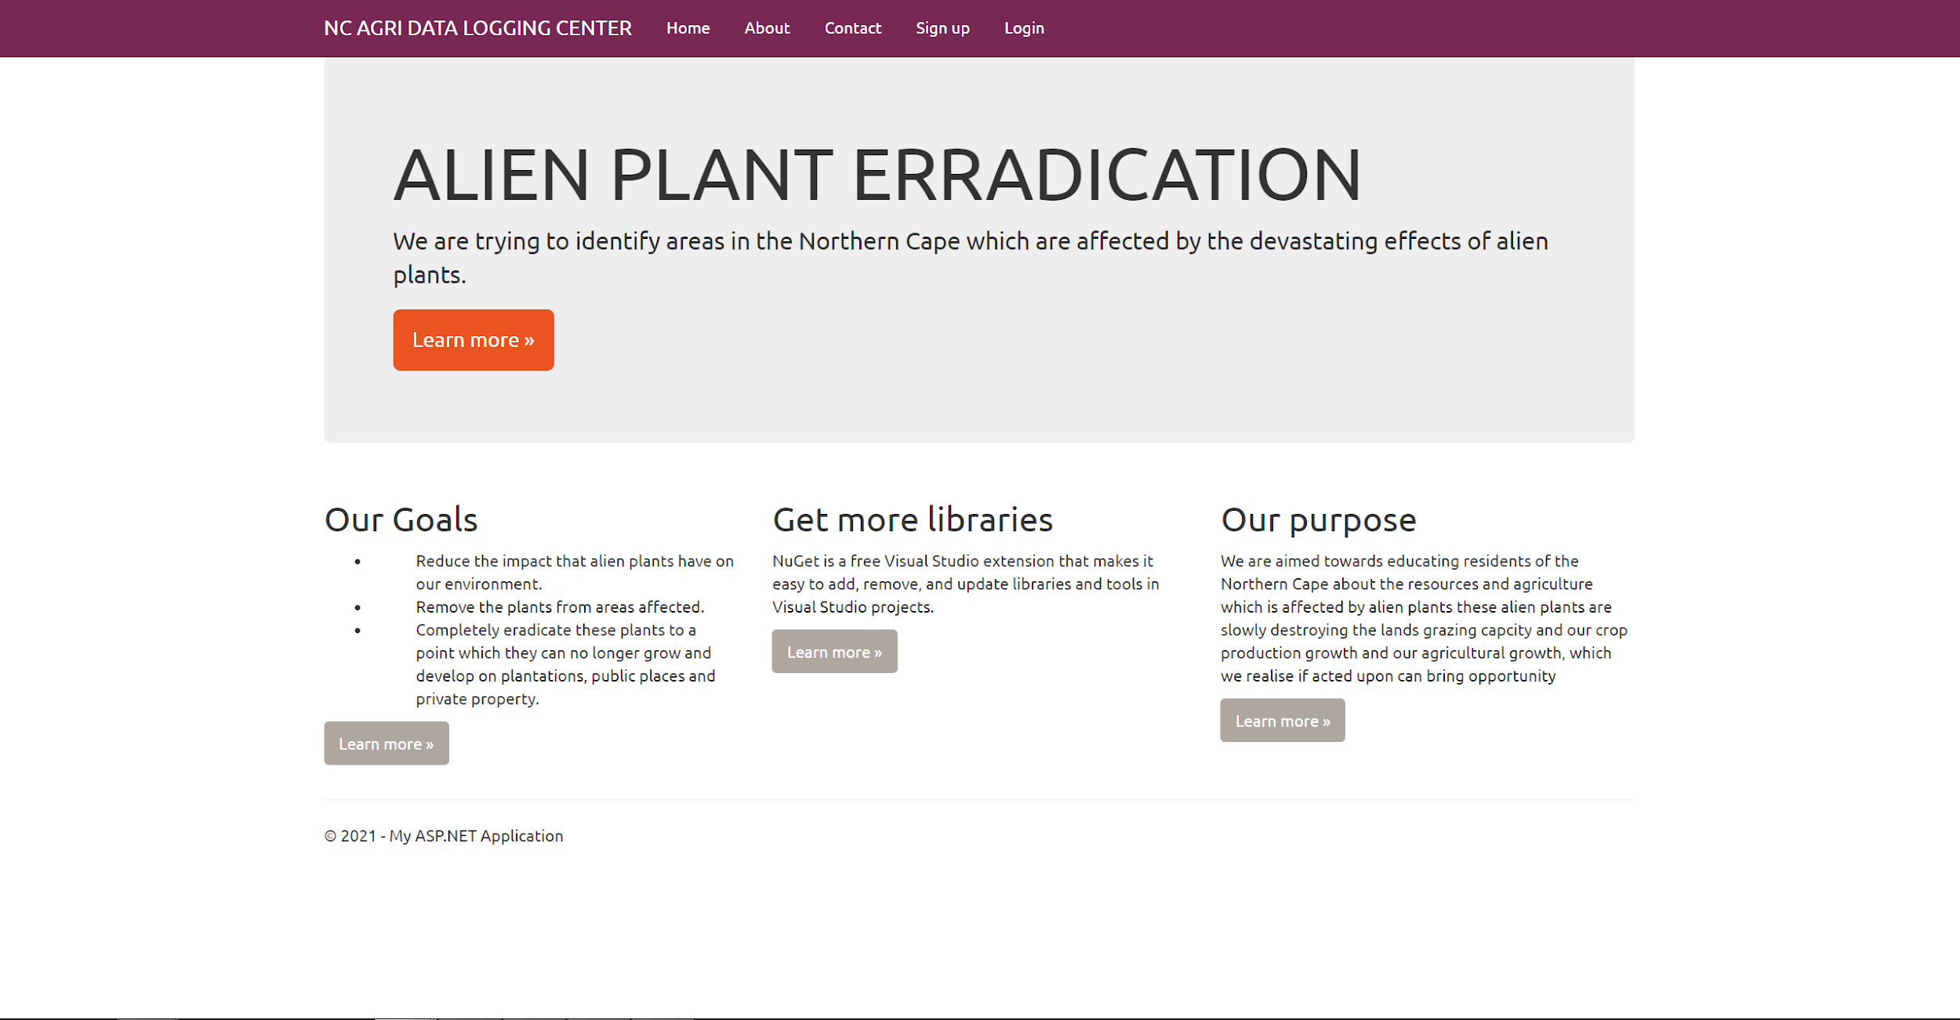
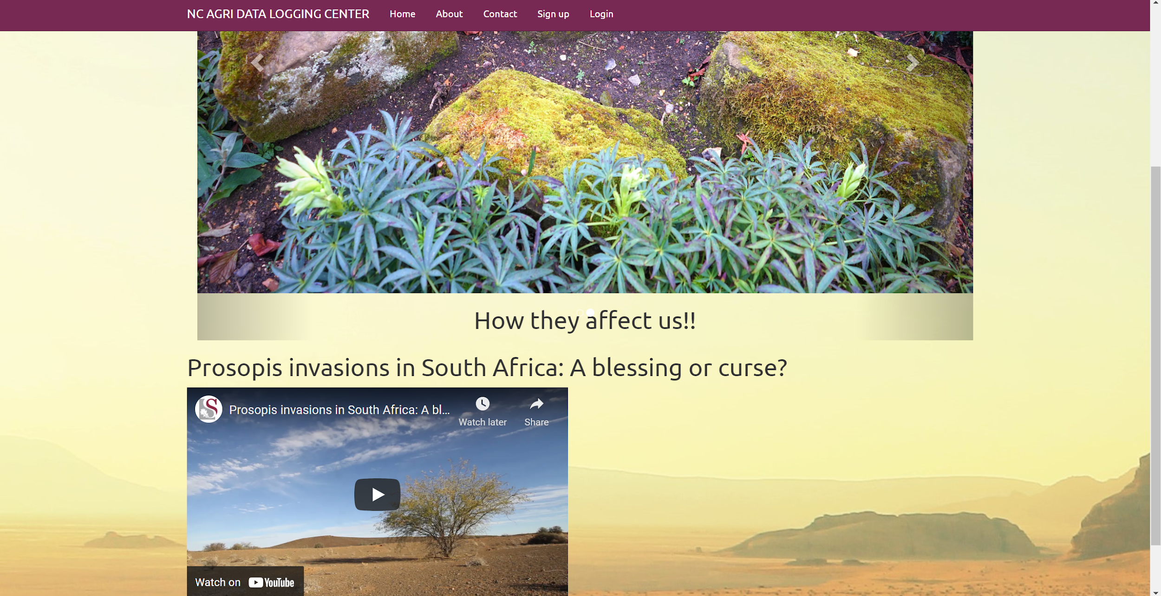
Solution

Slide 12
References
Oleander p5 -tylerpaper.com
Lantana camara p4 - lifeisagarden.co.za
Alien plants suck up 30% of Cape's water | CapeTown ETC

