Slide 1
Are direng
Act 5 of 2005 (“the Constitution”) which provides in section 23(1) that everyone has the right to fair labour practices and not only citizens.
Since NDP plans to eliminate poverty by 2030 so the website will already assist in achieving that

Slide 2
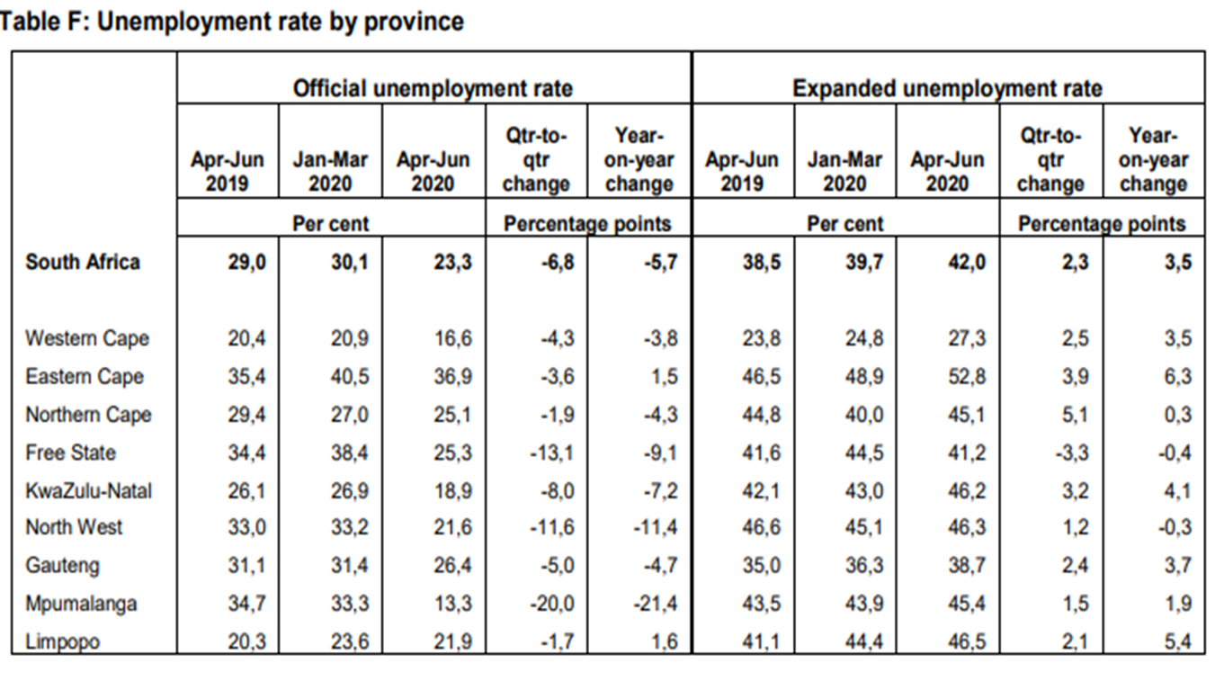
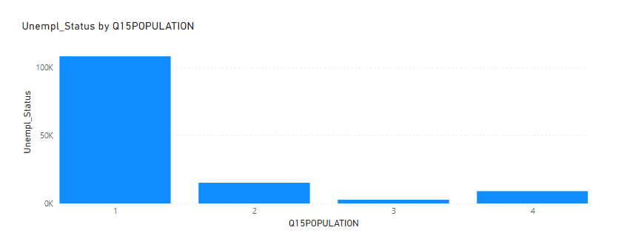
Data collected from Sa stats showing rate of unemployment
Introduction
The employment rate has affected every province and keeps growing as the society continue to suffer. Regardless of the qualifications attained the society some how continue to suffer with the level of crime increasing as well.

Slide 3
Proposed solutions
The website created will link people with employer only in North West province.
People will have specific credentials to access the website ,.
The website will be data free.
The website will help job seeker with learning ships and internships as possible.
The website is strictly designed for North West residents only.

Slide 4
