Slide 1

Access
Eastern Cape
CONNECTING YOU, TO YOUR DREAM.

Slide 2
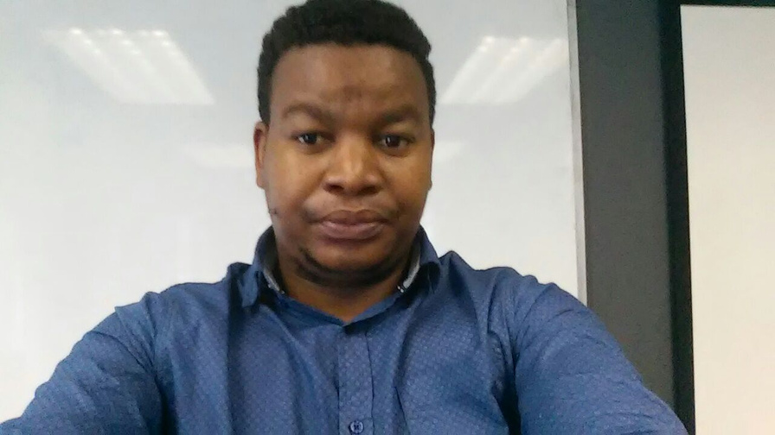
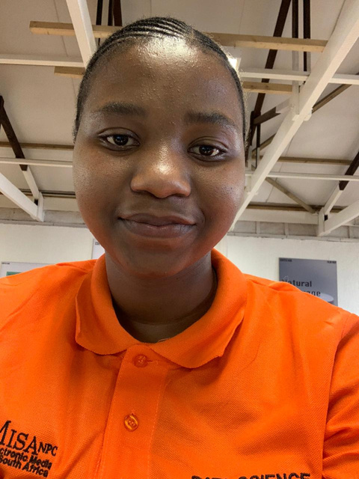
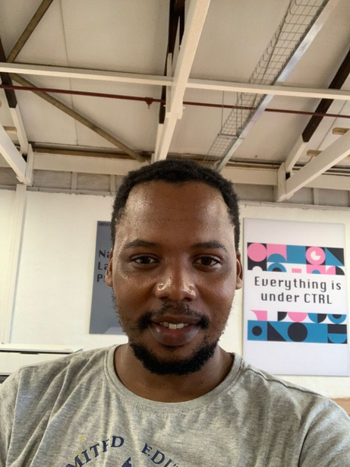
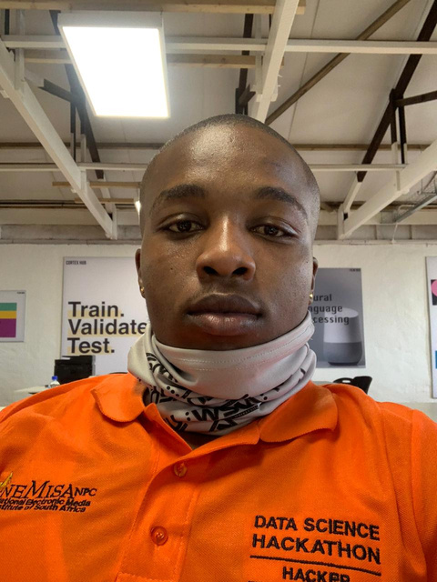
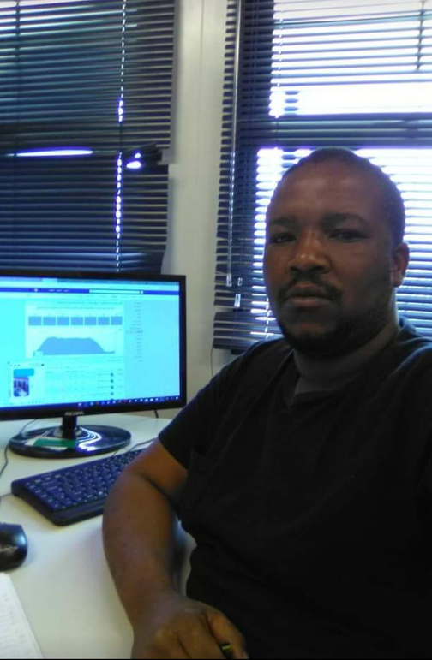
Meet The Team
Meet The Team
Collius Charuka
Team Lead
Nozuko Mvango
Head Research
Siviwe Bala
Project Co-ordinatorr
Asavela Mbambani
Software Dev
Iviwe Sopangisa
Ux/Ui

Slide 3
Problem Statement
There is a high unemployment rate in South Africa

Slide 4
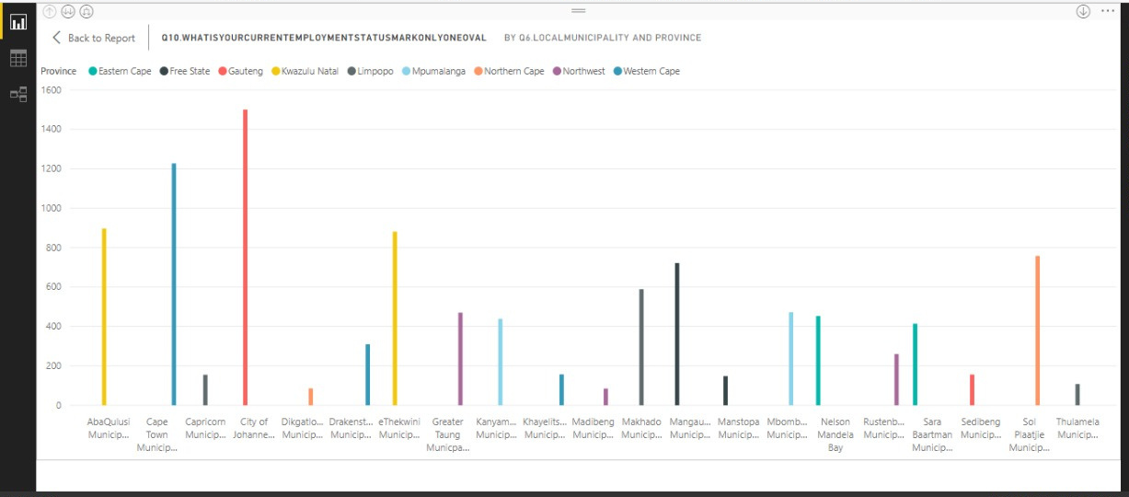
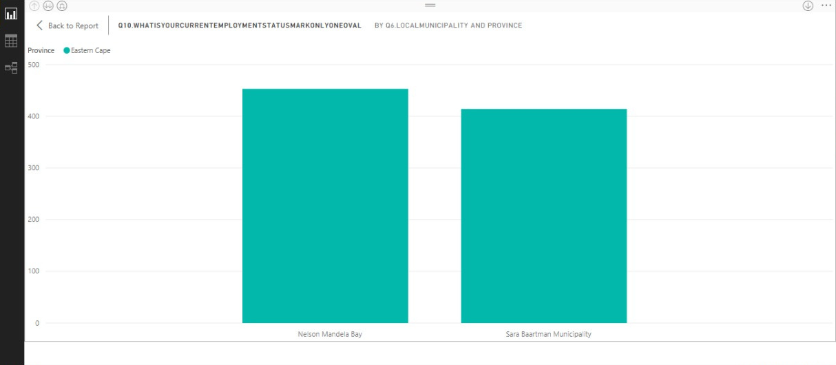
Data Analysed
Stry `time

Slide 5
Data Analysed
Online Courses
13.5%
Podcast
6.7%
Watch Video
37.7%
Listen music
42.1%

Slide 6
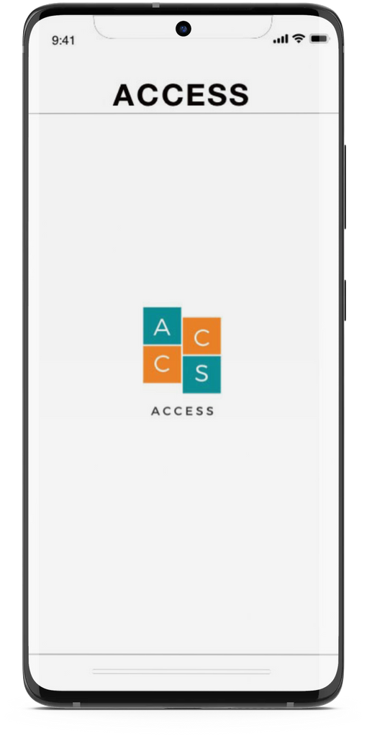
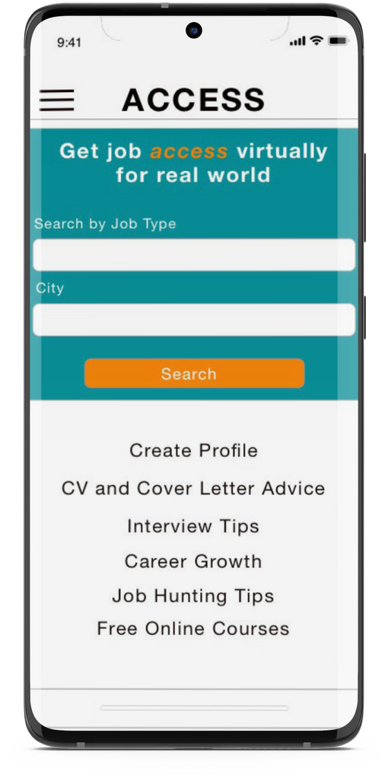
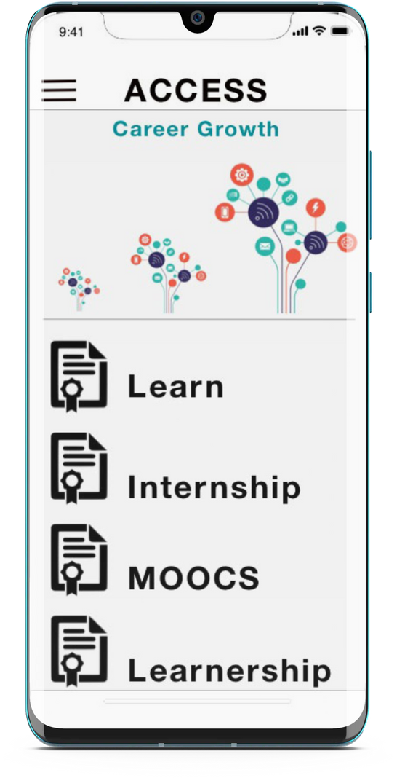
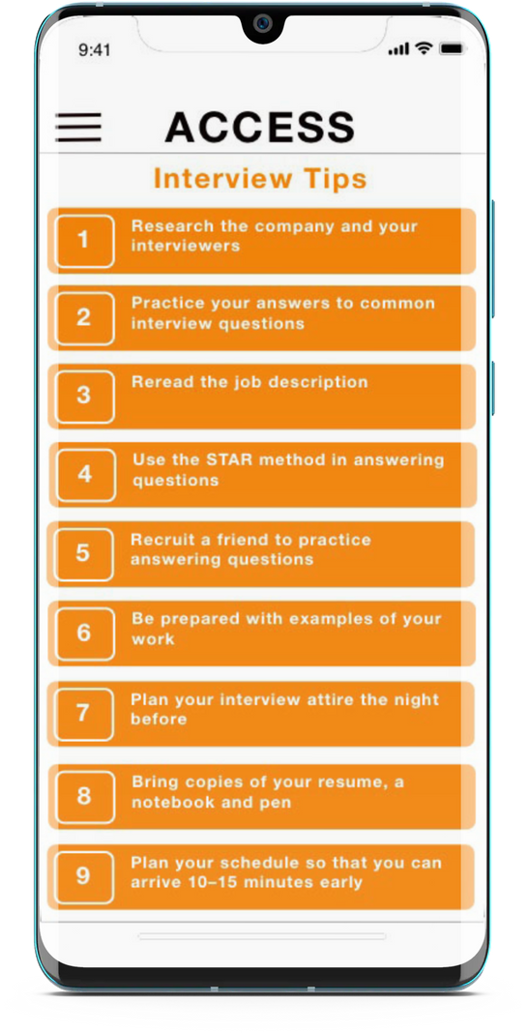
Solution
HTTPS://ASAVELA979279.INVISIONAPP.COM/CONSOLE/SHARE/QZ29OU5OBH/545359336

Slide 7
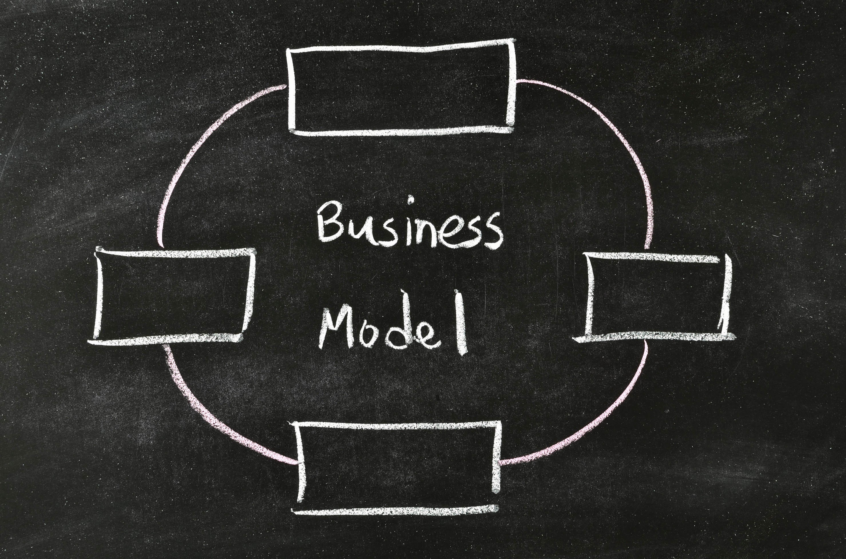
Value
proposition
Revenue
streams
Life-long journey with clients.
Relevant updates
Upskilling
Easier job placement
Advertising on the Application to make money.
Value-added for employers
Beacon technology will be added for
direct advertising
Customer segments
Graduates
Unemployed job candi
People under a changing work environment

Slide 8
Time frame
Project Outline
2months
2months
1months
1months
Mvp
control group
ux design & build
test
Product market fit

Slide 9
Thank You
Alpha Cobra Team

